Slide 1
Chapter 8: Key Issue 1 – Political Geography –

Slide 2
Key Issue #3
Where Are Ethnicities Distributed?
Learning Outcome 8.4.1: Describe the functions of the United Nations.
Learning Outcome 8.4.2: Describe the principle military and economic alliances in Europe.
Learning Outcome 8.4.3: Explain the concept of terrorism and cite U.S. examples.
Learning Outcome 8.4.4: Describe the major terrorist organizations.
Learning Outcome 8.4.5: Understand varying degrees of support for terrorism by states in Southwest Asia.

Slide 3
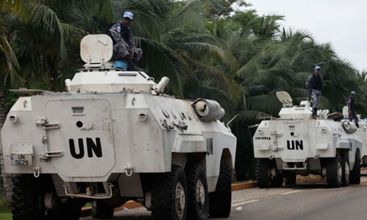
Key Issue 4: Why Do States Face Threats?
The most important global forums for cooperation among states is the United Nations, created at the end of World War II by the victorious Allies.
The early years of the U.N. were colored by competition and tension between the United States and the Soviet Union and their respective allies.

Slide 4
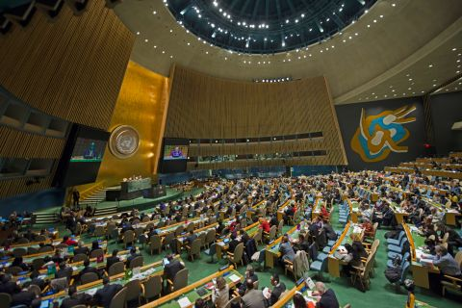
The United Nations
The most important global organization is the United Nations.
The United Nations has provided a forum for the discussion of international problems.
On occasion, the U.N. has intervened in conflicts between or within member states, authorizing military and peacekeeping actions.

Slide 5
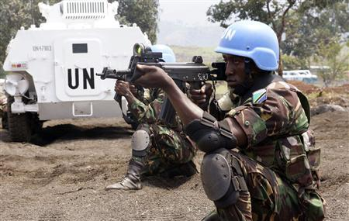
The United Nations
The U.N. seeks to promote international cooperation to address global economic problems, promote human rights, and provide humanitarian relief.
The U.N. members can vote to establish a peacekeeping force and request states to contribute military forces.

Slide 6
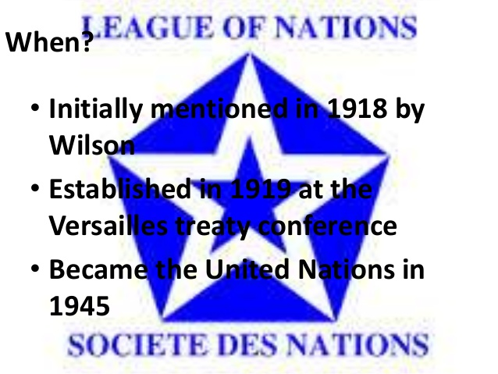
The League of Nations
The world’s first attempt at an international peacekeeping organization.
The League of Nations was never an effective peacekeeping organization because it could not stop aggression by these states against neighboring countries.
The United States never joined the League of Nations and it fell apart in the 1930s.

Slide 7
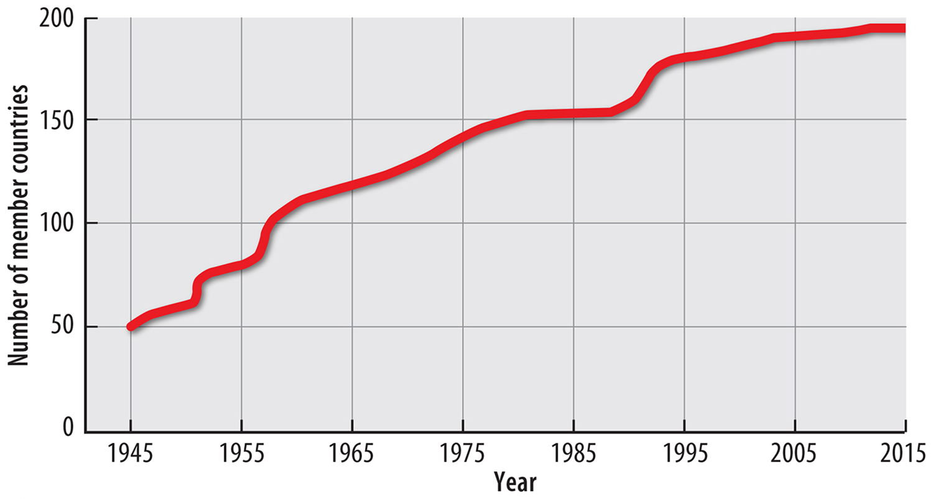
The League of Nations
The United Nations was created at the end of World War II and only had 51 member states.
The number of U.N. members reached 193 in 2011.

Slide 8
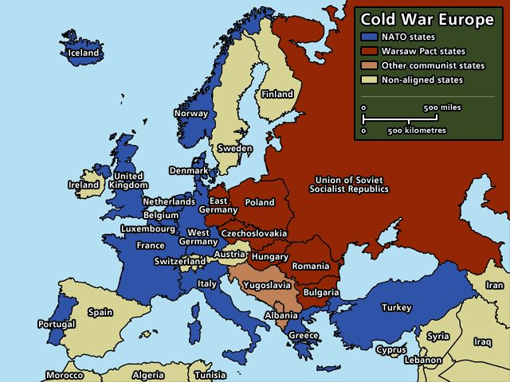
The Cold War
To maintain strength in regions that were not contiguous to their own territory, the United States and Soviet Union established military bases in other countries (Cold War).
Both superpowers repeatedly demonstrated they would use military force if necessary to prevent an ally from becoming too independent.

Slide 9
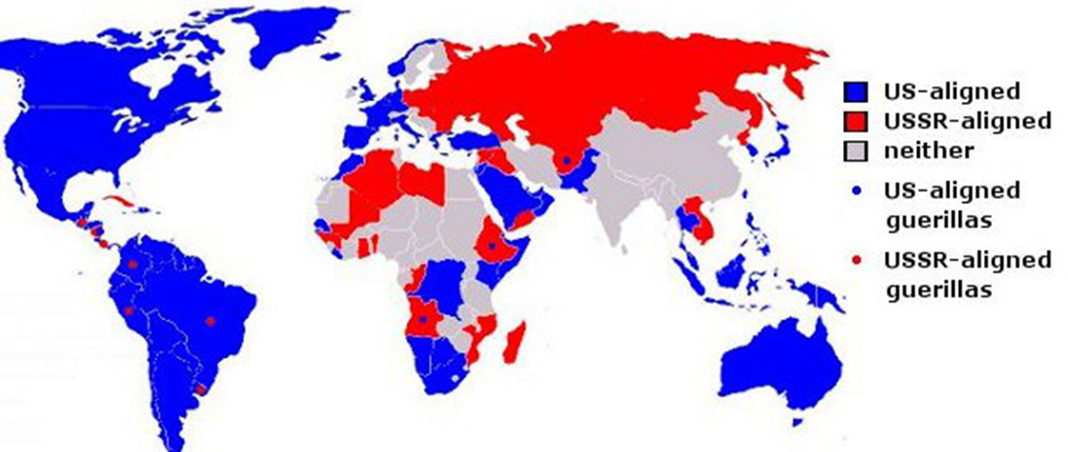
The Cold War
Because the power of the United States and Soviet Union was so much greater than the power of all other states, the world comprised of two camps, each under the influence of one of the superpowers.

Slide 10
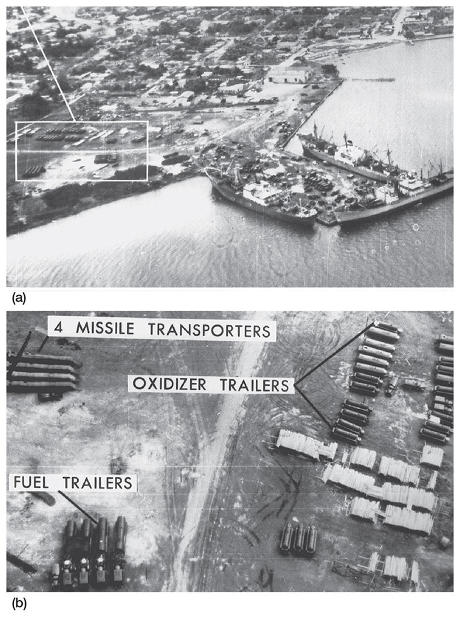
Cuban Missile Crisis
Major confrontation 1962 - the Soviet Union covertly began to construct missile-launching sites in Cuba, less than 90 miles from U.S. territory.
President John F. Kennedy appeared on television to demand that the missiles be removed, and he ordered a naval blockade to prevent additional Soviet material from reaching Cuba.

Slide 11
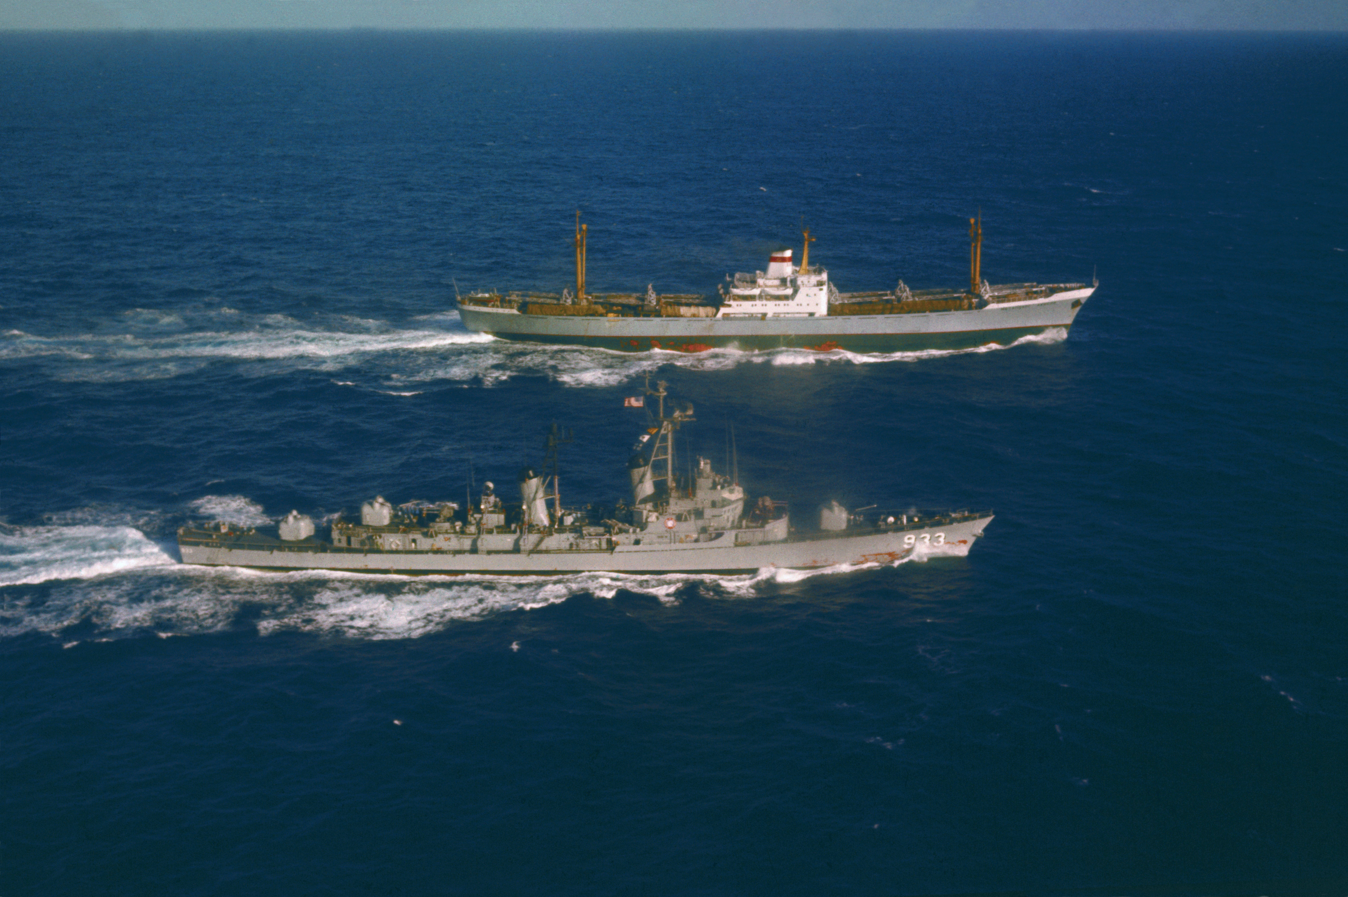
Cuban Missile Crisis
Rather than order a missile strike, President Kennedy decided on a naval blockade of Cuba, which prevented the Soviets from continuing to arm Castro's regime.
The crisis was eventually diffused when Khrushchev agreed to remove the missiles from Cuba in exchange for a public promise that the United States would not invade the island, as well as a private back-room deal in which America would also remove its own missiles in Turkey.

Slide 12
Competition and Cooperation in Europe
During the Cold War that followed World War II, two military alliances and two economic alliances formed in Europe.
In the twenty-first century, one of the military alliances and one of the economic alliances continues, whereas the other two have been disbanded.

Slide 13
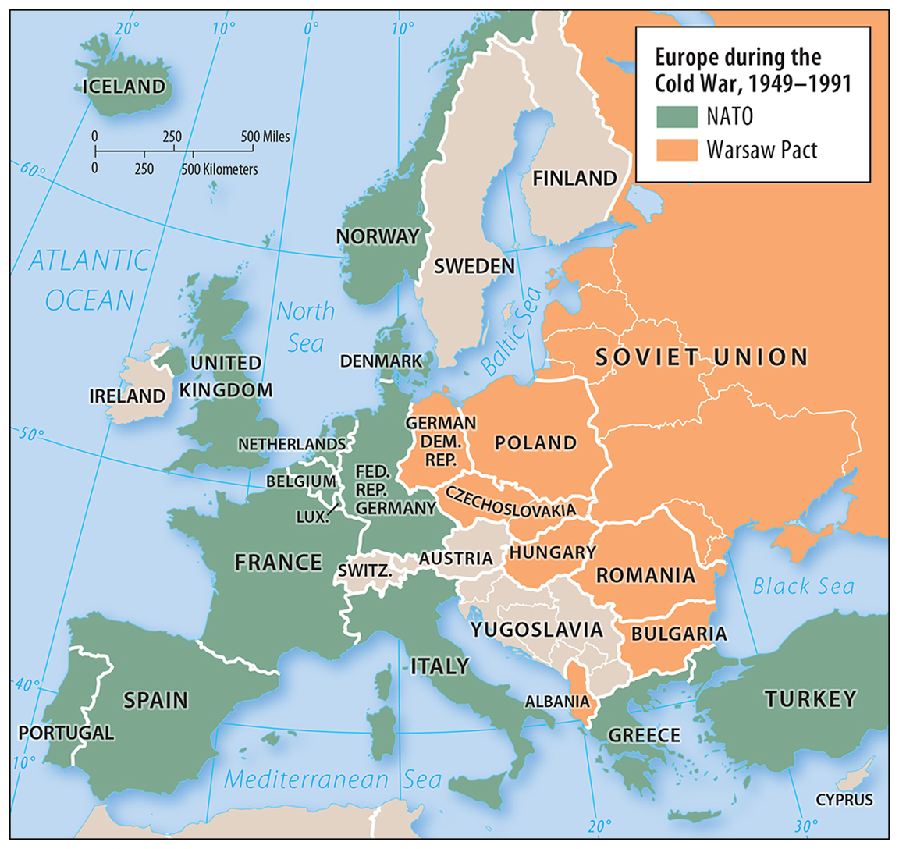
Cold War-Era Military Alliances
After World War II, most European states joined one of two military alliances dominated by the superpowers—NATO (North Atlantic Treaty Organization) or the Warsaw Pact.

Slide 14
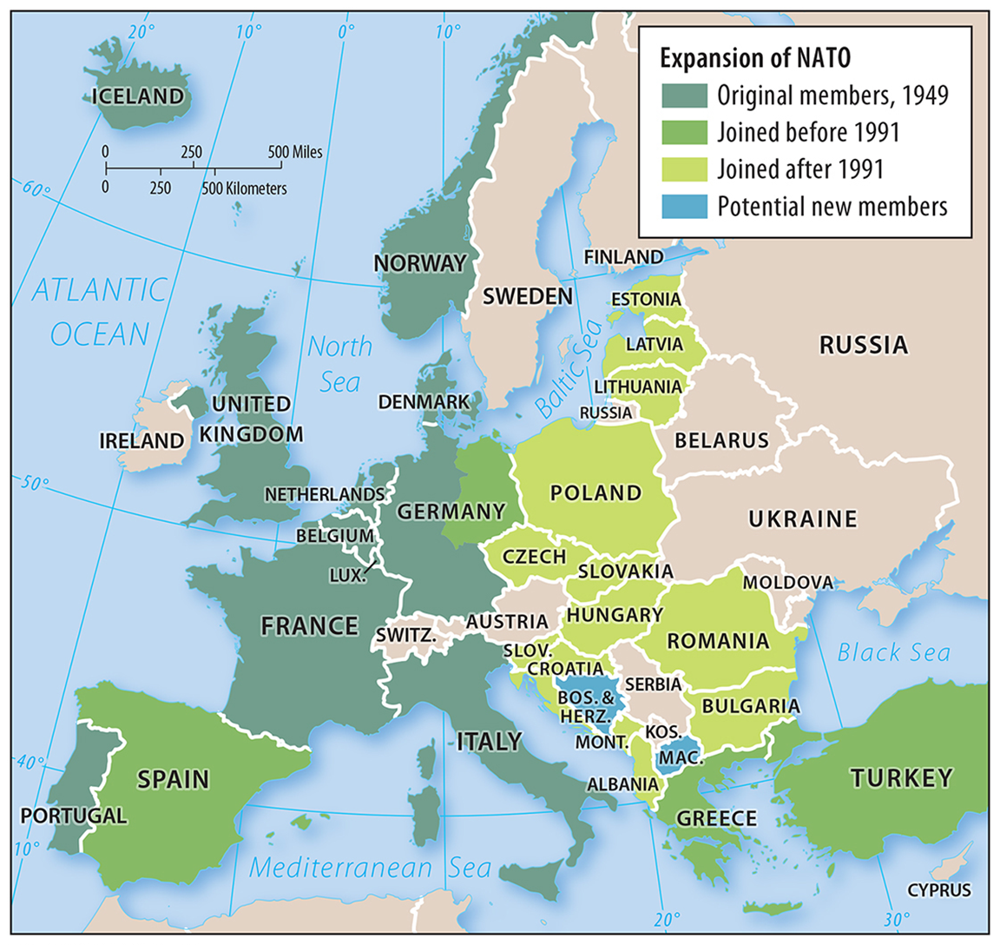
Cold War-Era Military Alliances
NATO was a military alliance among 16 democratic states, including the United States and Canada plus 14 European states.
For NATO allies, the principle objective was to prevent the Soviet Union from overrunning West Germany and other smaller countries.

Slide 15
Cold War-Era Military Alliances
The Warsaw Pact was a military agreement among seven communist Eastern European countries to defend each other in case of attack.
The Warsaw Pact provided the Soviet Union with a buffer of allied states between it and Germany to discourage a third German invasion of the Soviet Union in the twentieth century.

Slide 16
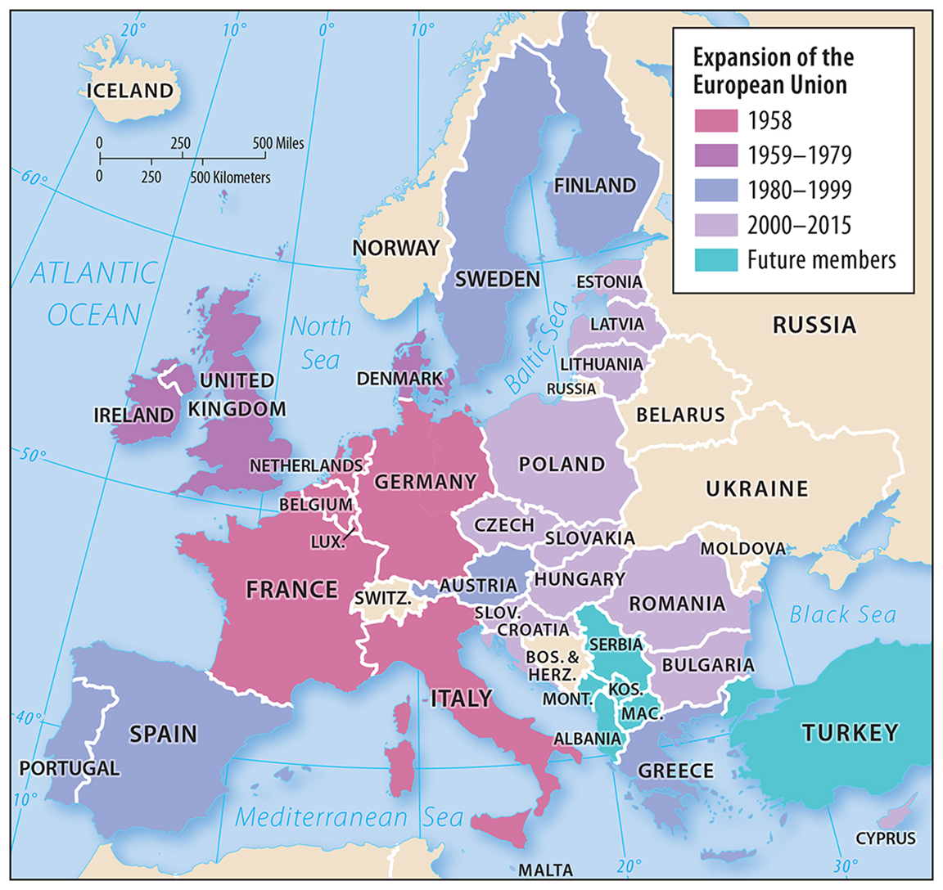
Two economic alliances formed in Europe during the Cold War: European Union (EU).
The EU (formerly known as the European Economic Community, the Common Market, and the European Community) formed in 1958 with six members.
The EU was designed to catalyze cooperation in Europe in the wake of World War II.
Cold War-Era Economic Alliances

Slide 17
Cold War-Era Economic Alliances
Council for Mutual Economic Assistance (COMECON). COMECON formed in 1949 with six members in 1960.
Mongolia, Cuba, and Vietnam also joined.
COMECON was designed to enhance trader and sharing of natural resources in Communist Eastern Europe.
Like the Warsaw Pact, COMECON dissolved in 1991.

Slide 18
The European Union in the Twenty-First Century
Economic power is eclipsing political and military power on the world stage.
The EU has emerged as the world’s leading superpower because it turned Europe into the world’s wealthiest market.
The EU now has 28 members.

Slide 19
The European Union in the Twenty-First Century
The main task of the European Union is to promote development within the member states through economic and political cooperation.
A single bank, the European Central Bank, was given responsibility for setting interest rates and minimizing inflation in the EU countries.
Most importantly, a common currency, the euro, was created for electronic transactions beginning in 1999 and in notes and coins beginning in 2002.

Slide 20
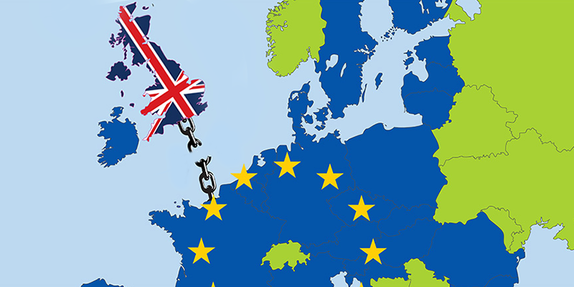
The European Union in the Twenty-First Century
European leaders bet that every country in the region would be stronger economically if it replaced its national currency with the euro.
For the first few years that was the case, but the future of the euro has been called into question by the severe global recession that began in 2008.
Economically strong countries, especially Germany, have been forced to subsidize the weaker states.
Britain voted “Brexit” leave the EU 6/23/16.

Slide 21
Terrorist Attacks Against the United States
The systematic use of violence by a group in order to intimidate a populace or coerce a government into granting demands is considered terrorism.
Terrorists generally have distinctive attributes, such as:
Attempting to achieve their objectives through organized acts that spread fear and anxiety among the population, such as bombing, kidnapping, hijacking, taking of hostages, and assassination.

Slide 22
Terrorist Attacks Against the United States
Viewing violence as a means of bringing widespread publicly to goals and grievances that are not being addressed through peaceful means.
Believing in a case so strongly that they do not hesitate to attack despite knowing that they will probably die in the act.

Slide 23
Terrorist Attacks Against the United States
Terrorist attacks are contrasted from other forms of political violence, such as assassination, in that ordinary people are targeted in attacks rather than political leaders or military groups.
The number of terrorist incidents increased from around 1,000 in 2000 to around 10,000 in 2013.

Slide 24
Terrorist Attacks Against the United States
Terrorism against Americans The United States has suffered several terrorist attacks since 1988. Among the most destructive:
December 21, 1988. A terrorist bomb destroyed Pan Am Flight 103 over Lockerbie, Scotland,
February 26, 1993. A car bomb parked in the underground garage damaged New York’s World Trade Center, killing 6 and injuring about 1,000.

Slide 25
Terrorist Attacks Against the United States
April 19, 1995. A car bomb killed 168 people in the Alfred P. Murrah Federal Building in Oklahoma City.
April 15, 2013. Two bombs were detonated near the finish line of the Boston Marathon, killing 3 and injuring more than 180.

Slide 26
September 11, 2001
Attacks The United States has experienced a number of terrorist attacks since the late 1980s, but the attacks of September 11, 2001, caused dramatic concern.
The twin towers of the World Trade Center in New York City were the two tallest buildings in the United States before they were destroyed in the attacks.
The Pentagon was also damaged. The attacks resulted in nearly 3,000 fatalities.

Slide 27
September 11, 2001

Slide 28
Terrorist Organizations
Some terrorist attacks are the work of one or two individuals who are not formally associated with terrorist organizations.
However, most recent attacks have been carried out by members belonging to terrorist organizations.
Al-Qaeda, the Islamic State, and Boko Haram are three prominent terrorist organizations from recent years.

Slide 29
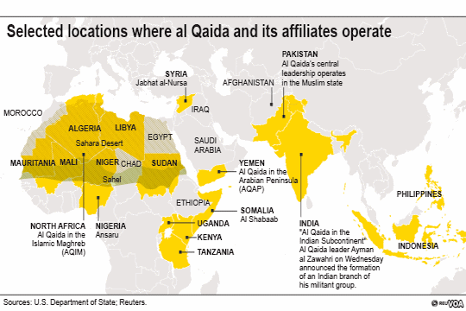
Al-Qaeda
Al-Qaeda is not a single unified organization and the number of people involved is unknown.
In addition to the original organization founded in 1990 by Osama bin Laden, al-Qaeda also encompassed local franchises concerned with country-specific issues, as well as imitators and emulators ideologically aligned with al-Qaeda but not financially tied to it.

Slide 30
Osama bin Laden
Osama bin Laden moved to Afghanistan from Saudi Arabia in the mid-1980s to support the fight against the Soviet army and the country’s Soviet-installed government.
Bin Laden left Afghanistan in 1989, and was later expelled from both Saudi Arabia and Sudan.
He returned to Afghanistan in 1994. Kelled

Slide 31
Al-Qaeda
In 1996, he issued a declaration of war, known as a fatwa, against the United States because of U.S. support for Saudi Arabia and Israel.
Al-Qaeda’s most active affiliate has been in Yemen in recent years.
In 2015, the Yemeni affiliate undertook the Charlie Hebdo attack in Paris.

Slide 32
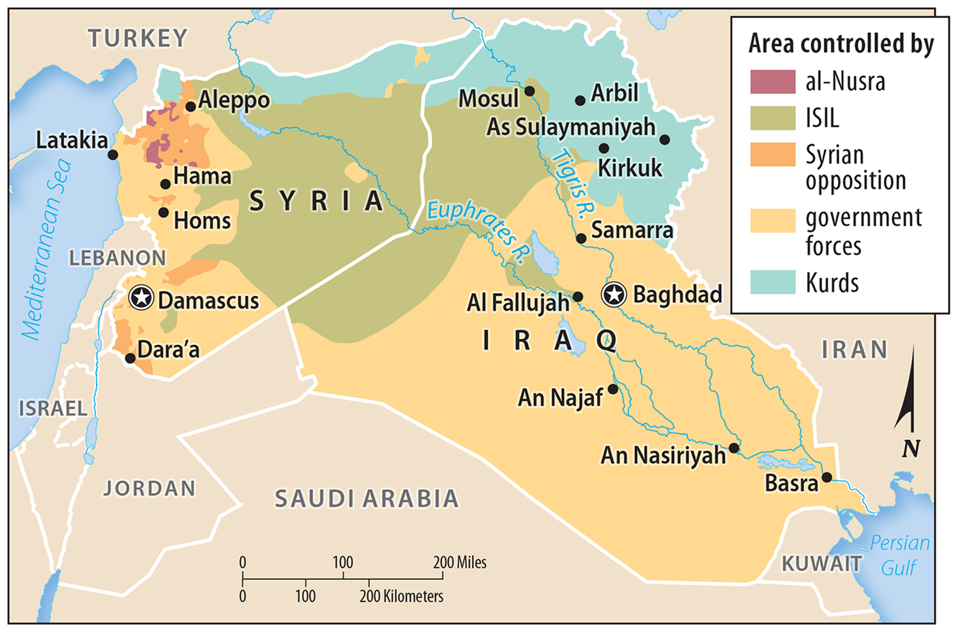
Islamic State (ISIS/ISIL)
The Islamic State, also known as the Islamic State of Iraq and Syria (ISIS) and the Islamic State of Iraq and the Levant (ISIL), originated in 1999 and became an affiliate of al-Qaeda in 2004.
In 2014, ISIS split from al-Qaeda due to a lack of agreement.

Slide 33
Islamic State (ISIS/ISIL)
Members of the Islamic State are Sunni Muslims who seek to impose strict religious laws throughout Southwest Asia.
ISIS is recruiting members on the Internet and social media, showing beheadings and destruction of sites of historical important, such as Shiite Muslim shrines.
ISIS has also launched attacks in Europe in 2015.

Slide 34
Boko Haram
Boko Haram (Arabic for “Western education is forbidden”) was founded in 2002 in northeastern Nigeria.
The organization seeks to impose their interpretation of Islamic law in Nigeria.
Its current leader, Abubakar Shekau, aligned the group with ISIS in 2014.

Slide 35
State Support for Terrorism
In recent years in Southwest Asia, several states have provided support for terrorism.
Support may include providing sanctuary for terrorists wanted by other countries, supplying weapons, money, and intelligence to terrorists, and planning attacks using terrorists.

Slide 36
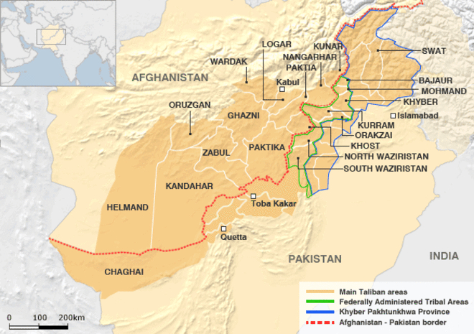
Sanctuary for Terrorists
Afghanistan and Pakistan have provided sanctuary for al-Qaeda terrorists.
The Taliban came to power in Afghanistan in 1995 and imposed strict Islamic fundamentalist law on the population. (Taliban rule end 2001 - U.S. invasion).

Slide 37
Sanctuary for Terrorists
Destroying the Taliban was necessary in order for the United States to go after al-Qaeda leaders who were living in Afghanistan as guests of the Taliban.
The United States also believes that Pakistan security was aware that Osama bin Laden was living in a fortified compound located in the city of Abbottabad which is only 75 miles from Pakistan’s capital.

Slide 38
Supplying Terrorists
Iraq and Iran are both alleged to have provided material and financial support for terrorists.
Controversy surrounds the degree of their involvement in terrorism.

Slide 39
Iraq
The United States removed Iraqi president Saddam Hussein in 2003 because the U.S. government believed that he had biological and chemical weapons that could eventually fall into the hands of terrorists.
U.N. experts concluded that Iraq had these weapons at one time but destroyed them in 1991 after its Desert Storm defeat.

Slide 40
Iraq
U.S. officials believed instead that Iraq hid the weapons, though they were never able to find them.
The United States also said that close links existed between Iraq’s government and al-Qaeda.
Saddam Hussein was not an observant Muslim and did not derive his philosophies from religious principles.

Slide 41
Iran
The Iranian Hostage Crisis has long been a source of tension between the United States and Iran.
The United States also accused Iran of harboring al-Qaeda members and trying to curry favor with fellow Shiite Muslims, as both countries have Shiite majorities.

Slide 42
Iran
Iran has also long provided support to Hezbollah, an organization based in Lebanon that the United States categorizes as a terrorist organization due to its calls for Israel’s destruction.

Slide 43
Iran
Iran has also aggressively pursued a nuclear program in recent years, causing tension between the country and much of the rest of the world.
Iran says it is for civilian purposes, such as energy production, while other countries have evidence that it is meant to contribute to weapon development.

Slide 44
The government of Libya, including its longtime leader, Muammar el-Qaddafi, was accused of:
1986 bombing of a nightclub in Berlin, Germany, popular with U.S. military personnel then stationed there.
Bombing on Pam Am Flight 103 that killed 270 people over Lockerbie, Scotland, in 1988.
Bombing UTA Flight 772 over Niger in 1989 (170 killed).
State Terrorist Attacks: Libya

Slide 45
U.S. Retaliated in 1986 – “Operation El Dorado” – which was directed at Qaddafi’s compound – he would escape before strike.
Libyan agents were found to have planted Qaddafi was overthrown by Libyan protestors in 2011 as a part of the Arab Spring – Killed later.
State Terrorist Attacks: Libya

