Slide 1
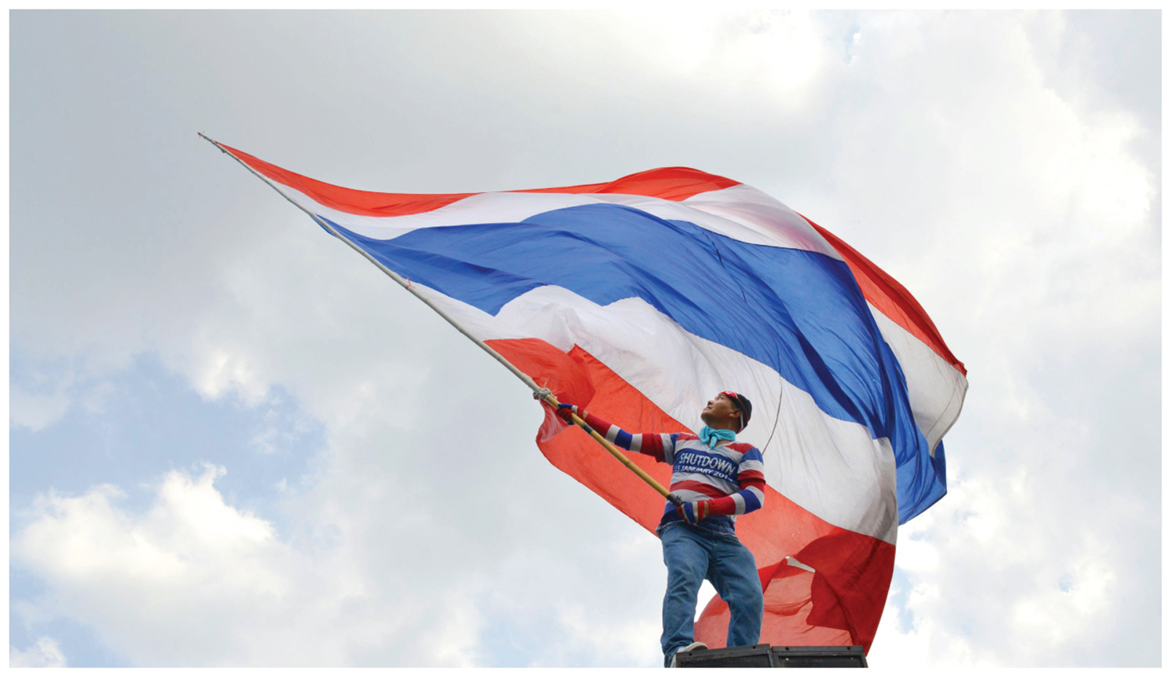
Chapter 8: Key Issue 1 – Political Geography –

Slide 2
Key Issue #1
Where Are Ethnicities Distributed?
Learning Outcome 8.1.1: Understand the difference between a state of the world and a state within the United States.
Learning Outcome 8.1.2: Explain why it is difficult to determine whether some territories are states.

Slide 3
Key Issue 1: Where Are States Distributed?
Political geography is concerned with the study of the way governments organize and administer space on Earth’s surface, and especially the geographic dimensions of conflict.
One of Earth’s most fundamental cultural characteristic is the division of our planet’s surface into a collection of spaces occupied by individual countries.

Slide 4
Introducing Political Geography
A state is an area organized into a political unit and ruled by an established government that has control over its internal and foreign affairs.
Country is synonymous with state.
Nearly all inhabitable land is organized into states. The land area occupied by states around the world widely varies -the largest states, Russia.

Slide 5
Other States?
In Asia/Europe, Russia has these (states) subdivisions that are called Oblasts.
Mexico has 31 federated states, federal district (MC)
In India, they are called States and Union territories.
Germany has its sixteen Bundeslands (Federal States)
Brazil has 26 states and a Federal district.
Malaysia has 13 states and 3 federal territories.
Many other countries call their administrative subdivisions by their local names - Department (France).
Province (Canada, South Africa),
Prefecture (Japan), etc.

Slide 6
Introducing Political Geography
Other end of the spectrum are about two dozen microstates (like Monaco), which are states with very small land area.
The Vatican is the world’s smallest microstate, coming in at 0.17 square miles.
Many microstates are islands, explaining both their small size and sovereignty.

Slide 7
Challenges in Defining States
A state has sovereignty, which means independence from control of its internal affairs by other states.
A sovereign state is a good example of a formal or uniform region, as the entire area of a state is managed by its national government, laws, army, and leaders.

Slide 8
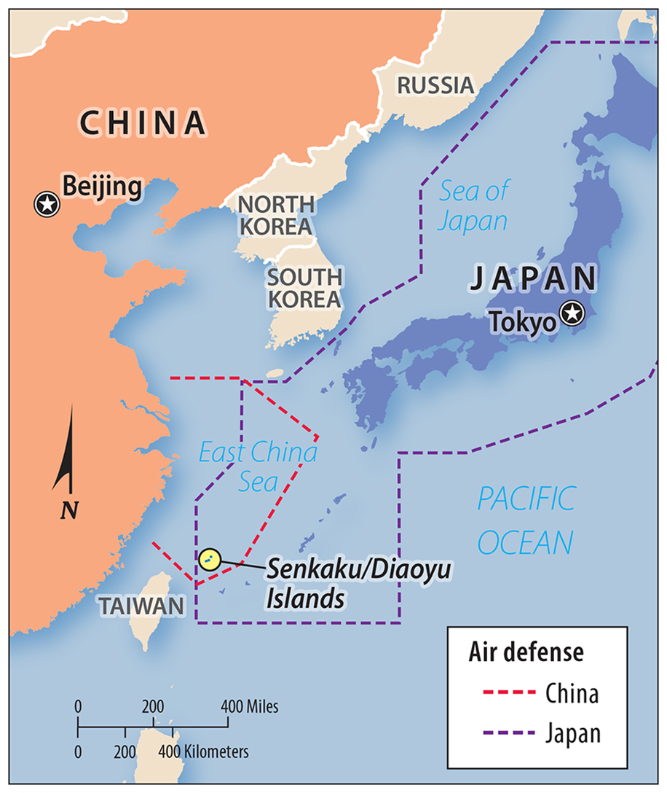
Challenges in Defining States
Disagreement over the number of sovereign states in the world is present in the global community.
Places that challenge the definition of sovereignty are Korea, China, and Western Sahara.

Slide 9
Not all states are universally recognized or well defined.
Korea was divided in half into two occupation zones by the United States and the former Soviet Union after they defeated Japan in World War II.
In 1992, North Korea and South Korea were admitted to the United Nations as separate countries.
Nuclear testing and inability to provide citizens with basic needs (electricity) makes Korea the world’s poorest country
Korea: One State or Two?

Slide 10
China and Taiwan: One State or Two?
Most countries consider China (officially the People’s Republic of China) and Taiwan (officially the Republic of China) as separate and sovereign states.
China does not consider Taiwan to be a separate state but part of China.
The question of who was the legitimate government of China plagued U.S. officials in the 1950s and 1960s.

Slide 11
China and Taiwan: One State or Two?
The United States considered the Nationalists in Taiwan the official government of China until 1971.
The United Nations voted that year to transfer China’s seat in the U.N. from the Nationalists in Taiwan to the Communist government in China.
Taiwan is now the most populous state not in the United Nations.

Slide 12
Senkaku/Diaoyu Islands:
The People’s Republic of China, Taiwan, and Japan all claim sovereignty over several small uninhabited islands in the East China Sea.
These islands are known as Diaoyu in China, Diaoyutai (you-thai) in Taiwan, and Senkaku (ka-koo) in Japan.

Slide 13
Senkaku/Diaoyu Islands:
Japan has controlled the islands since 1895, except between 1945 and 1972, when the United States administered them after the Japanese defeat in World War II.
China and Taiwan claim that the islands historically belonged to China until the Japanese government illegally seized them in 1985.

Slide 14
Questions – Case Study #1 – 4 Geopolitical Hotspots
Why are certain parts of Russia “in the red” – What areas have the two largest surpluses?
Why would Vladimir Putin be concerned?
Why is China at a disadvantage in the Pacific?
Why are the Middle East boundaries re-drawn by the author?
What area’s do not require re-drawing?
Why is national self-determination a concern in Europe?

Slide 15
Questions – Case Study #2 – Kurds: Largest Stateless Nation
What is this article about?
Who has been the West’s most effective partner in the war against the IS?
Who are the Kurds? How many? Religion?
Why is the Turkish strike against the PKK controversial )hint: what is the relationship with most Kurds?
Why is it hard to stereotype all Kurds in the war with the IS?

Slide 16
Key Issue #2 – Why are Nation-States Difficult to Create?
A nation-state is a state whose territory corresponds to that occupied by a particular ethnicity.
To preserve and promote distinctive cultural traits, ethnicities seek to govern themselves without interference - the idea of partitioning the world into a set of independent nation-states is relatively new.

Slide 17
Friedrich Ratzel:
Three theories important to the development of nation-state concept in last 200 years.
Organic theory – if states do not expand their land area would disintegrate “like an organism that fails to find food”

Slide 18
Sir Halford Mackinder:
Heartland theory – (beg. 20th century) Believed that the Eurasian landmass was the world’s heartland for the food supply and thus the key to the world domination
Nicholas Spykman:
Rimland theory– Disagreed, and argued the rimland area surrounding the heartland and including the world’s oceans was the key to world political theory

Slide 19
Ancient States:
The state concept developed in the Middle East.
The first states were territories surrounding cities.
A city-state is a sovereign state that comprises a town and the surrounding countryside -walls clearly delineated the boundaries of the city.

Slide 20
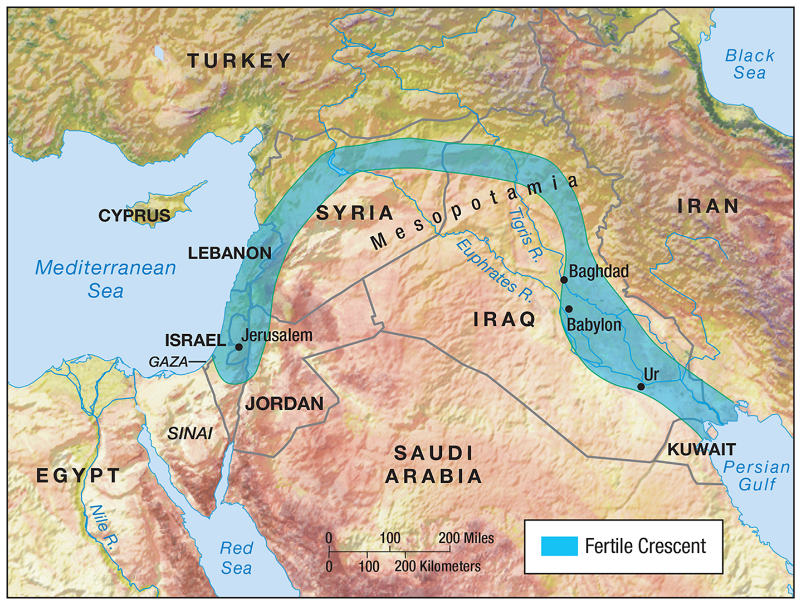
Ancient States:
The city controlled the agricultural land surrounding the city that produced food for the urban residents.
The countryside also provided the city with an outer line of defense against attack by other city-states.
One city may gain military dominance over the others and form an empire – Assyrians, Persians, Babylonians.

Slide 21
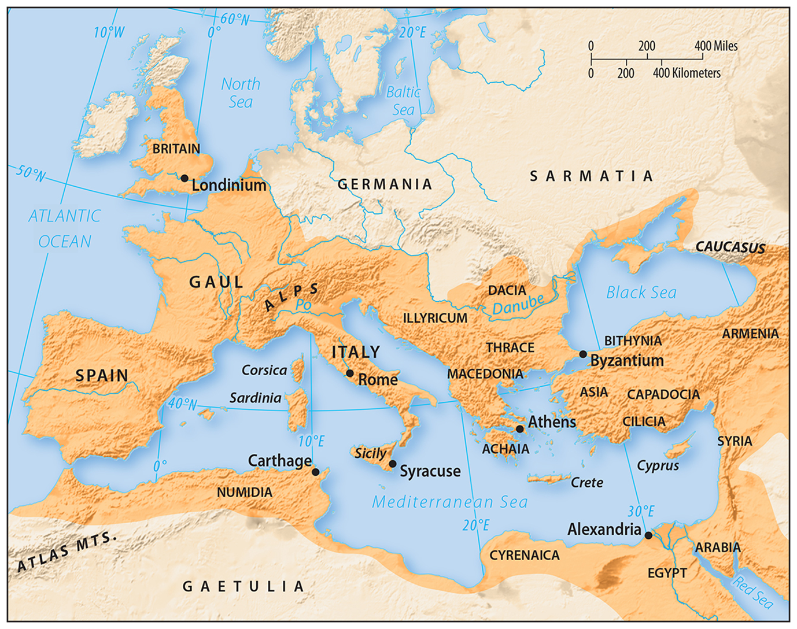
Medieval States
The largest unified political territory of the preindustrial times was the Roman Empire.
The Roman Empire eventually collapsed in the fifth century -fragmented into a large number of estates owned by competing kings, dukes, barons, and other nobles.

Slide 22
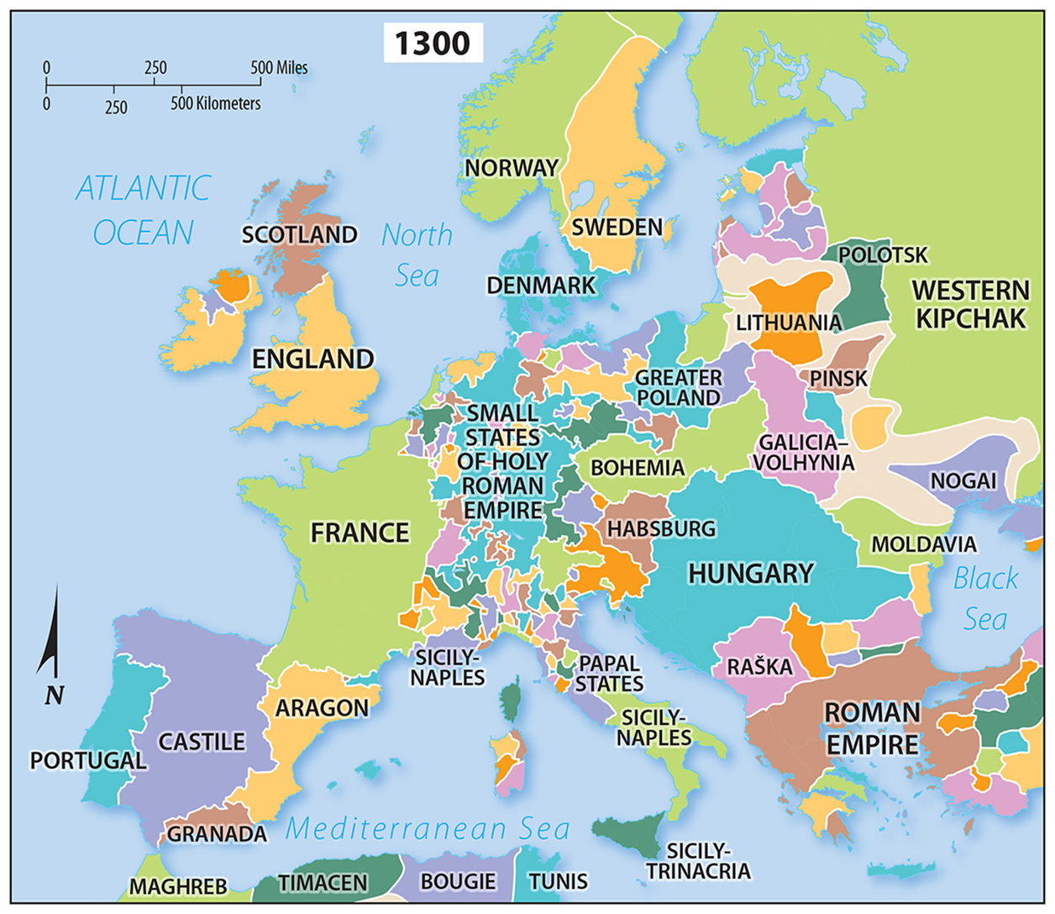
Medieval States
A handful of powerful kings emerged as rulers over a large number of these European estates beginning about the year 1100.
The consolidation of neighboring estates under the unified control of a king formed the basis for the development of states.

Slide 23
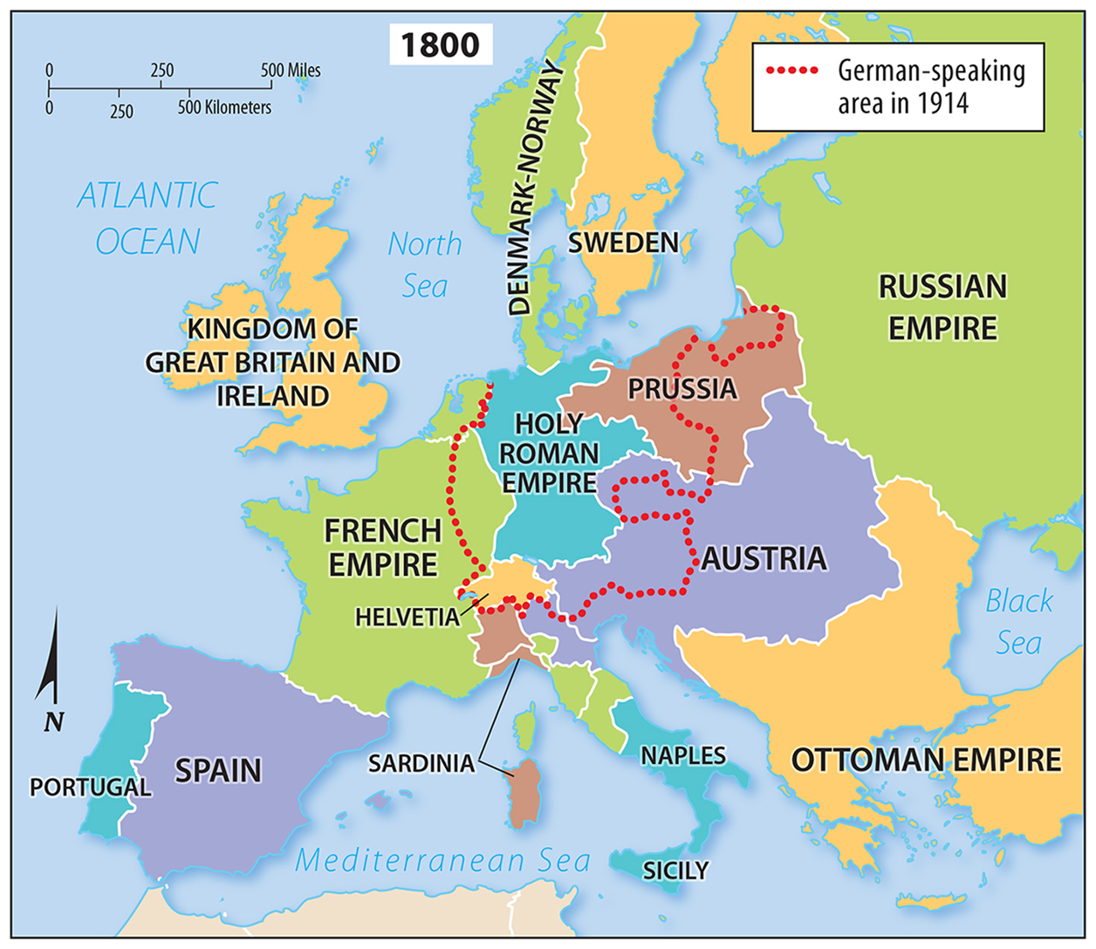
States in Twentieth-Century Europe
At the beginning of the twentieth century, Europe’s territory was ruled by several emperors, kings, and queens.
Following the first World War, leaders of the victorious countries convened at the Versailles Peace Conference to redraw the map of Europe.

Slide 24
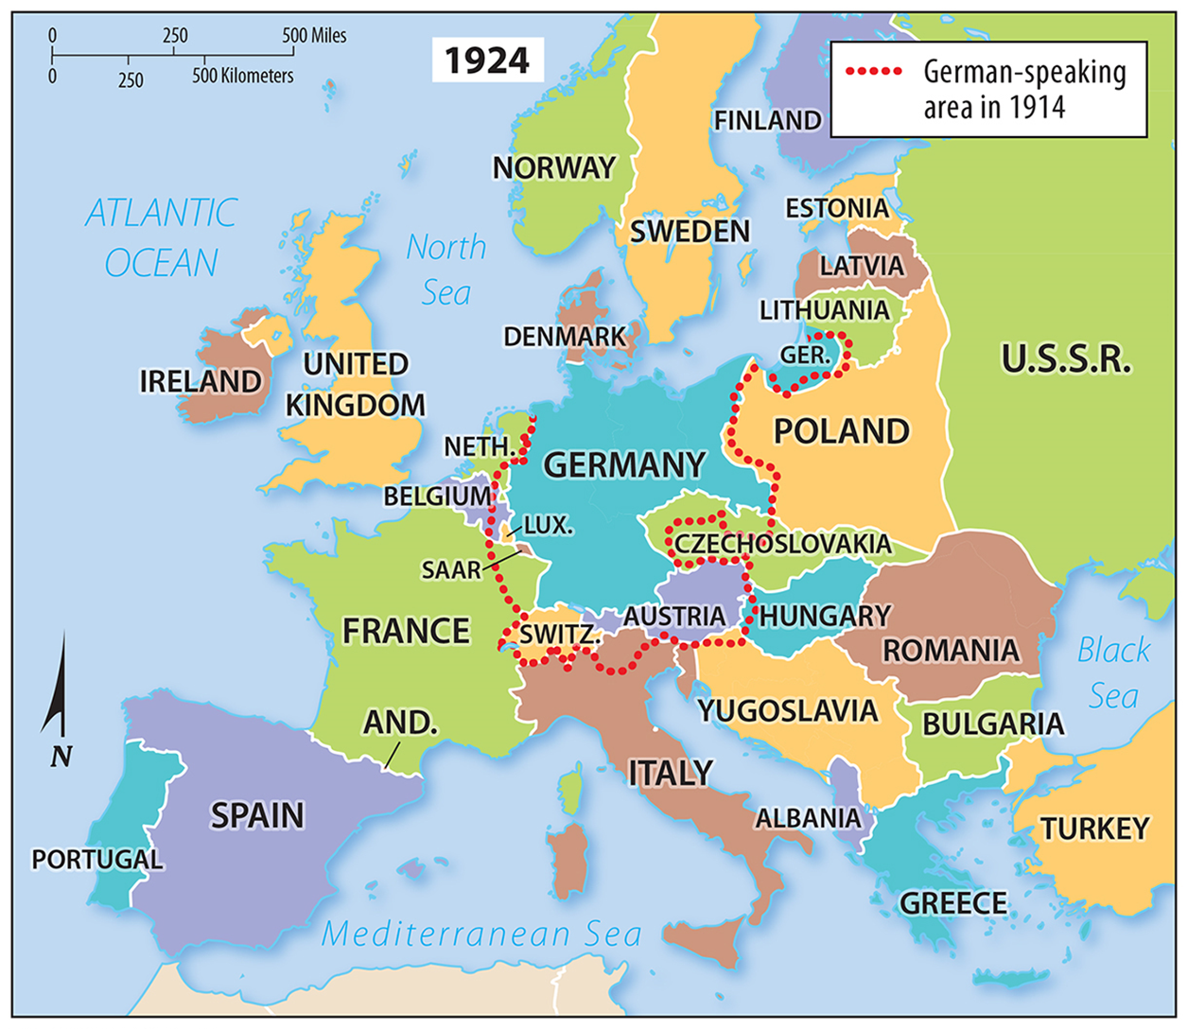
Nation-States and Multinational States
Self-determination is the concept that ethnicities have the right to govern themselves.
There is no perfect nation-state, as territory inhabited by a specific ethnicity never directly reflects the boundaries of countries. However, some states, such as Japan, are excellent examples of a nation-state. The ethnic make-up of Japan is 98.5 percent Japanese.

Slide 25
Multiethnic and Multinational States
A multiethnic state is a state that contains more than one ethnicity.
Every nation is multiethnic to some degree, as no state’s population encompasses 100 percent of a single ethnicity.

Slide 26
Multiethnic and Multinational States
A multinational state is a state that contains more than one ethnicity with traditions of self-determination and self-governance.
Some multinational states, distinct ethnic groups control governmental functions in the area it occupies.
In others, (United States), ethnicities all contribute cultural features to the formation of a single nationality.

Slide 27
Multiethnic Revival in Europe
In the 1930s, German National Socialists (Nazis) attempted to form a single state that encompasses all German-speaking areas of Europe.
The Nazis achieved their goals of forming this state, and continued to seize lands of non-German-speaking populations (such as Poland), precipitating World War II.

Slide 28
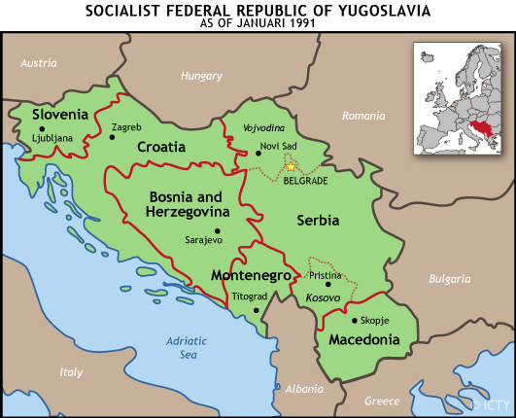
Multiethnic Revival in Europe
Following World War II, a large-scale forced migration in Europe relocated many ethnic groups into newly established territory of the region’s many nation-states.
Some of the nation-states formed as a result of World War II, such as Yugoslavia, failed after the collapse of the Soviet Union.

Slide 29
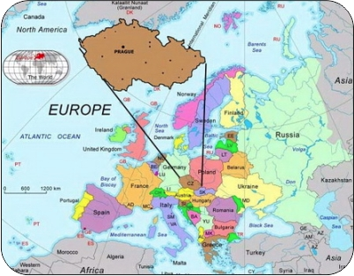
Multiethnic Revival in Europe
The breakup of the Soviet Union, Yugoslavia, and Czechoslovakia during the 1990s gave numerous ethnicities the opportunity to organize nation-states.
These ethnic groups were no longer content to just control a local government unit, but sought to be the majority in a completely independent nation-state – leaving ethnic groups with smaller populations as minorities in multinational states.

Slide 30
Russia: The Largest Multinational State
The Soviet Union consisted of 15 republics, based on its 15 largest ethnicities.
With the breakup of the Soviet Union into 15 independent countries.

Slide 31
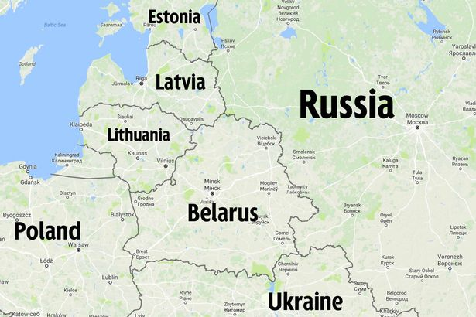
Russia: The Largest Multinational State
These 15 states constitute five groups:
Russia.
Three Baltic states: Estonia, Latvia, and Lithuania.
Three European states: Belarus, Moldova, and Ukraine.
Five Central Asian states: Kazakhstan, Kyrgyzstan, Tajikistan, Turkmenistan, and Uzbekistan.
Three Caucasus states: Armenia, Azerbaijan, and Georgia.

Slide 32
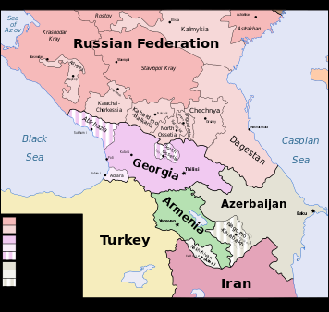
Reasonably good examples of nation-states have been carved out of the Baltic, European, and Central Asian republics.
Peaceful nation-states have not been created in any of the small Caucasus republics.
Russia officially recognizes the existence of 39 nationalities, many of which are eager for independence.
Russia: The Largest Multinational State

Slide 33
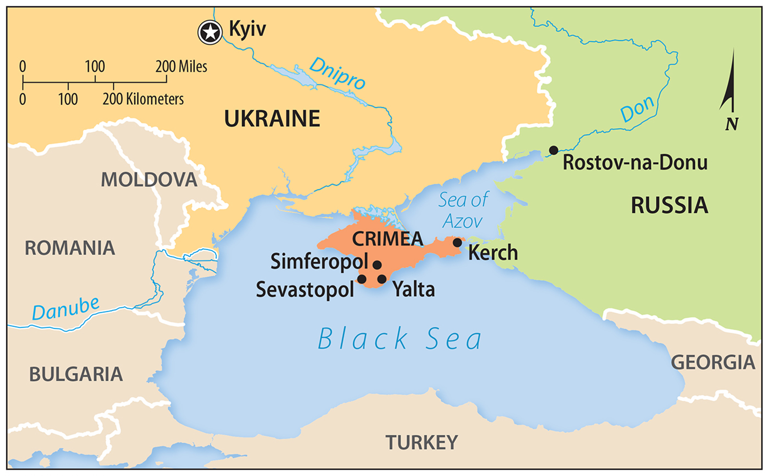
Russia in Ukraine
Following the collapse of the Soviet Union, prospects for a stable nation-state were favorable in independent Ukraine because it possessed economic assets, such as coal deposits, a steel industry, and proximity to the wealthy countries of Western Europe.

Slide 34
Russia in Ukraine
2014, the Russian minority population clustered in eastern Ukraine rebelled against the Ukrainian government, leading to the annexation of the Crimean Peninsula by Russia and the War in Donbass.

Slide 35
Questions – Case Study #3 – Russia: War Games
What do you think “war games” means?
Why is Russia taking such an aggressive position?
What could be the ramifications if either side attacks?
What is Russia claiming (Putin’s play)?
What are the two major aims of Russian President Putin according to this article?
Looking back to 2016: Was the author right?

Slide 36
Nation-States in the Former Soviet Union
The new states in the former Soviet Union are an assemblage of nation-states and multinational states.
Belarus peacefully transitioned into an independent nation-state, while Moldova and Ukraine have experienced ethnic tensions.

Slide 37
Belarus and Ukraine
The ethnic distinction among Belarusians, Ukrainians, and Russians is difficult to pin down.
All three speak similar East Slavic languages/ common ethnic heritage.
Following invasions and conquests of the area by Mongolians, Poles, and Lithuanians beginning in the thirteenth century, Belarusians and Ukrainians became isolated from Russians and developed distinct ethnicities.

Slide 38
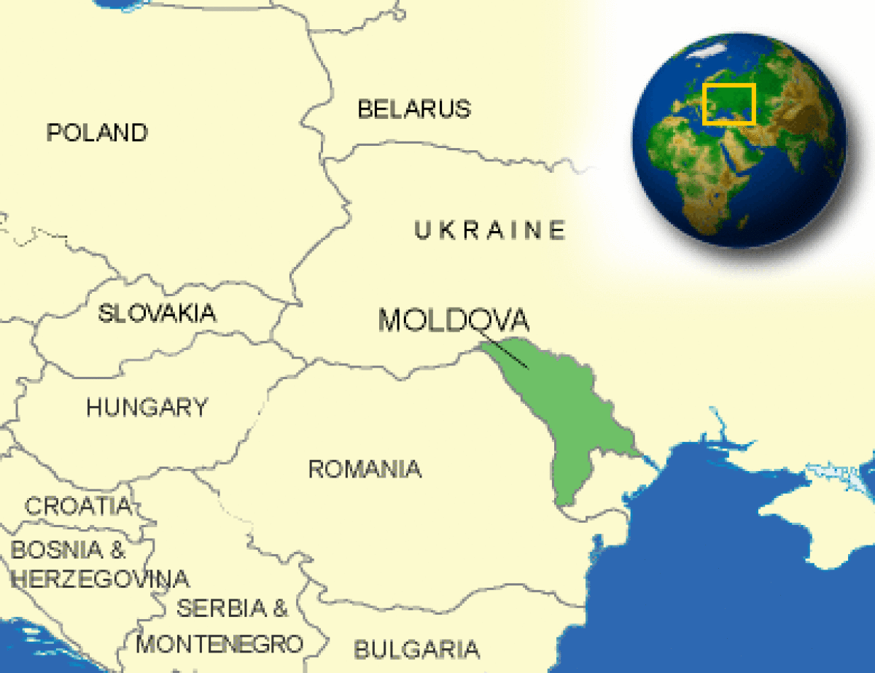
Moldova
Moldovans are ethnically indistinguishable from Romanians, and Moldova was historically a part of Romania until the Soviet Union took control of it in 1940.
Following Moldova’s declaration of independence in 1992, many Moldovans wished to reunify with Romania.
However, ethnic Ukrainians and Russians have prevented Moldovan reunification with Romania.

Slide 39
Located on the Baltic Sea, the countries of Estonia, Latvia, and Lithuania are known as the Baltic states.
These three states were annexed by the Soviet Union in 1940 under an agreement with Nazi Germany. All three have distinct cultural / religious differences and discernable historical traditions.
Three Baltic States

Slide 40
The Caucasus -situated between the Black & Caspian seas/ gets its name from the mountains that separate Azerbaijan and Georgia from Russia.
The USSR gov. promoted allegiance to the Soviet state and quelled disputes among ethnicities, by force if necessary.
The Caucasus: Many Ethnicities

Slide 41
The Caucasus: Many Ethnicities
With the breakup of the region into several independent countries, long-standing conflicts among ethnicities have erupted into armed conflicts.
The region’s ethnicities have had varying degrees of success in forming nation-states.

Slide 42
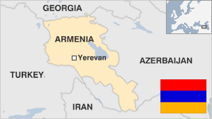
Armenia
Armenia is a Christian-majority state that has historically lived under the rule of Turkish Muslims.
Following World War I, the Allies created the independent state of Armenia, although it was soon divided between Turkey and the Soviet Union in 1921.
98 % of Armenian pop. are ethnic Armenians, making it the most ethnically homogenous country in the area.

Slide 43
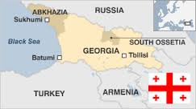
Georgia
Georgia is more ethnically diverse than Armenia and Azerbaijan.
Ossetians and Abkhazians have fought the Georgian government for control over the territory that their respective ethnicity predominantly occupies, forming two independent republics.
These republics, South Ossetia and Abkhazia, are only recognized by a handful of states (such as Russia, which has installed troops in both areas).

Slide 44
Central Asian States
Turkmenistan and Uzbekistan are relatively stable nation-states.
In contrast, Tajikistan is a nation-state that has endured a civil war, fought between Tajiks who were former Communists, and a coalition of Muslim fundamentalists and Western-oriented intellectuals.

Slide 45
Central Asian States
Kazakhstan is a relatively peaceful multinational state divided between Kazakhs and Russians.
Kyrgyzstan, however, is relatively unstable, facing prolonged ethnic conflict.
Successive presidents were ousted in the early 21century, and ethnic cleansing of hundreds of thousands of Uzbeks by Kyrgyz is alleged.

Slide 46
Colonialism
The single most important global geopolitical phenomenon of the past 500 years is colonialism.
While we usually think of Britain, Spain, Portugal and France – do not forget Sweden, Russia, Austria, China and Japan.
Although the great European colonial empires largely disbanded – the U.S. and China still control the destines of millions of colonized people throughout the world

Slide 47
Colonies
A colony is a territory that is legally tied to a sovereign state rather than being completely independent.
In some instances, a sovereign state manages the colony’s military and foreign affairs – sometimes even its internal affairs.

Slide 48
Distribution of Colonies
The U.N. does not include territories that are uninhabited, or those that they consider to have considerable autonomy in self-governing.
Puerto Rico, Greenland, and Hong Kong and Macao are all examples of territories with significant levels of self-governance.

Slide 49
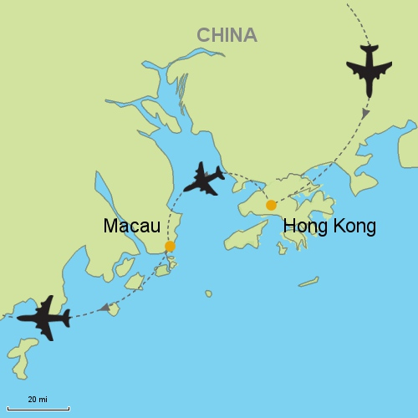
Colonialism
Colonialism is an attempt by one country to establish settlements and impose its political, economic, and cultural principles in another territory.
European states established colonies for three basic reasons: God, gold, and glory.
European states started establishing colonies in the Western Hemisphere in the 1400s.

Slide 50
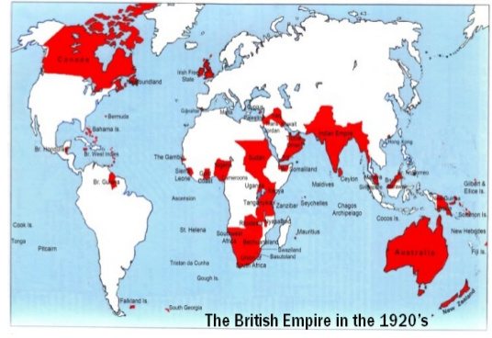
Colonialism
The United Kingdom and France had the largest colonial empire.
UK – every continent - “Sun never set” on its empire.
France had second-largest overseas territory – attempted to assimilate into culture

Slide 51
Colonialism
The European colonial era ended in the Western Hemisphere by 1824.
European states then started to establish colonies in Africa and Asia.
Most African and Asian colonies became independent after World War II. (only 15 UN 1945 – 106 in 2012)

Slide 52
The United Nations has classified 17 places in the world as “non-self-governing territories.”
Western Sahara, French Polynesia, and New Caledonia are all examples of this type of territory.
Distribution of Colonies

Slide 53
Imperialism
In many cases, imperialism has arisen where colonialism once flourished.
While colonialism involves the official government rule of one state over another, imperialism describes a situation in which one country exerts cultural or economic dominance over anther without the aid of official government institutions.

Slide 54
Imperialism
Ex. – many South American and African countries that were European colonies during 18th & 19th centuries are still dominated by the culture of the former colonizers.
U.S. is dominant imperial power in the sense that American culture and economics affect the lives of millions of people throughout the world.

Slide 55
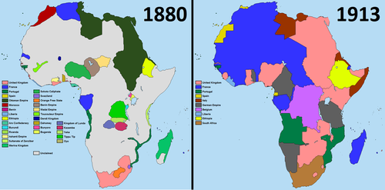
Imperialism
Kenya (Independent of G.B. 1963) still retains legacy of British language, religion and administration systems.
India and Vietnam also hold onto legacy of imperialism.

