Slide 1
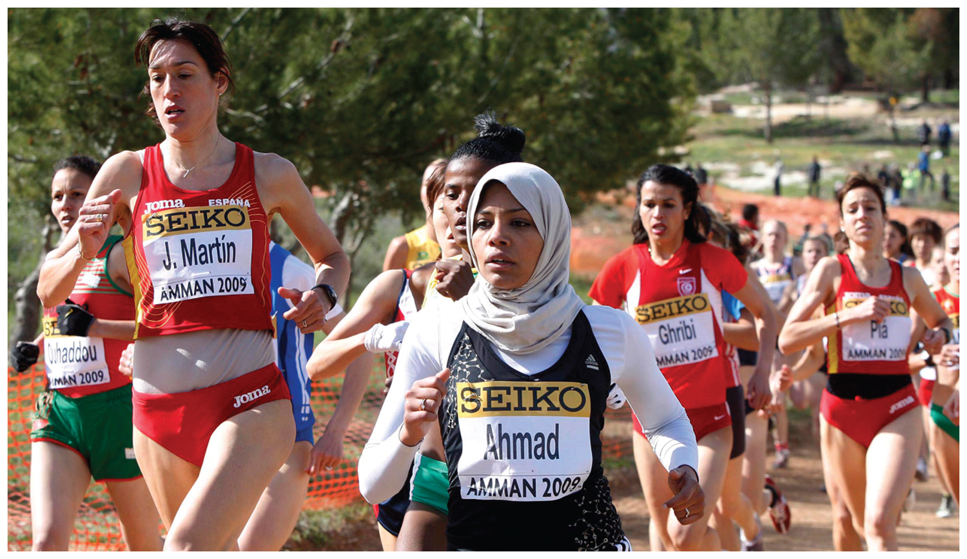
Chapter 7: Key Issue 4 - Ethnicity –

Slide 2
Key Issue #4
Why Do Ethnic Cleansing and Genocide Occur?
Learning Outcome 7.4.1: Describe the process of ethnic cleansing.
Learning Outcome 7.4.2: Explain the concept of ethnic cleansing in Bosnia & Herzegovina.
Learning Outcome 7.4.3: Explain the concept of ethnic cleansing in the Balkans.
Learning Outcome 7.4.4: Identify the principal recent episodes of genocide in Africa.
Learning Outcome 7.4.5: Identify the principal recent episodes of genocide in Central Africa.

Slide 3
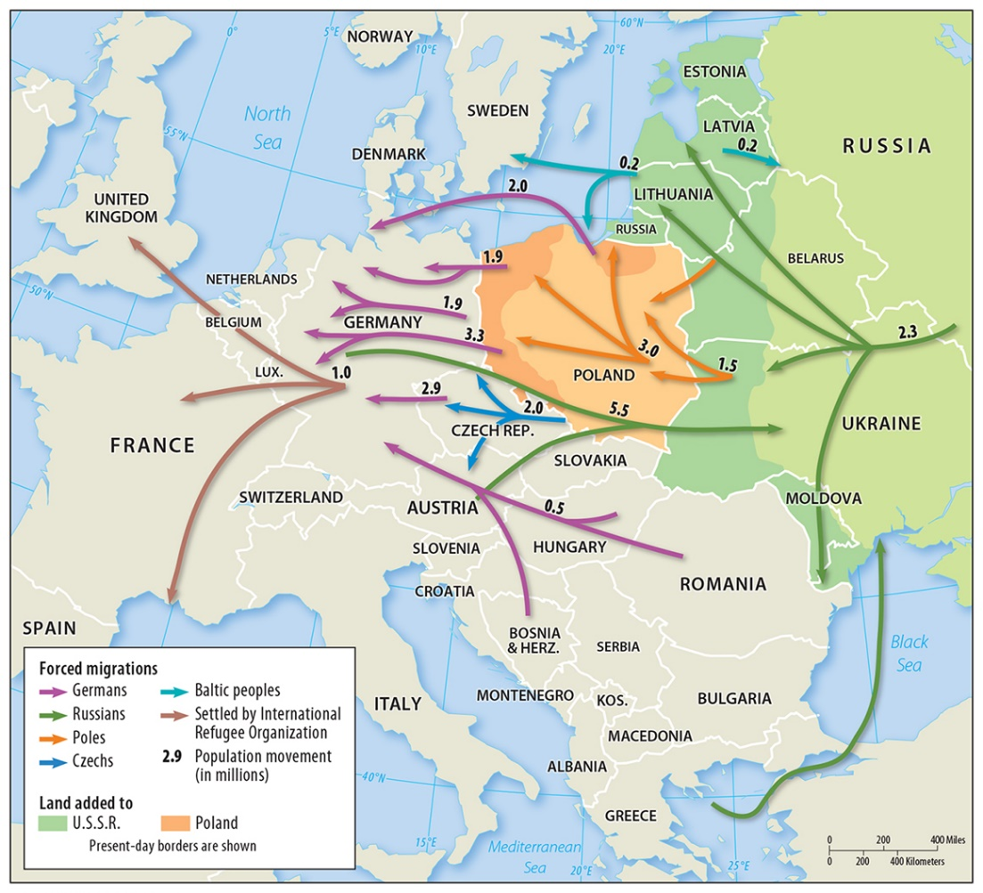
Ethnic Cleansing occurs when a more powerful group removes all the members of an ethnic group from an area to create more territory for the powerful group.
Rather than a clash between armies of soldiers, ethnic cleansing involves the removal of every member of the less powerful ethnicity—men, women, children.
Ethnic Cleansing

Slide 4
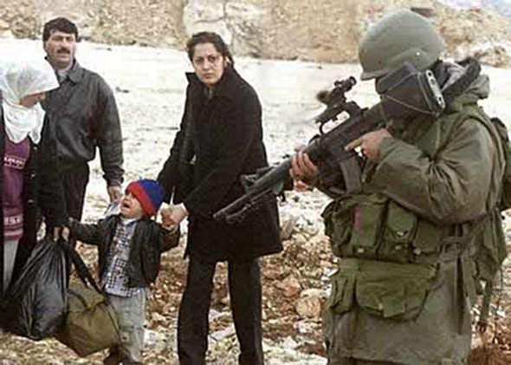
Ethnic Cleansing
Ethnic cleansing may take the form of large-scale forced migration or genocide, where members of the ethnic group are targeted for extermination.
The largest forced migration occurred during World War II due to events preceding the war, the war itself, and postwar effects.

Slide 5
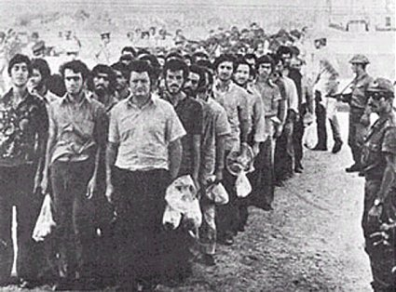
Forced Migration in Europe
The deportation of millions of Jews, gypsies, and other ethnic groups by German Nazis to concentration camps is the most notorious forced migration in history.
As a result of national boundary changes following World War II, millions of ethnic Germans, Poles, Russians, and other groups were forced to migrate.

Slide 6
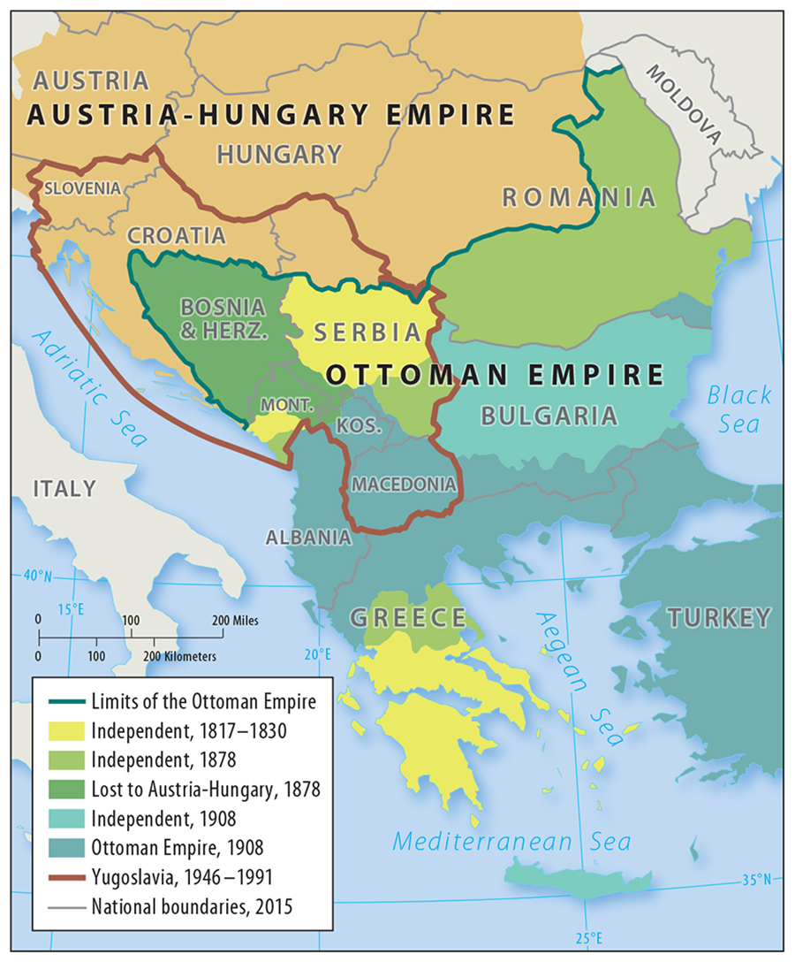
After WWI, the allies created Yugoslavia to unite several Balkans ethnicities that spoke similar South Slavic languages.
The creation brought stability that lasted for most of the 20th century.
Rivalries among the different ethnicities resurfaced after the death of President Tito in 1980, and the dissolution of the Soviet Iron Curtain.
Multiethnic Yugoslavia

Slide 7
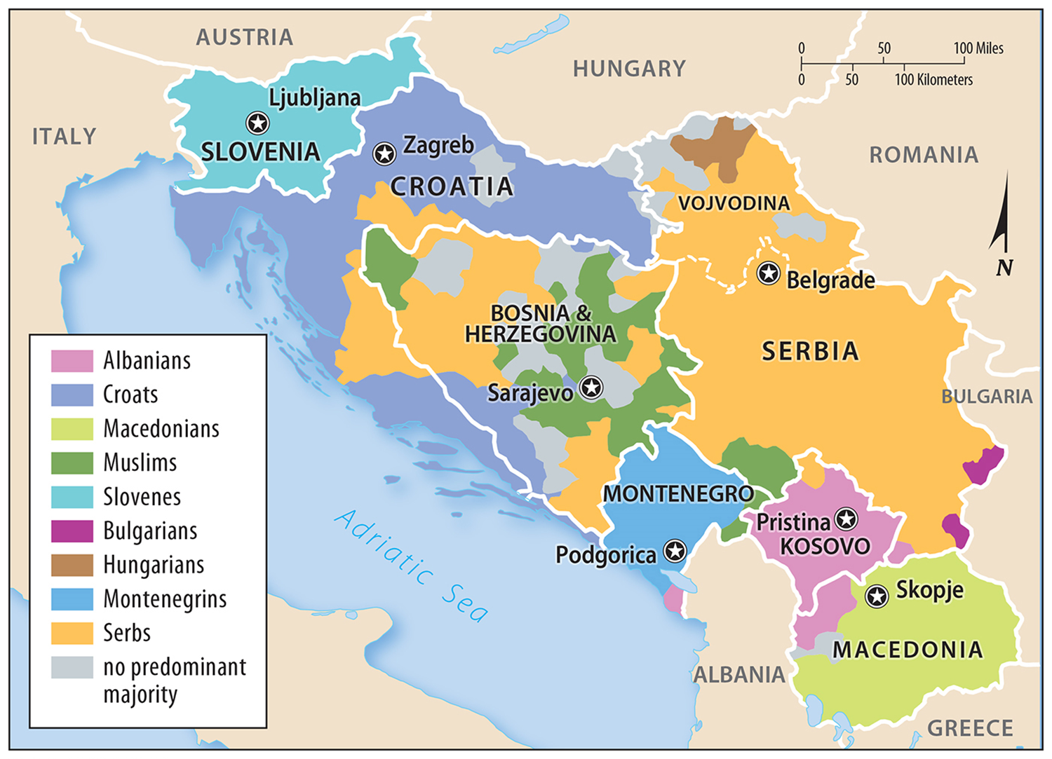
Multiethnic Yugoslavia
Leading to the breakup of the country into seven small countries.
The borders of the new countries did not reflect the distribution of ethnicities, leading to several episodes of ethnic cleansing.

Slide 8
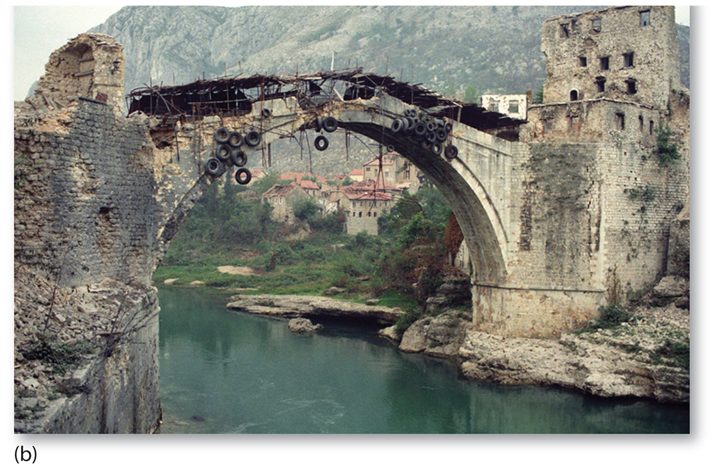
Ethnic Cleansing in Bosnia
Ethnic cleansing generally follows four steps:
Move military into a village that has no strategic value.
Round up all the people -Segregate and place men in detention camps or kill them, the rest are forced to leave.
Destroy the vacated village, such as by setting it on fire.

Slide 9
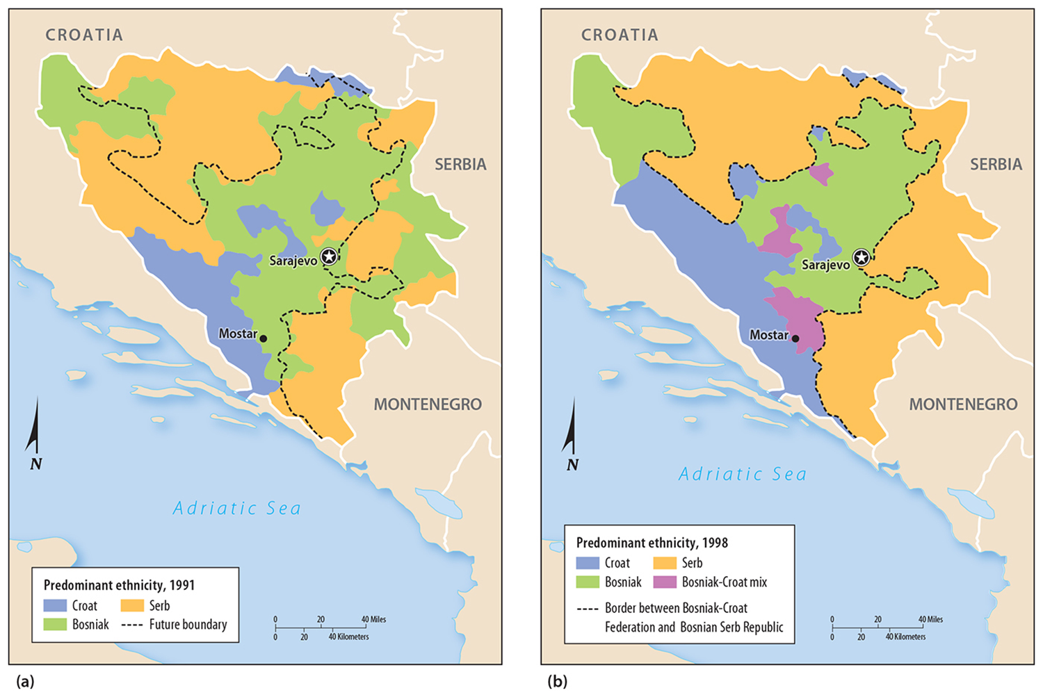
Ethnic Cleansing in Bosnia
Ethnic Serbs and Croats practiced ethnic cleansing of Bosniak Muslims in Bosnia and Herzegovina in hopes of unifying their regions with Serbia and Croatia.
Ethnic cleansing ensured ethnically homogeneous and better candidates for union with Serbia and Croatia.

Slide 10
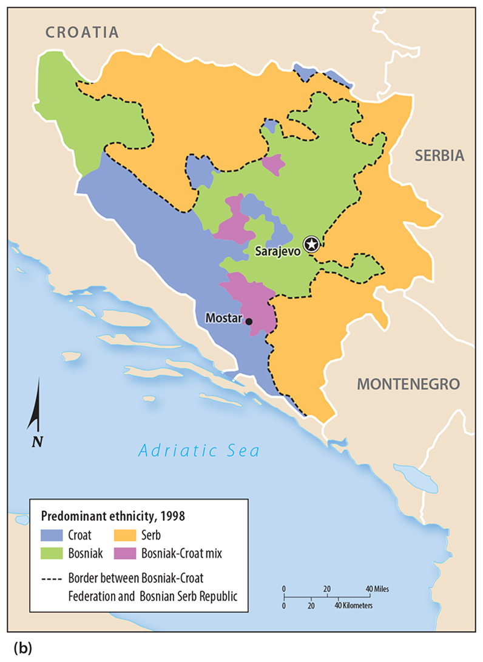
Following the Accords reached in Dayton, Ohio, in 1996 by leaders of the various ethnicities, Bosnia and Herzegovina was divided into three regions, one each dominated by the Croats, Serbs, and Bosniaks.
Ethnic Cleansing in Bosnia

Slide 11
Ethnic Cleansing Elsewhere in the Balkans
Kosovo and Croatia, also former Yugoslav republics, are locations of recent ethnic cleansings.
With the breakup of Yugoslavia, Serbia took direct control of Kosovo.
The Serbs practiced ethnic cleansing in the province of Kosovo, where the large Albanian population was forced to migrate to Albania.

Slide 12
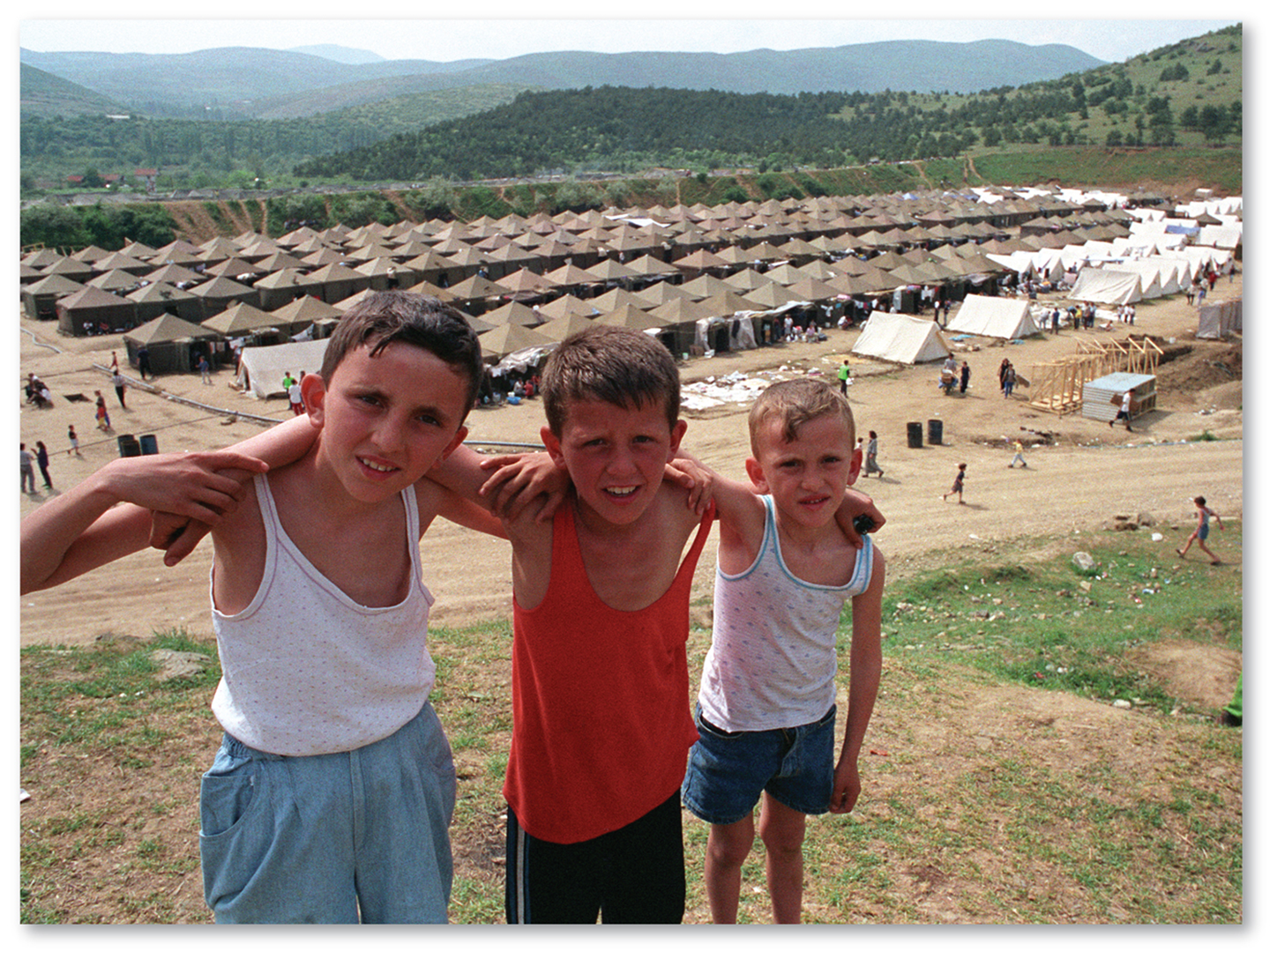
Ethnic Cleansing Elsewhere in the Balkans
At its peak in 1999, Serb ethnic cleansing had forced 750,000 of Kosovo’s two million ethnic Albanian residents from their homes.
NATO launched an air attack against Serbia and the Serbs eventually agreed to withdraw from Kosovo.
Kosovo became an independent state in 2008.

Slide 13
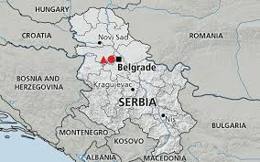
Ethnic Cleansing in Croatia
Croat and other non-Serb ethnicities were also victims of ethnic cleansing by Serbs in Croatia.
Following its declaration of independence in 1991, Croatia faced internal conflict between the aforementioned ethnic groups after its ethnic Serbs attempted to form an independent republic (Krajina) in eastern Croatia.

Slide 14
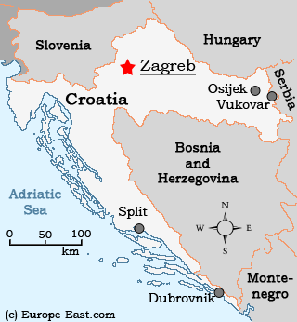
The Serbs expelled roughly 170,000 Croats and other non-Serbs from the eastern part of Croatia.
After a four-year war that resulted in a Croat victory, around 20,000 Serbs were expelled and 180,000 left Croatia voluntarily.
Ethnic Cleansing in Croatia

Slide 15
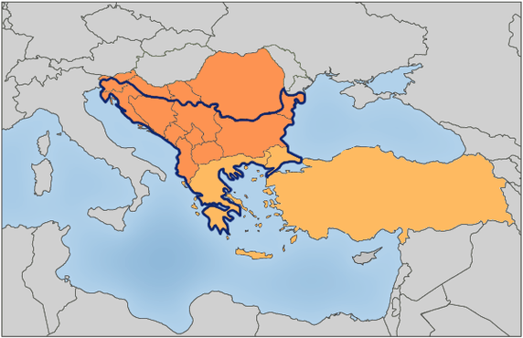
Balkanization
Balkanization is a geo-political term which refers to the division of a larger region into small territories often hostile to each other.
In most cases this region is inhabited by many ethnicities with complex, long-standing antagonisms toward each other.

Slide 16
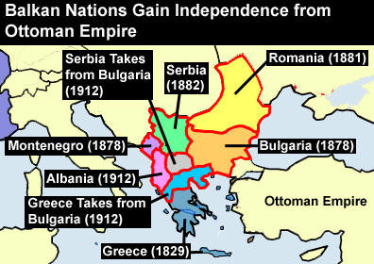
Balkanization
Balkanization led directly to World War I because the various nationalities in the Balkans dragged the larger powers that they had alliances with into a war.
The Balkans have become balkanized again because of the rise and fall of communism in the region.

Slide 17
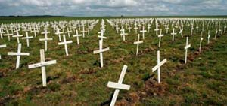
Ethnic Cleansing and Genocide in Africa
The mass killing of a group of people in an attempt to eliminate the entire group from existence is known as genocide.
In recent years, several areas of Africa have been affected by conflicts among ethnicities that have led to genocide.
Other countries have been either unable or unwilling to stop genocides from occurring.

Slide 18
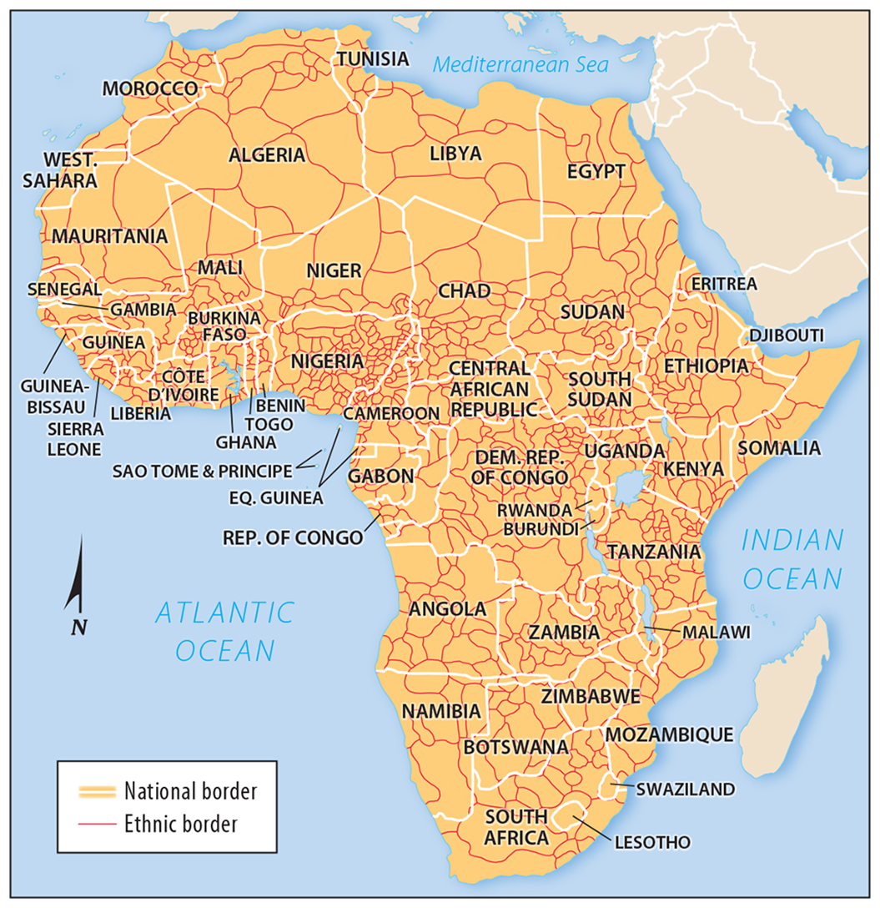
Ethnicity was traditionally the most important element of cultural identity in Africa – nationality was considered secondary to ethnicity.
Several thousand distinct ethnicities are present in Africa, each with their own languages, religions, and social customs.
Ethnicities and Nationalities in Africa

Slide 19
Ethnicities and Nationalities in Africa
Conflict today can be traced to the European colonization of Africa, which divided up the continent into countries with little regard for distribution of ethnicities.

Slide 20
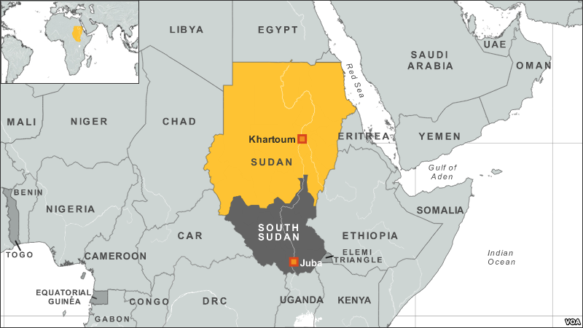
Ethnic Cleansing and Genocide in Sudan
In Sudan, several civil wars have ravaged the country since 1983, resulting in genocide and ethnic cleansing.
Sudan’s conflicts with South Sudan and Darfur have affected the most victims.

Slide 21
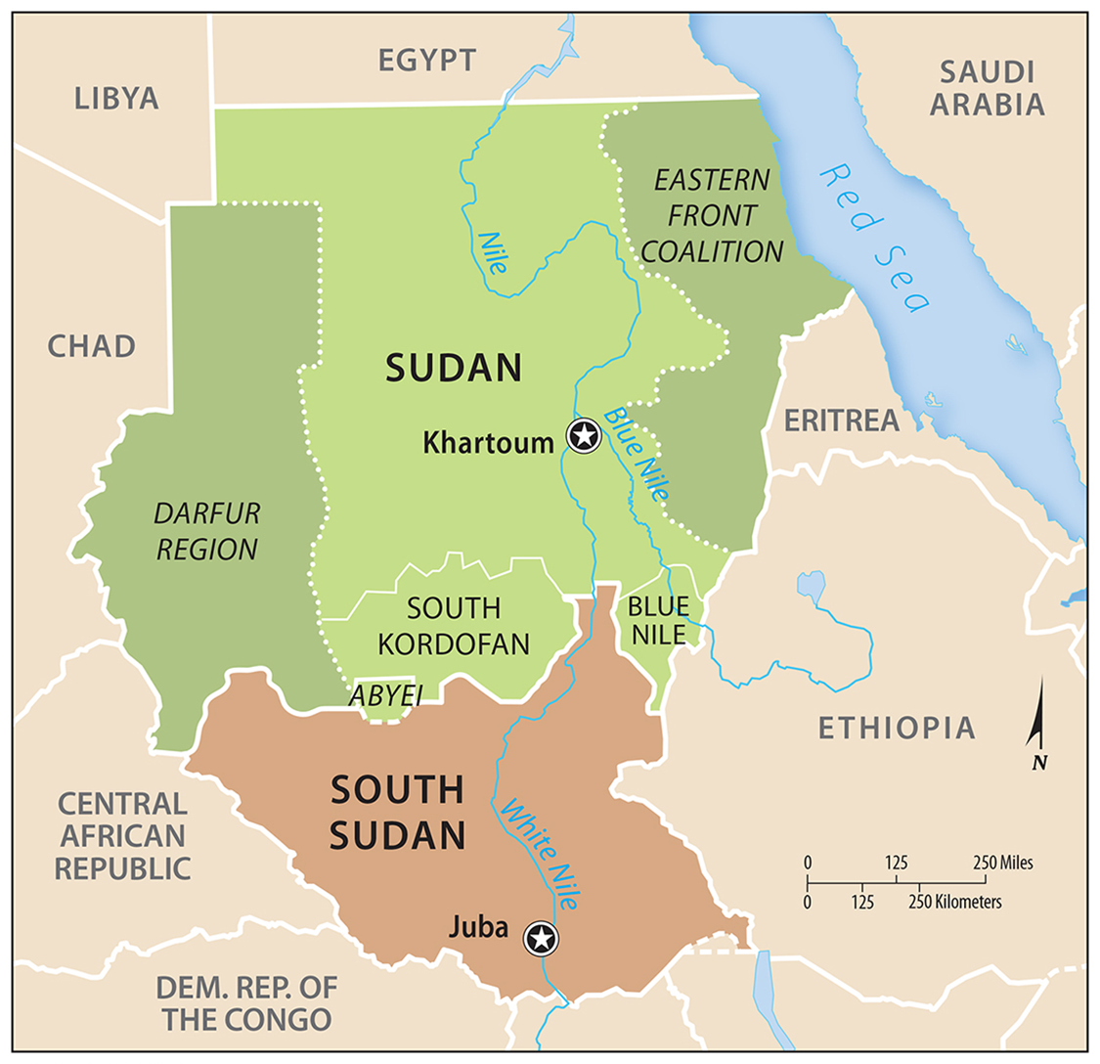
70 % of Sudan is Arab and 97 % Muslim.
The balance of other ethnicities descended from groups living in Sudan prior to the arrival of Arabs in the 12th century.
The non-Arab ethnicities are clustered in the west (Darfur), south, and east of Sudan.
Ethnic Cleansing and Genocide in Sudan

Slide 22
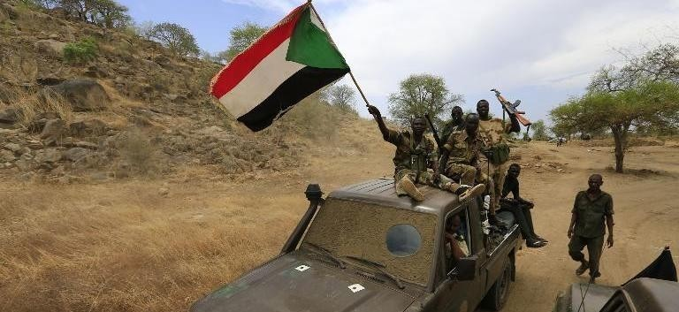
Darfur
The genocide is being carried out by a group of government-armed and funded Arab militias known as the Janjaweed (which loosely translates to ‘devils on horseback’).
The Janjaweed systematically destroy Darfurian’s by burning villages, looting economic resources, polluting water sources, and murdering, raping, and torturing civilians.

Slide 23
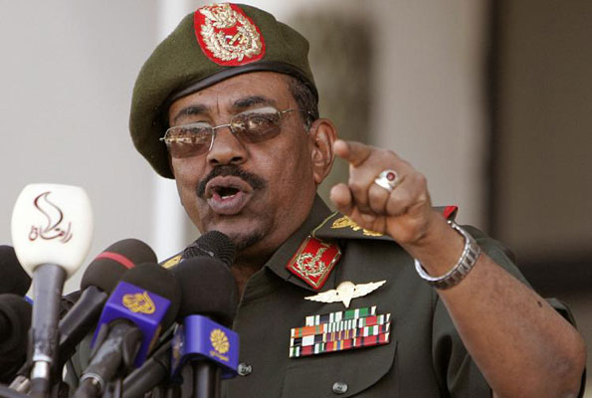
Darfur
As of today, over 480,000 people have been killed, and over 2.8 million people are displaced.
On March 4, 2009, the International Criminal Court issued an arrest warrant for Sudanese President Omar Bashir for crimes against humanity and, in July 2010, a warrant for arrest on charges of genocide.
The government of Sudan, however, has yet to turn him over, and since the issuance of the warrants.

Slide 24
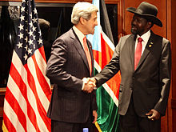
South Sudan
U.S. Secretary of State John Kerry meets with President Salva Kiir, May 26, 2013
South Sudan was established in 2011 following a war (lasting from 1983 until 2005) between Sudan’s northern and southern ethnicities.
Certain disputes still remained, including the division of oil revenues, as 75% of all the former Sudan's oil reserves are in South Sudan
This war resulted in the death of an estimated 1.9 million Sudanese and the ethnic cleansing of approximately 700,000.

Slide 25
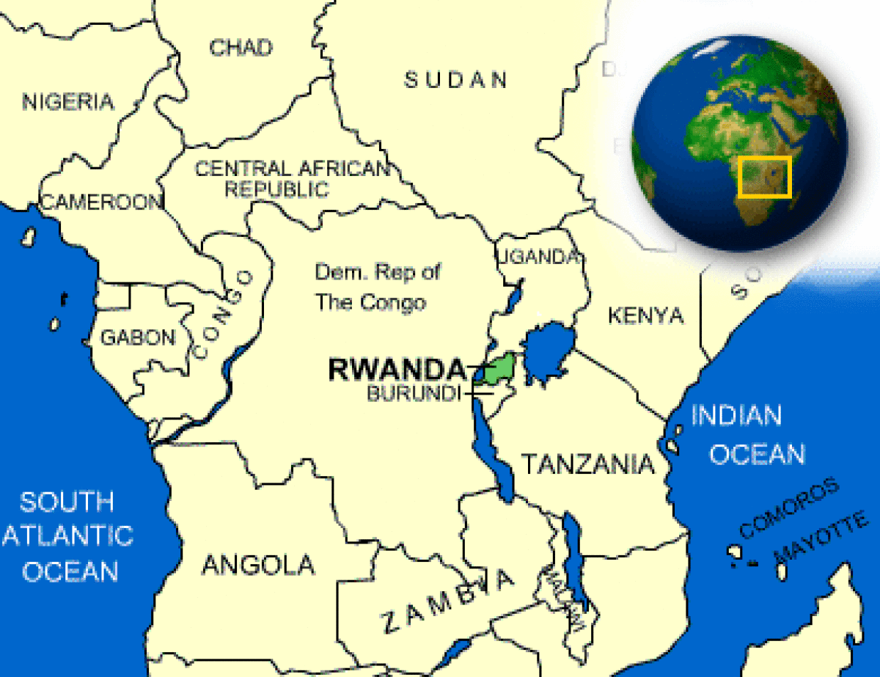
Ethnic Cleansing and Genocide in Central Africa
Rwanda’s major groups of Hutus and Tutsis have practiced genocide against one another.
The two ethnicities speak the same language, hold similar beliefs, and practice similar social customs.
Intermarriage has even lessoned the physical differences between the two groups.

Slide 26
Ethnic Cleansing and Genocide in Central Africa
The Hutus were farmers and the Tutsis were herders, and relations between settled farmers and herders are often uneasy.
Hutus constituted a majority of the population of Rwanda historically, but Tutsis controlled the kingdom of Rwanda for several hundred years and turned the Hutus into their serfs.

Slide 27
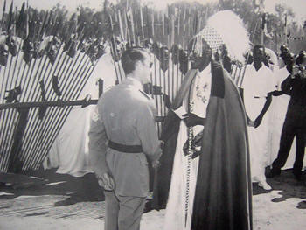
Ethnic Cleansing and Genocide in Central Africa
After World War I, Belgium controls Rwanda.
The Belgians increased the divide between the Hutus and Tutsis through the use of the eugenics, which was rather popular at the time (i.e. Nazi Germany).
Skull measurements showing larger brain size, greater height, and lighter skin tones all reaffirmed the Tutsis’ superiority over the Hutus - providing proof closer ancestry to Europeans.

Slide 28
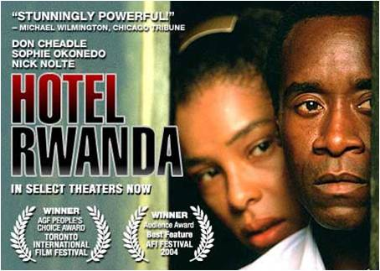
Ethnic Cleansing and Genocide in Central Africa
In 1962, the Belgians left Rwanda and it was officially declared an independent state.
Hutu led government, after hundreds of years of Tutsi rule, the roles reversed.
Hutu power quickly became centralized and all Tutsis were removed from positions of power – some fleeing.

Slide 29
Ethnic Cleansing and Genocide in Central Africa
1990 Rwandan Civil War
1994 President (Hutu) plane was shot down.
Hutu spread propaganda quickly instigated the Rwandan Genocide.
The genocide was 100 days of horrific massacre of Tutsis and other innocent Rwandans by Hutu militia.

Slide 30
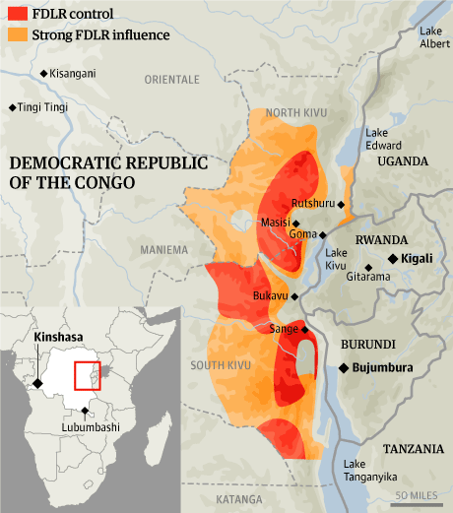
Conflict between Hutus and Tutsis spilled into Democratic Republic of Congo.
Tutsis were instrumental in the successful overthrow of Congo’s president in 1997.
The new president relied heavily on Tutsis and permitted them to kill some Hutus who had been responsible for atrocities against the Tutsis in the early 1990s.
Ethnic Cleansing and Genocide in Central Africa

Slide 31
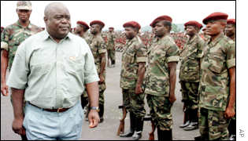
Ethnic Cleansing and Genocide in Central Africa
Later, Congo’s president, Laurent Kabila, split with the Tutsis and was assassinated in 2001.
The day before his assassination, Kabila had witnessed the execution of 47 Kadogos, all believed to be plotting against him.
The president’s son took power and negotiated an accord with the Tutsis, although violence has persisted among the country’s many ethnicities.

