Slide 1
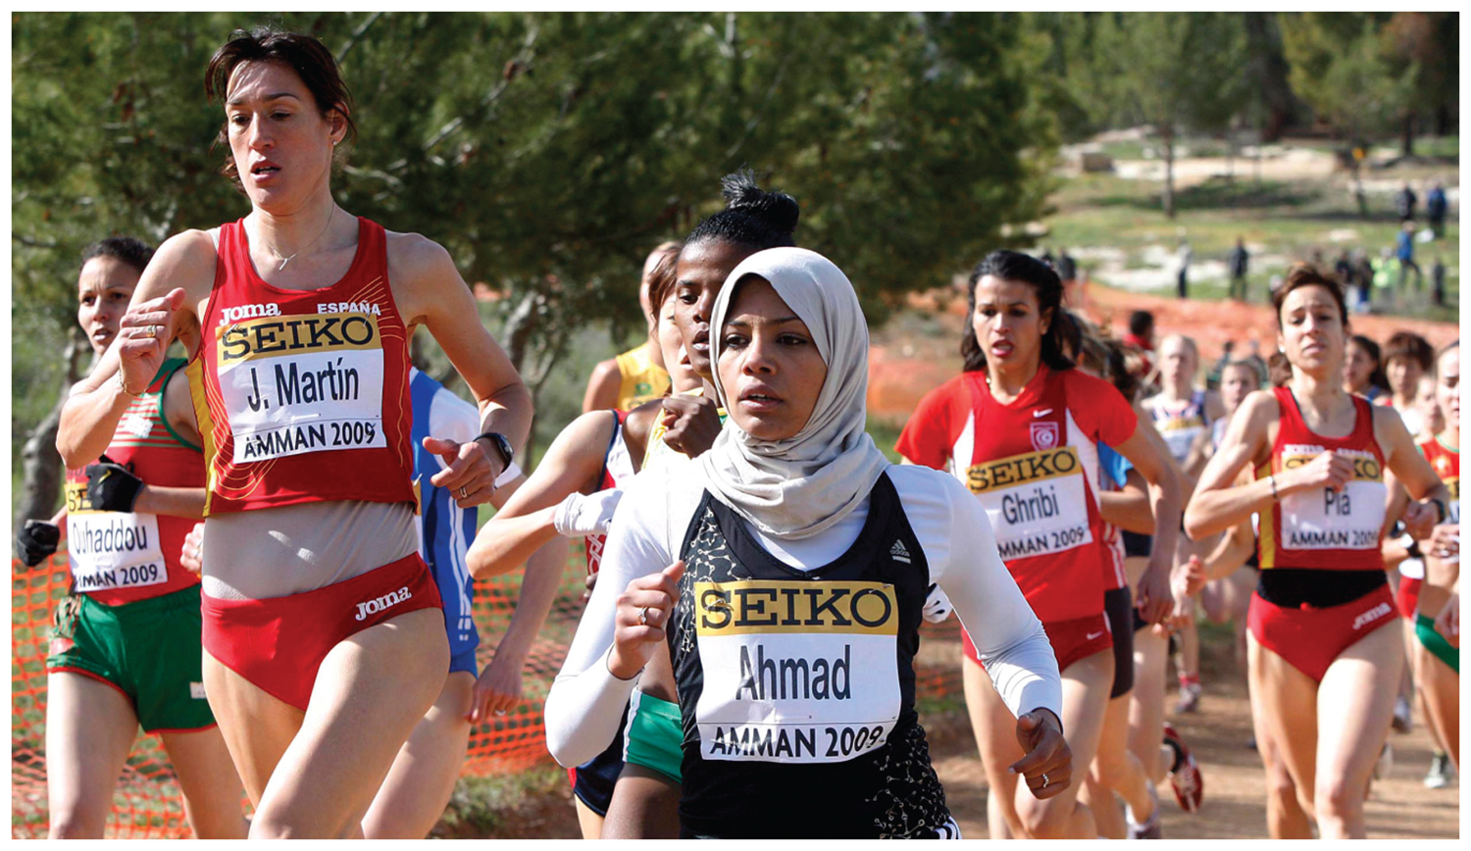
Chapter 7: Key Issue 2 - Ethnicity –

Slide 2
Mixed Marriage assignment
How are mixed marriages changing the way we think about race and ethnicity?
What are the two major consequences of mixed marriages?
Why would progress of minorities be difficult to measure?

Slide 3
Key Issue #3
Why Might Ethnicities Face Conflicts?
Learning Outcome 7.3.1: Understand differences between ethnicities and nationalities.
Learning Outcome 7.3.2: Describe how ethnicities can be divided among more than one nationality.
Learning Outcome 7.3.3: Identify and describe the principal ethnicities in western areas of Asia.

Slide 4
Why Might Ethnicities Face Conflicts?
Sorting out ethnicity and nationality can be a challenging and complex effort
Famous golfers Tiger Woods – Nationality is clear, ethnicity? Dad was a mix of African American, Native American and Mom was a mix of Thai, Chinese and Dutch.
Woods invented term “Cablinasian”-blend of Caucasian, black, American Indian, and Asian

Slide 5
Ethnicity and Nationality in North America
Nationality kept reasonably distinct from ethnicity and race in the United States.
Nationality classifies citizens of the United States, including those born in the country and those who immigrated and became naturalized citizens.
Ethnicity identifies groups with distinct ancestry and culture, such as African Americans and Mexican Americans.

Slide 6
Ethnicity and Nationality in North America
These distinctions are not as clear and controversial in Canada.
Québecois are easily distinguishable from other Canadians vis-à-vis cultural traditions, especially language.
Contested whether Québecois constitute a distinct ethnicity within the Canadian nationality or a second French-speaking nationality separate altogether from English-speaking Canadian.

Slide 7
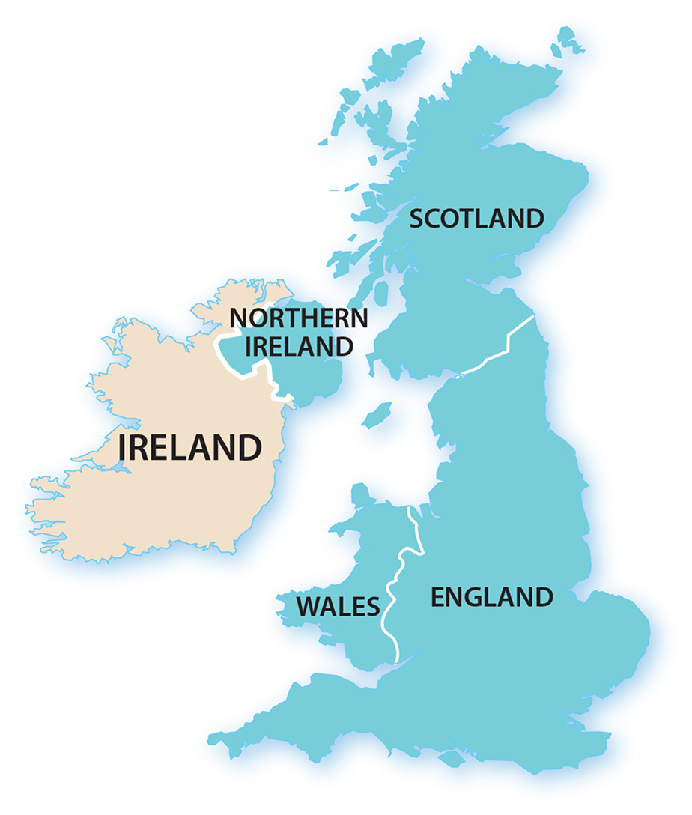
The United Kingdom contains four principle ethnicities and two nationalities.
A strong element of ethnic identity in the United Kingdom comes from sports.
Even though they are not separate countries, England, Scotland, Wales, and Northern Ireland field their own national soccer and rugby teams.
Ethnicity and Nationality in the United Kingdom

Slide 8
A nationality must hold the loyalty of its citizens to survive.
Nationalism is loyalty and devotion to a particular nationality.
States foster nationalism by promoting symbols of the country, such as flags and songs.
Nationalism

Slide 9
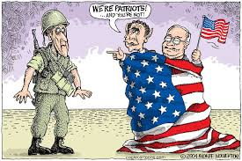
Nationalism is an example of centripetal force, which is an attitude that tends to unify people and enhance support for the state.
Most countries find that the best way to achieve citizen support is to emphasize shared attitudes that unify the people (Patriotism).
Nationalism

Slide 10
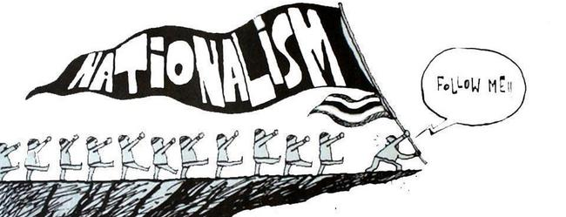
Nation-States vs. City States
Loyalty to a particular state can be beneficial to the state’s internal governance but can also lead to intolerance of differences.
Nationalism

Slide 11
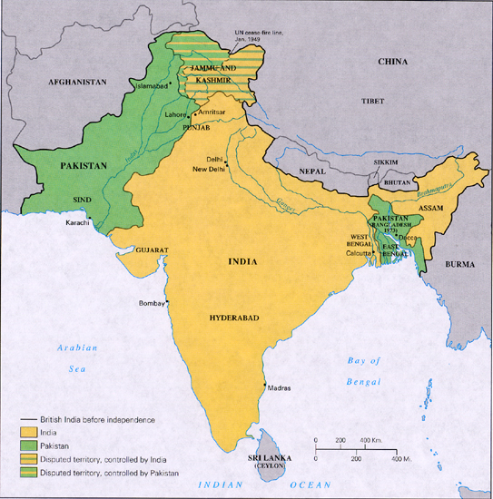
British ended colonial rule 1947 - divided country into the two irregularly shaped countries—India and Pakistan (West/ East).
East Pakistan became the independent country of Bangladesh in 1971.
Ethnicities in South Asia - India

Slide 12
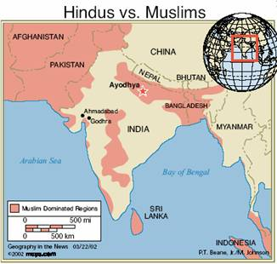
Pakistan predominantly Muslim; India predominately Hindu.
Muslims have long fought with Hindus for control of territory in South Asia.
Ethnicities in South Asia - India

Slide 13
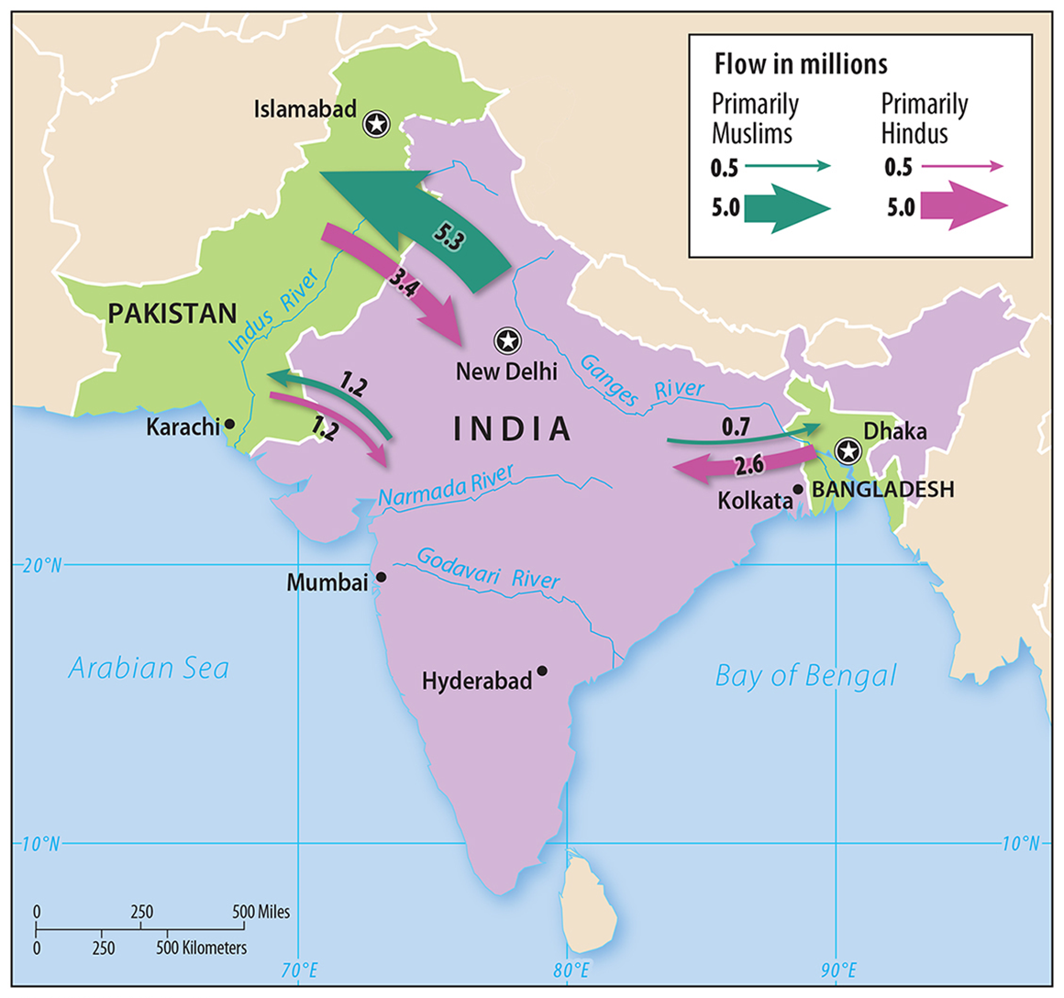
The partition resulted in massive migration because the two boundaries did not correspond precisely to the territory inhabited by the two ethnicities.
17 million people caught on the wrong side of the boundary felt compelled to migrate during the late 1940s.
Hindus in Pakistan and Muslims in India were killed by the rival religions.
Ethnicities in South Asia - India

Slide 14
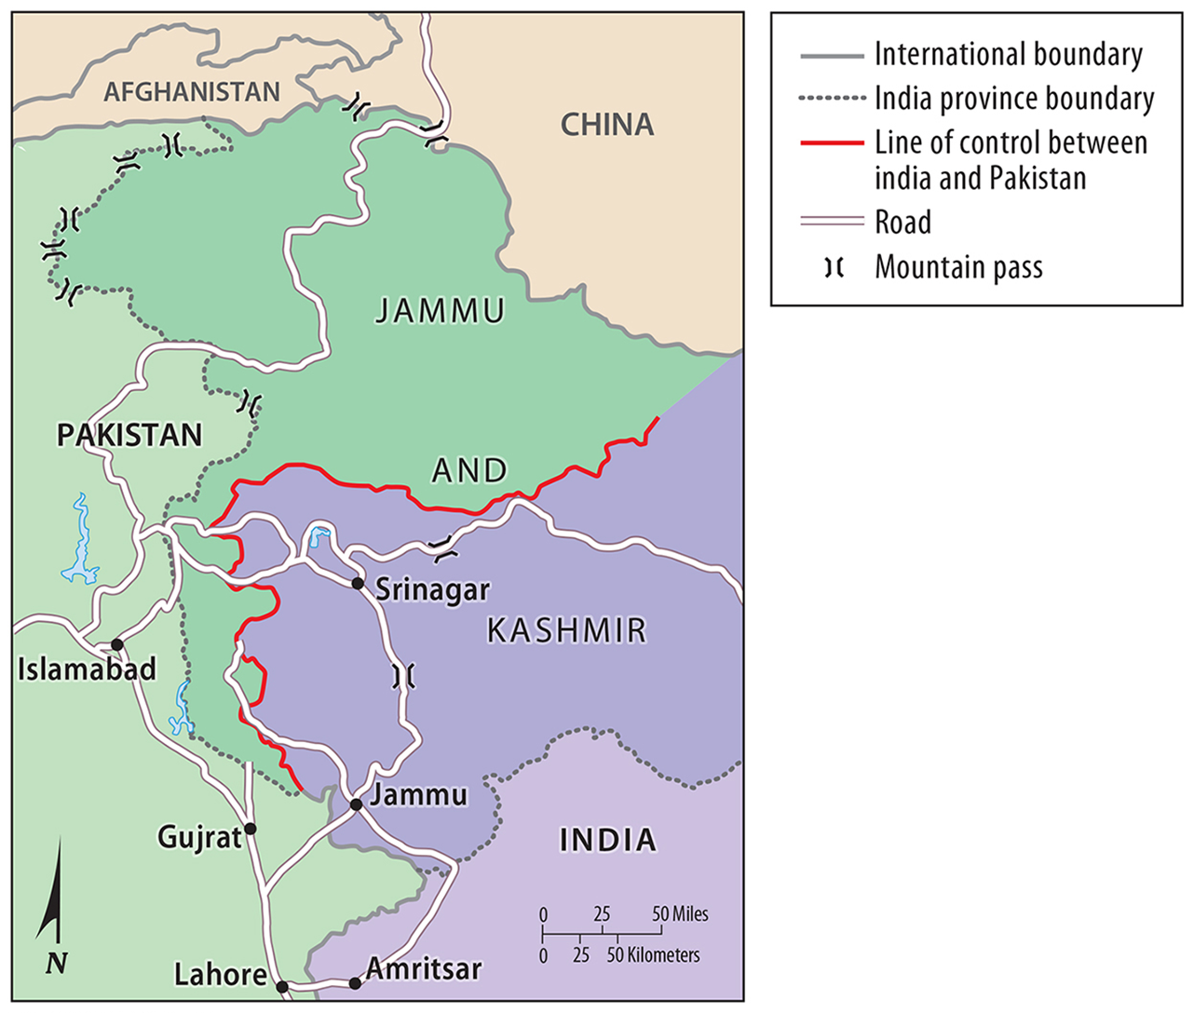
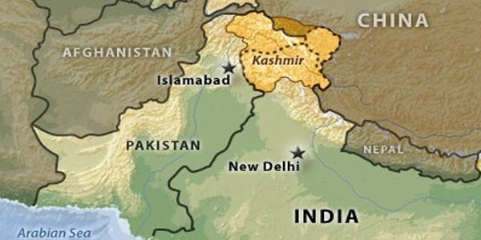
Pakistan and India never agreed on the location of the boundary separating the two countries in the northern region of Kashmir.
Ethnicities in South Asia - India

Slide 15
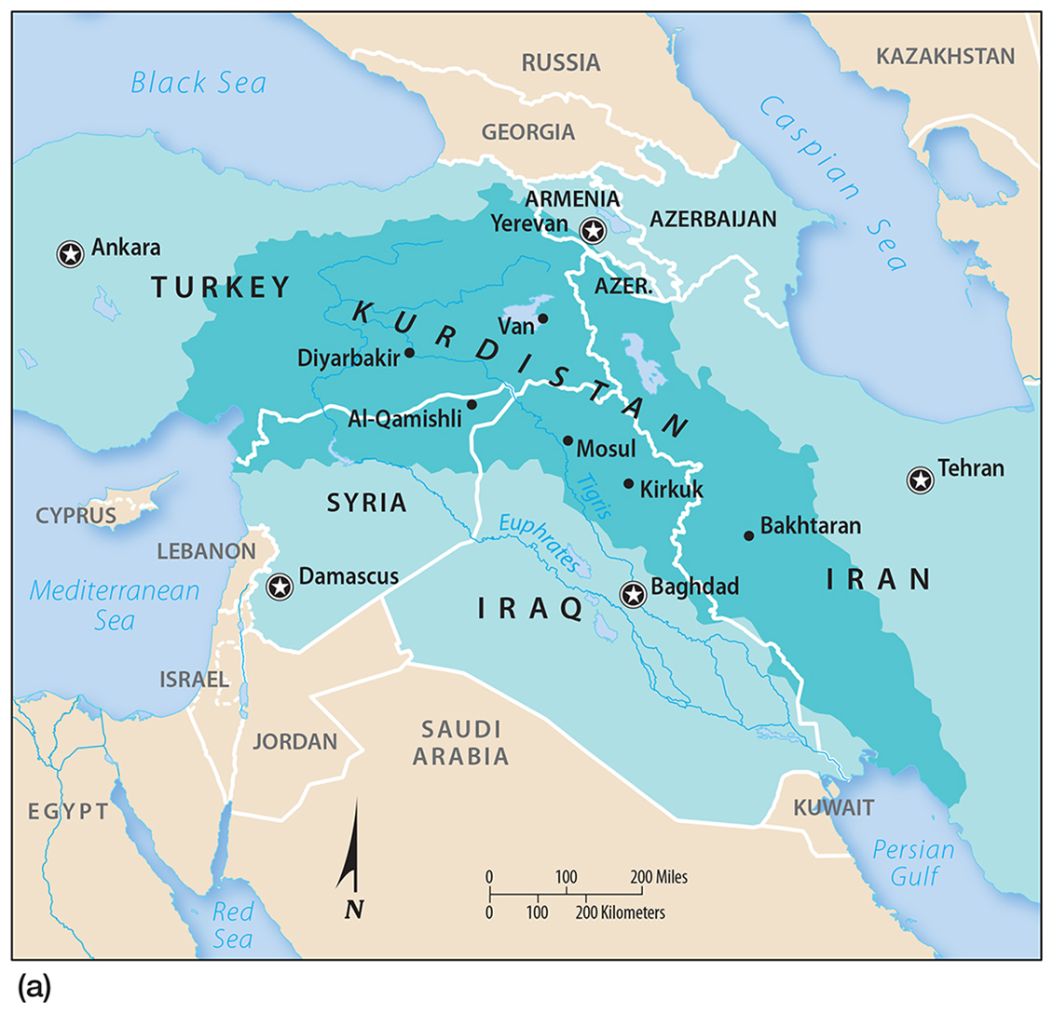
The Kurds – Sunni Muslims, homeland straddles the border between Iraq, Turkey, Iran, and Syria.
Given their independent state after WW1 only to have the Turks fight successfully to expand their territory (Turkey 1923)
Have their own language, literature, dress, and other cultural traditions.
Dividing the Kurds

Slide 16
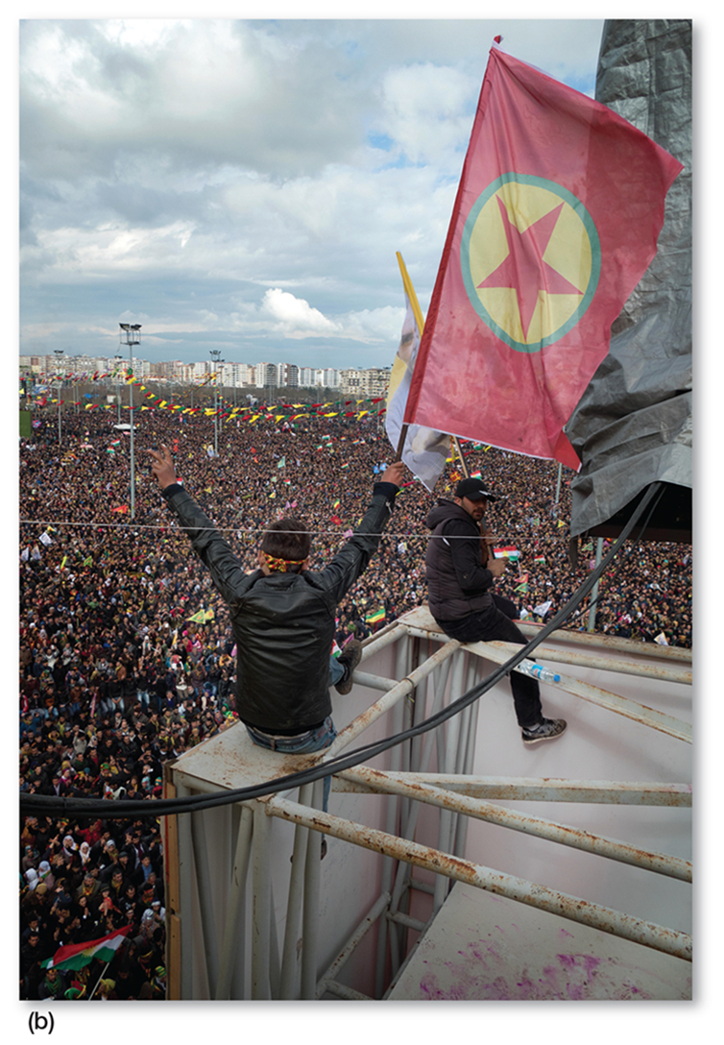
Many Kurds would like an independent homeland.
Many of these countries have historically restricted aspects of Kurdish culture.
Dividing the Kurds

Slide 17
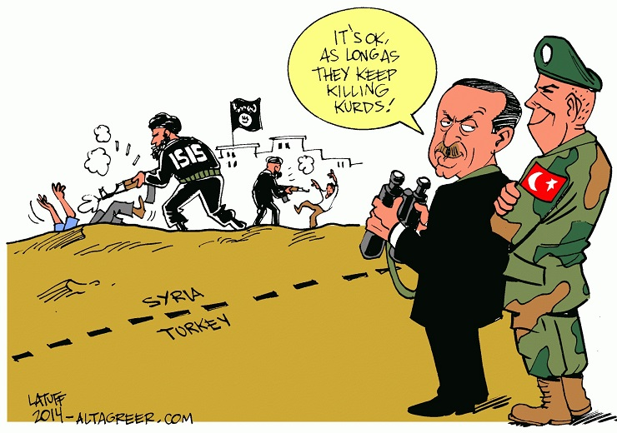
Dividing the Kurds
Until 1991, the use of the Kurdish language in Turkey was banned, and is still illegal to use in broadcasts and classrooms across the country.
1/12/17 -Turkey lashed out at the US military for allegedly supporting "terrorist" Syrian Kurdish fighters. The Syrian Kurds meanwhile continue to advance on the "Islamic State" capital of Raqqa

Slide 18
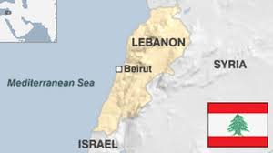
Lebanon 54 % Muslim, 41 % Christian, and 9% Druze.
Muslims in Lebanon are about equally split between Sunnis and Shiites.
Lebanon’s religious groups have tended to live in different regions of the country.
Ethnic Competition in Lebanon

Slide 19
There was a civil war between the two religious groups in 1975 and 1990, with each group forming its own militia to control its territory
Ethnic Competition in Lebanon

Slide 20
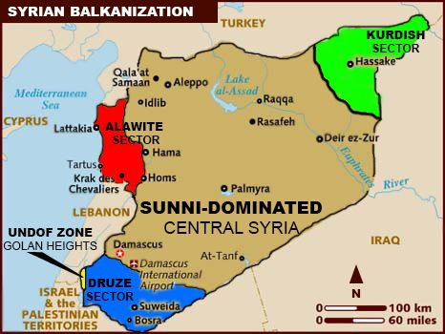
While Syria is 90 percent Arab, this segment of the population is divided among Sunni Muslims, Alawi Muslims, Christians, Druze, and other Muslim denominations
Ethnicities in Syria

Slide 21
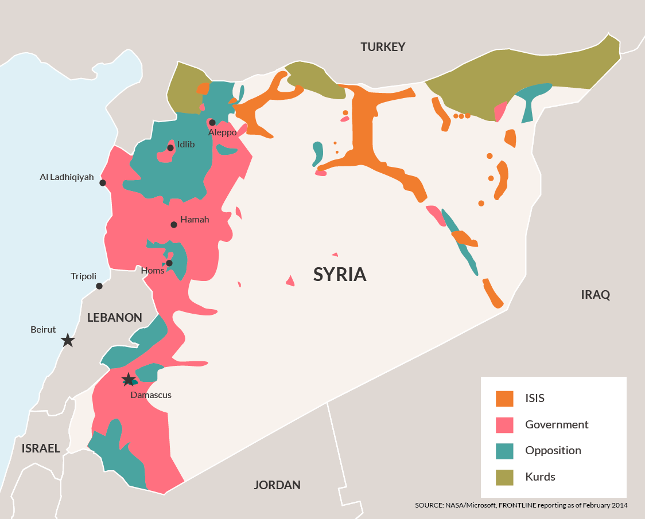
The Alawi, led by the Assad family, have held power in Syria since 1970.
A civil war has ravaged the country since 2011, fought between the Assad government and its opponents.
Ethnicities in Syria

Slide 22
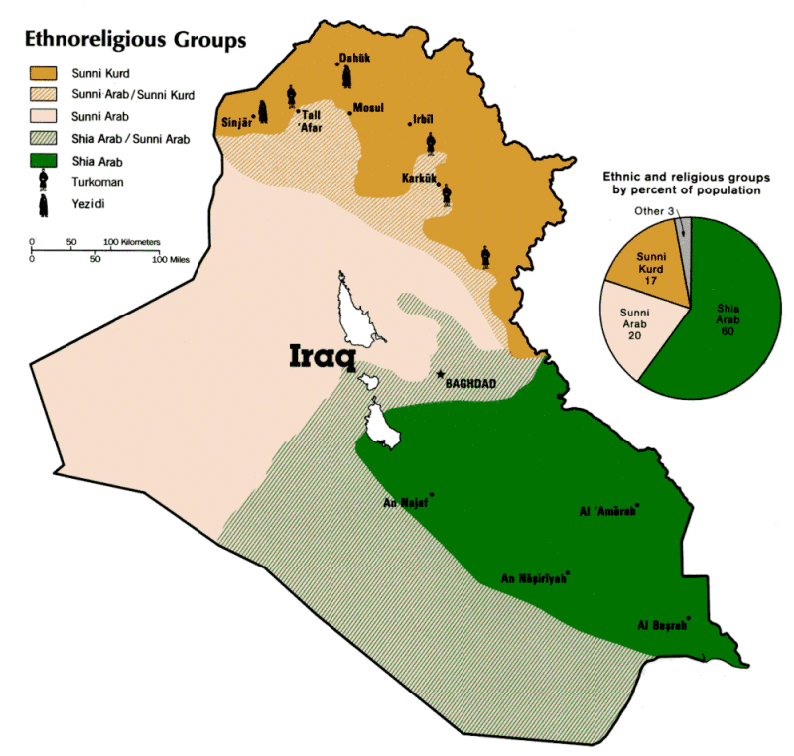
55 % Shiite Muslim Arabs, 21 % Kurds, and 19 % Sunni Arabs.
Ethnicities in Iraq

Slide 23
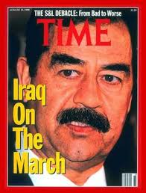
Following the 2003 invasion of Iraq by the United States and the fall of Saddam Hussein, the country has been entangled in a complex and violent struggle among its ethnicities.
Ethnicities in Iraq

Slide 24
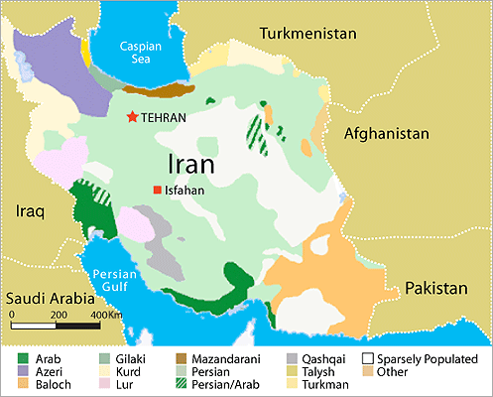
The majority are Persians.
Persians make up the world’s most numerous ethnicity adhering to Shiite Islam.
Azeri and Baluchi are other significant ethnicities present in Iran.
Ethnicities in Iran

Slide 25
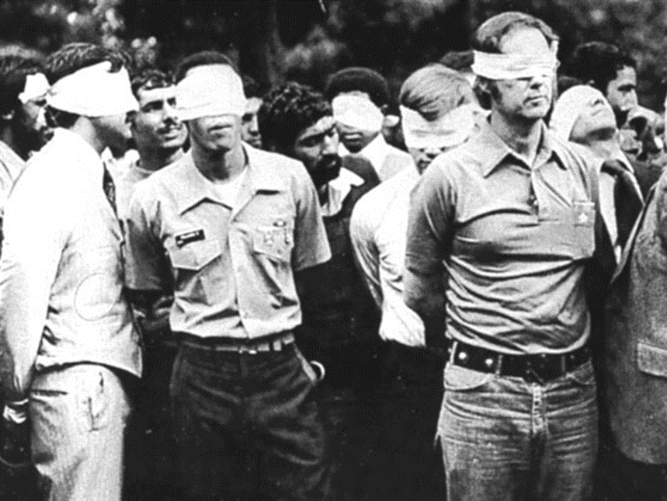
Relations between Iran and U.S. have been poor.
1979 Iran held 52 American hostages for a year.
Ethnicities in Iran

Slide 26
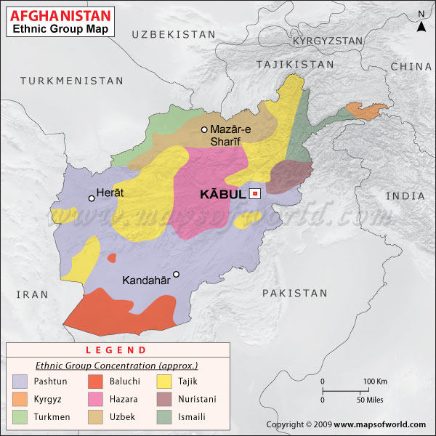
Pashtun, Tajik, and Hazara ethnicities are the most abundant in Afghanistan.
The current conflicts in Afghanistan stem from a 1979 rebellion by several ethnic groups against the Afghan government.
Ethnicities in Afghanistan

Slide 27
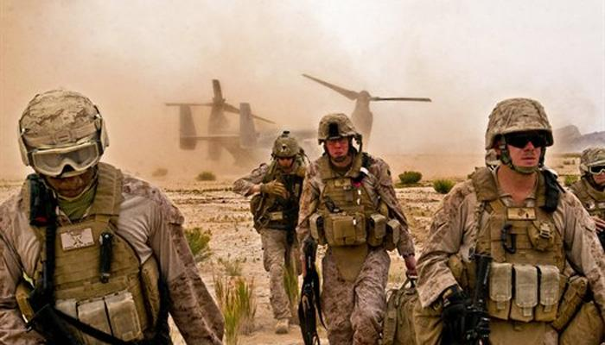
In 1995, a Pashtun faction called the Taliban took control of most of Afghanistan, (fundamentalist interpretation of Islam doctrine).
Taliban overthrown in 2001 by invading U.S.-led forces, leading to further instability among the country’s ethnicities
Ethnicities in Afghanistan

Slide 28
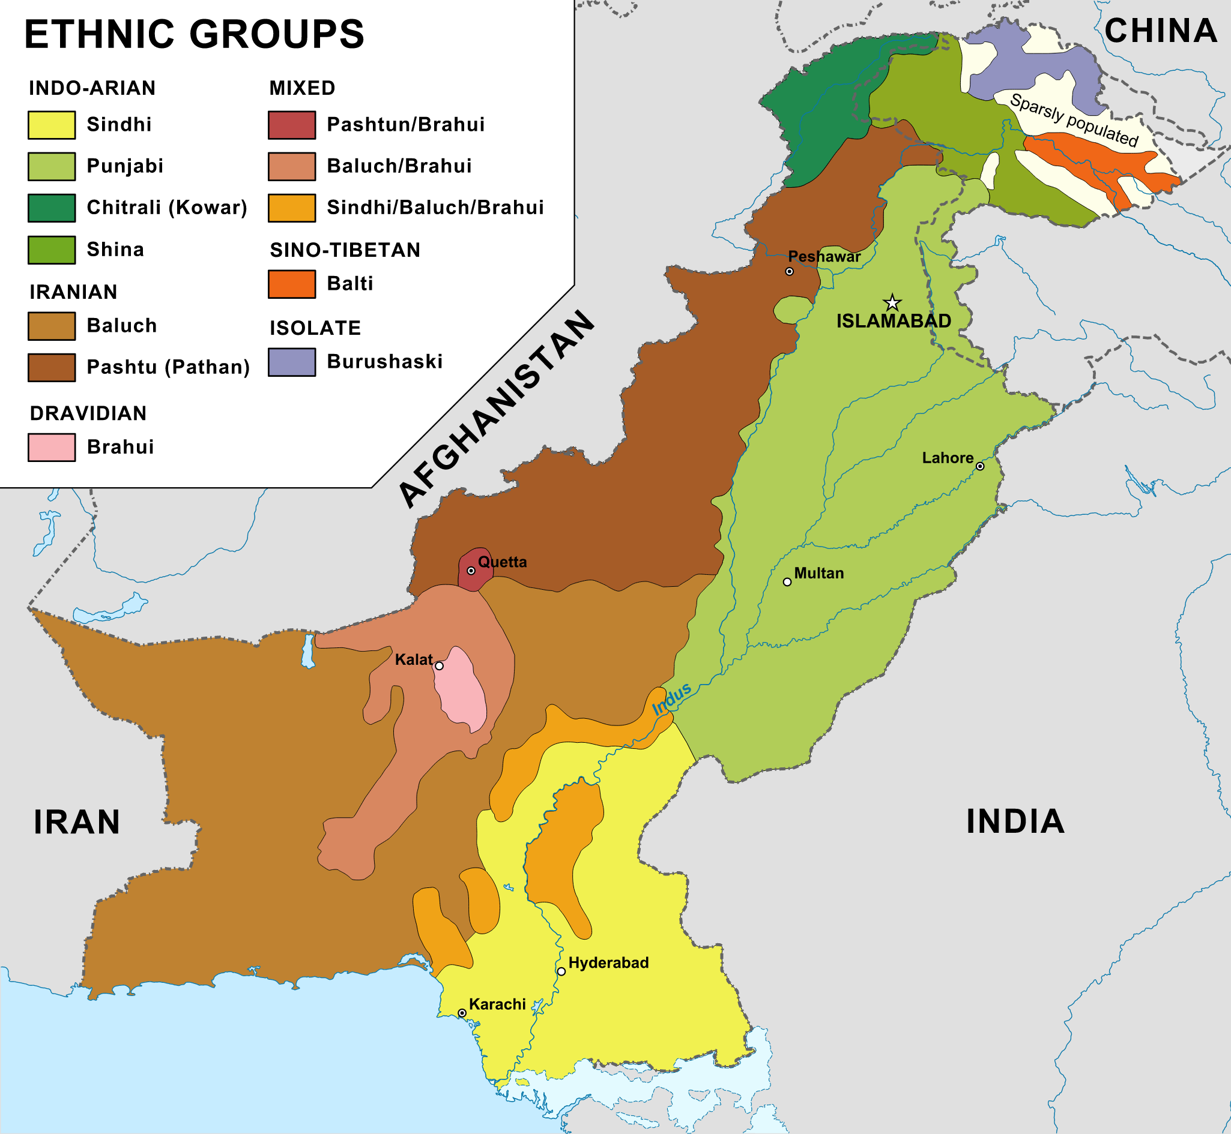
The Punjabi (Sunni) have been the most abundant ethnicity of present-day Pakistan for thousands of years.
The montane territory separating Pakistan from Afghanistan is predominantly Baluchi and Pashtun (Shiite).
Ethnicities in Pakistan

