Slide 1
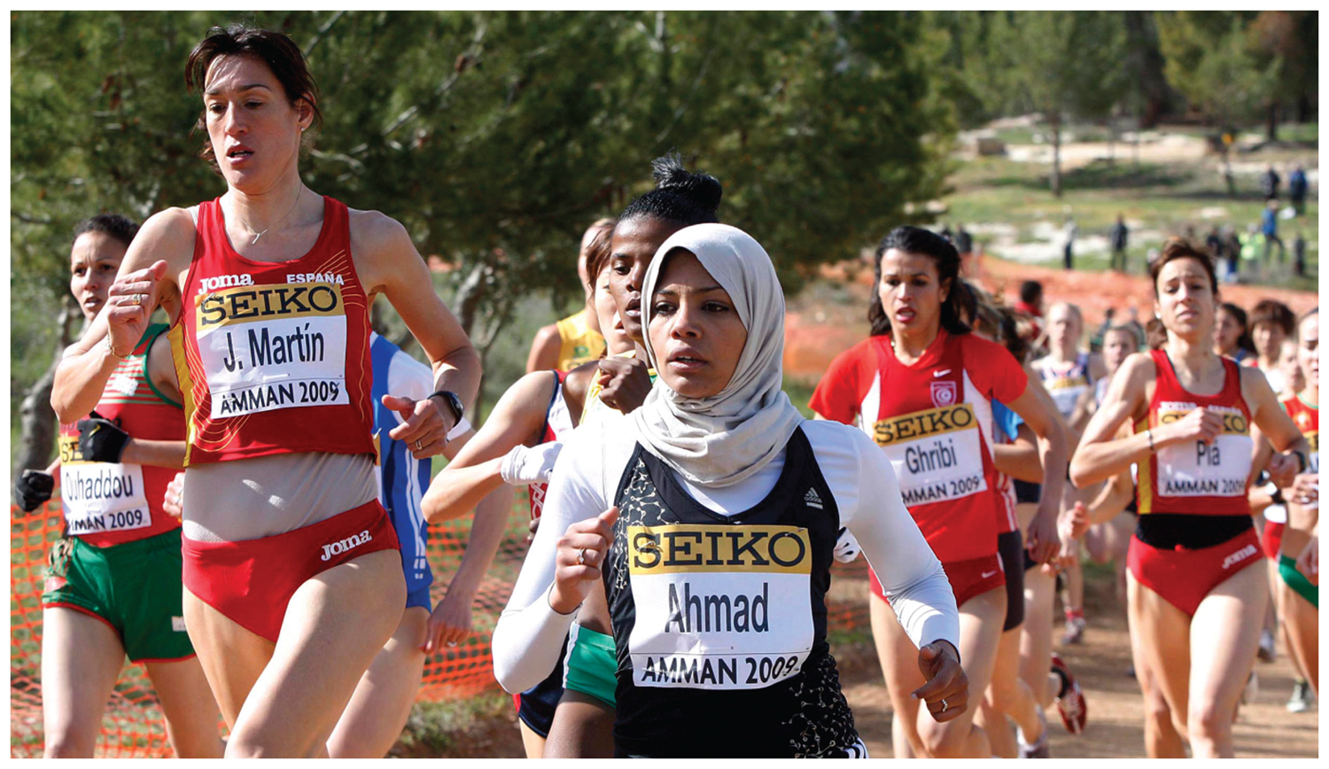
Chapter 7: Key Issue 2 - Ethnicity –

Slide 2
Key Issue #2
Why Do Ethnicities Have Distinctive Distributions?
Learning Outcome 7.2.1: Describe forced migration from Africa.
Learning Outcome 7.2.2: Describe the patterns of migration of African American within the United States.
Learning Outcome 7.2.3: Explain the laws once used to segregate races in the United States and South Africa.

Slide 3
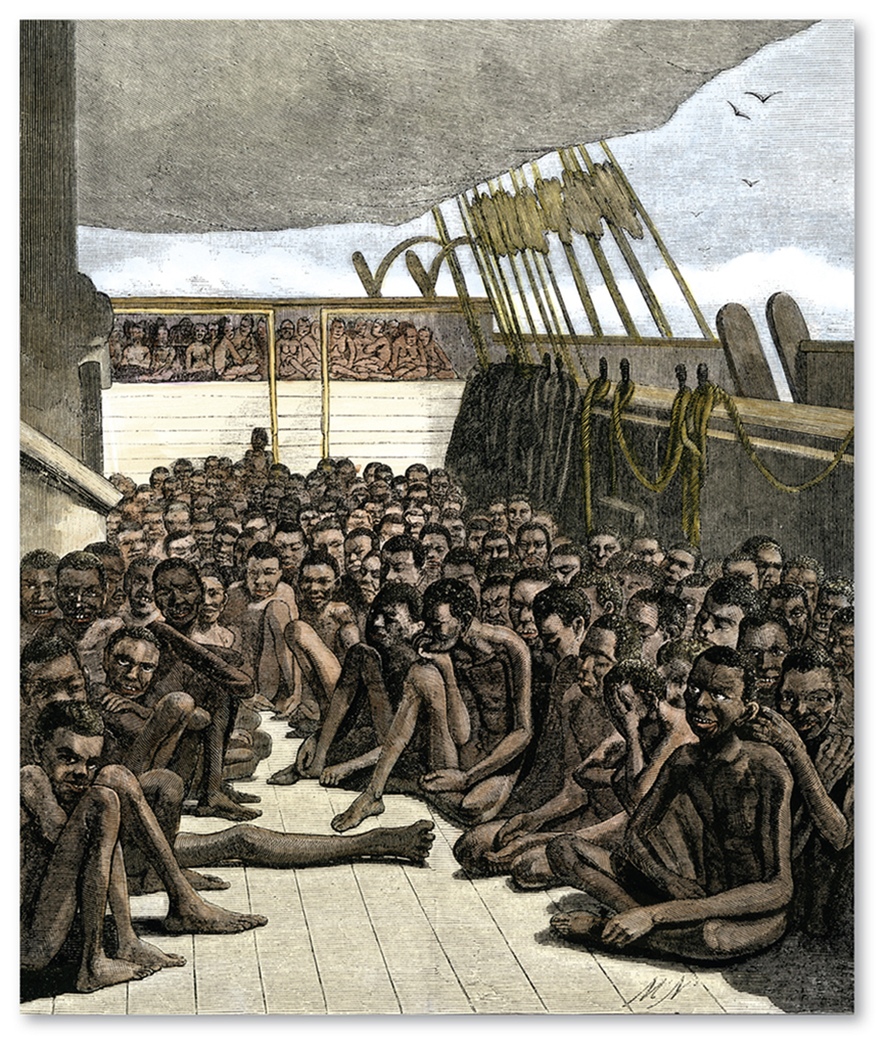
International Migration of Ethnicities
Most African Americans are descended from Africans forced to migrate as slaves in the eighteenth century.
In contrast to this forced migration, most Asian Americans and Hispanics are descended from voluntary immigrants to the United States during the late twentieth and early twenty-first centuries.

Slide 4
Forced Migration from Africa
During the eighteenth century, the British shipped about 400,000 Africans to the 13 colonies that later formed the United States.
In 1808, the United States banned bringing in additional Africans as slaves, but 250,000 were illegally imported during the next half-century.

Slide 5
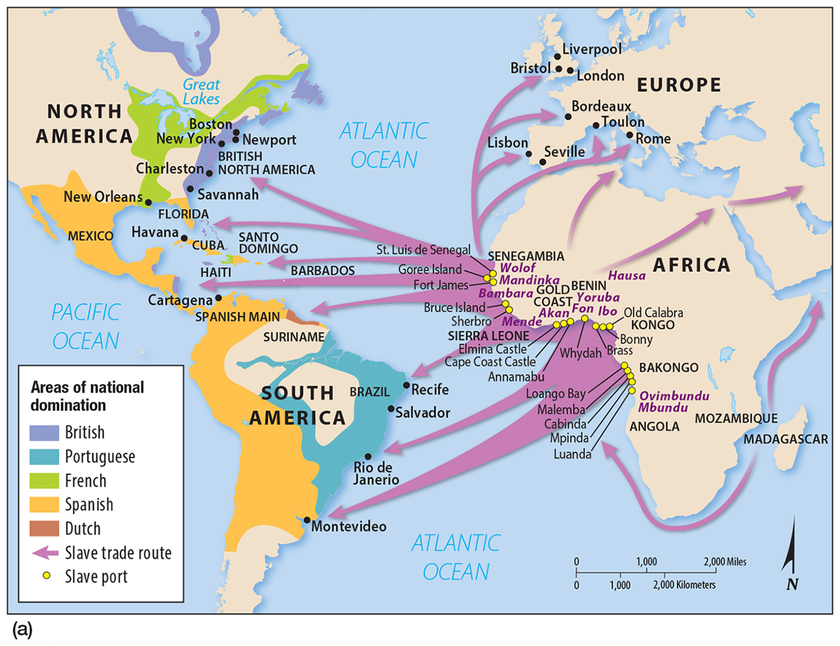
Forced Migration from Africa
The forced migration began when people living along the east and west coasts of Africa, taking advantage of superior weapons, captured members of other groups living farther inland and sold the captives to the Europeans.

Slide 6
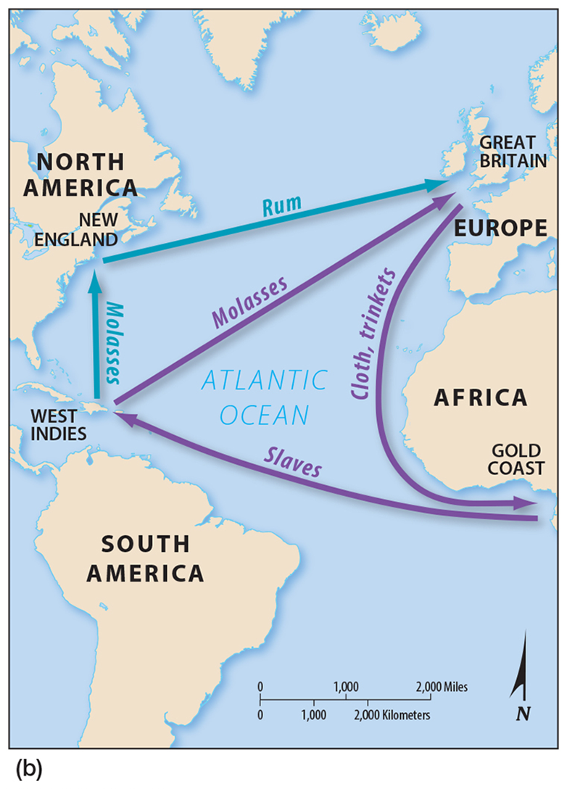
Forced Migration from Africa
Many European ships transported slaves from Africa to the Caribbean islands, molasses from the Caribbean to Europe, and trade goods from Europe to Africa—this was known as the triangular slave trade.

Slide 7
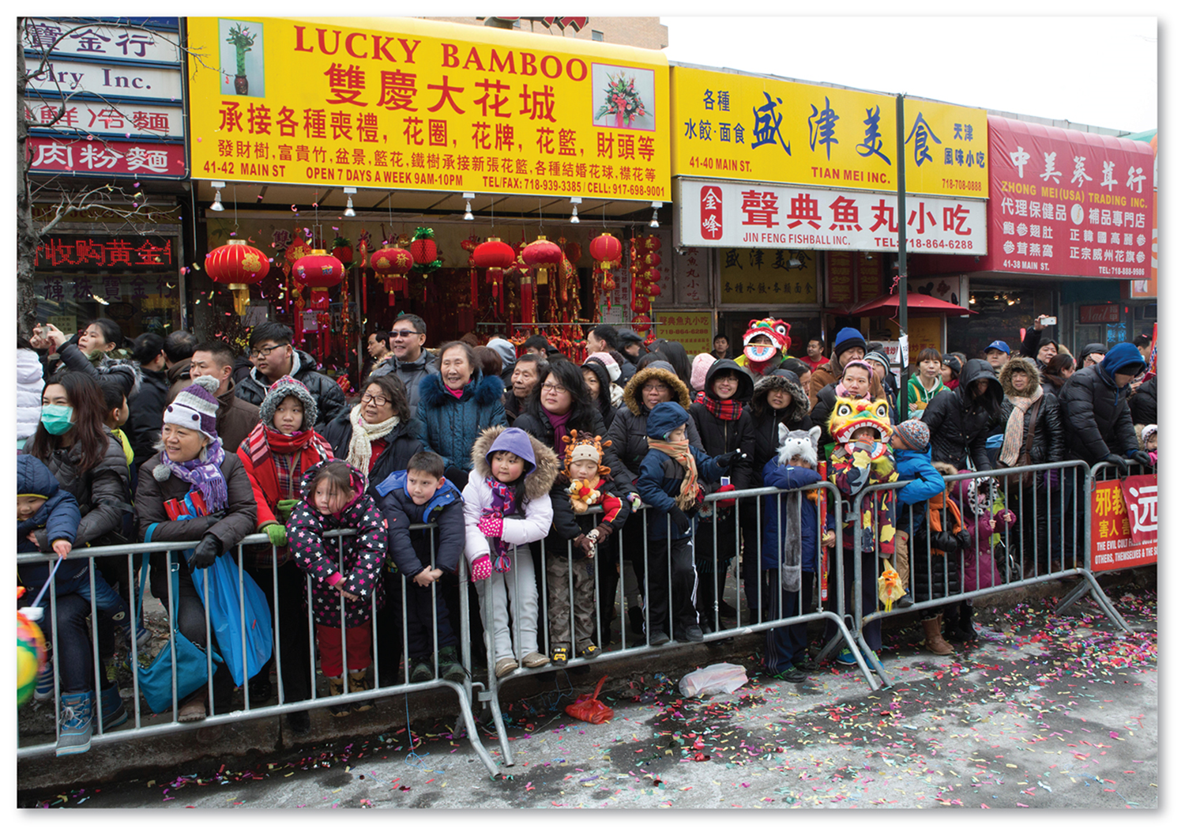
Voluntary Migration from Latin America and Asia
Quota laws limited the number of people who could immigrate to the United States from Latin America and Asia.
After the immigration laws were changed during the 1960s and the 1970s, the population of Hispanic and Asian Americans in the United States increased rapidly.

Slide 8
Internal Migration of African Americans
In the twentieth century, African Americans exhibited two distinctive migration patterns within the United States.
In the first half of the twentieth century, interregional migration from the U.S. South to northern urban areas was undertaken.
In the second half of the twentieth century, African Americans migrated inter-regionally from inner-city ghettos to outer-city and inner suburban neighborhoods.

Slide 9
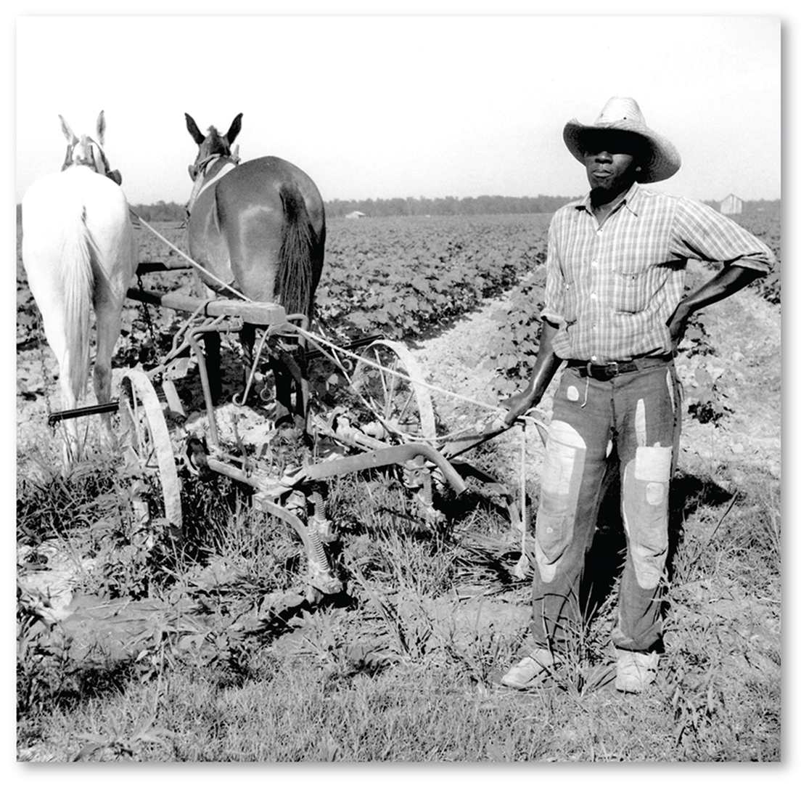
Interregional Migration
At the close of the Civil War, most African Americans were concentrated in the rural South working as sharecroppers.
A sharecropper works fields rented from a landowner and pays the rent by turning over to the landowner a share of the crops.

Slide 10
Interregional Migration
Sharecropping became less common in the twentieth century - introduction of farm machinery and a decline in land devoted to cotton reduced the demand for labor.
At the same time they were pulled by the prospect of jobs booming in industrial cities in the North and West.

Slide 11
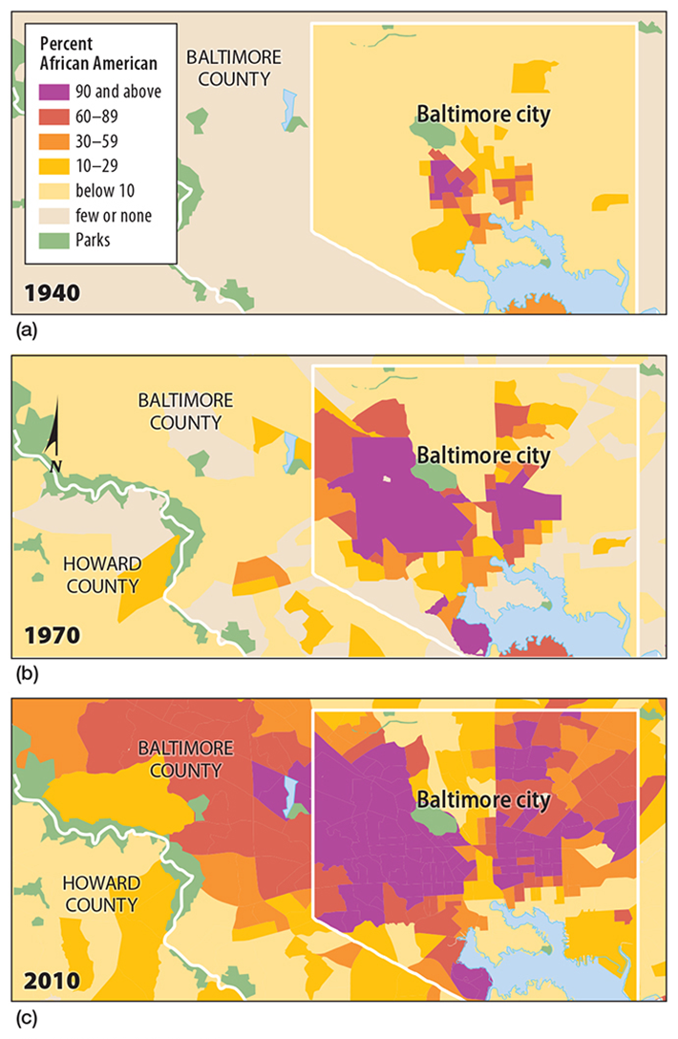
Interregional Migration
Southern African Americans migrated north and west in two main waves, the first in 1910s and 1920s before and after World War I, and the second in the 1940s and 1950s before World War II.

Slide 12
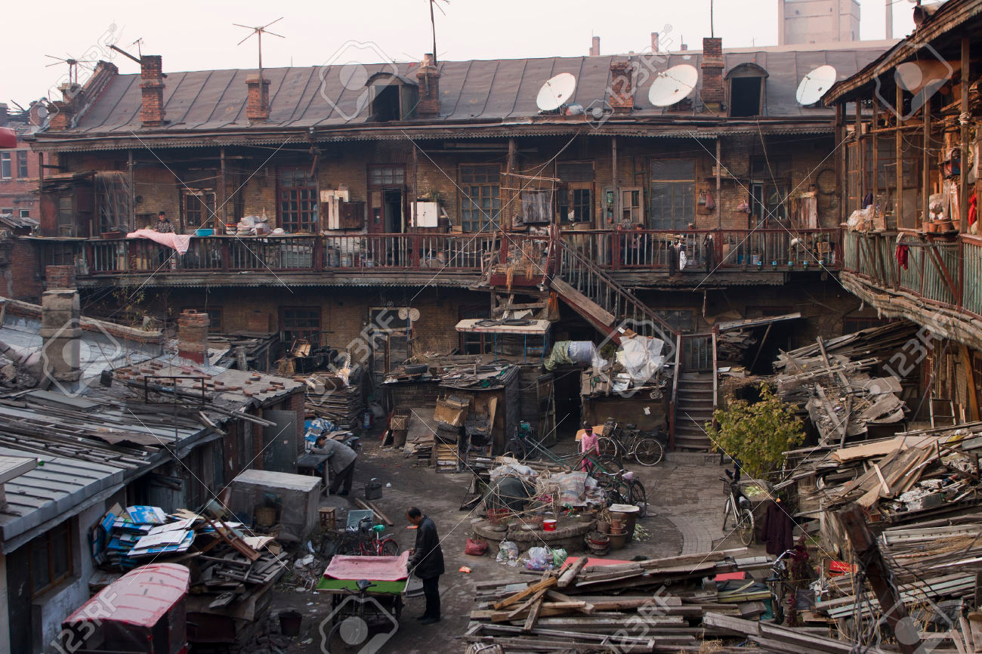
Intraregional Migration
African Americans clustered in one or two neighborhoods in big cities.
These neighborhoods became known as ghettos, after the term for neighborhoods in which Jews were forced to live in the Middle Ages.

Slide 13
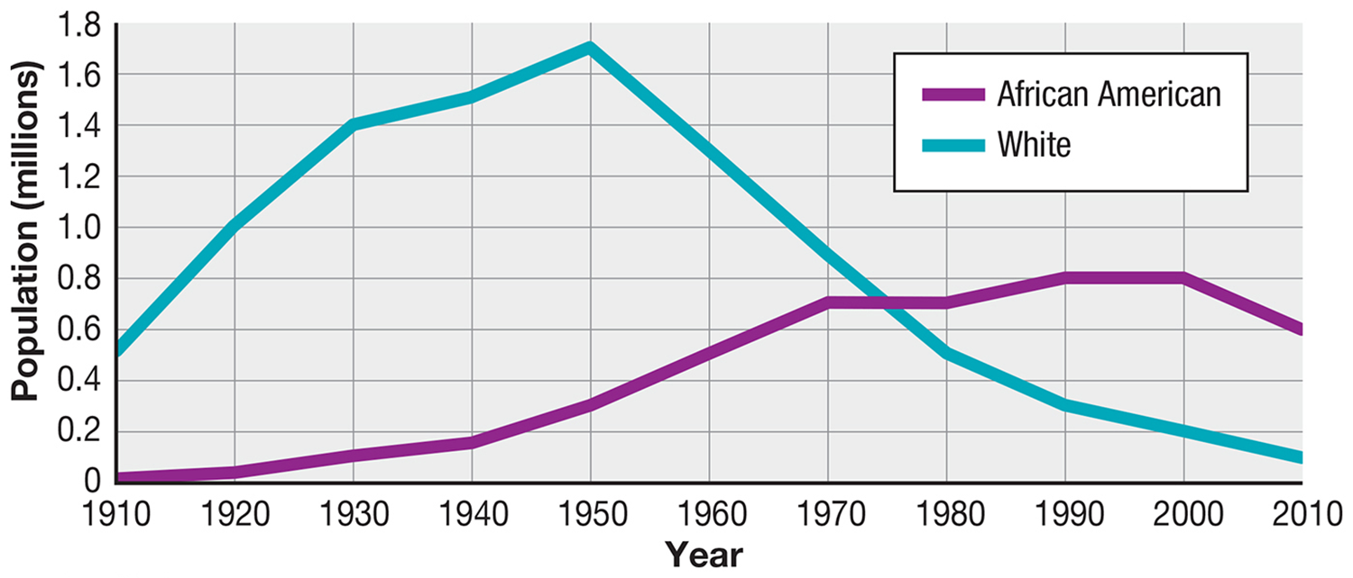
Expansion of the Ghetto
Detroit – Ethnic Population Change
During the 1950s and 1960s, African Americans moved from the compact ghettoes into immediately adjacent neighborhoods, following major avenues that radiated out from the center of the city.

Slide 14
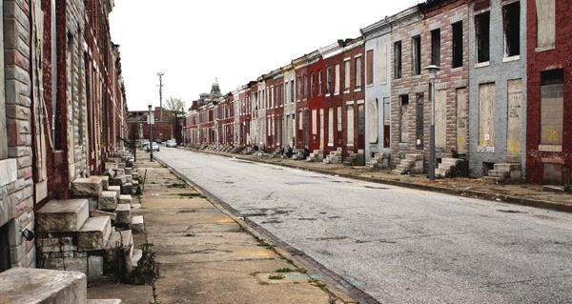
Expansion of the Ghetto
In Baltimore, for example, the west-side African American ghetto expanded from 1 square mile in 1950 to 10 square miles by 1970, along with a 2-square-mile area on the east-side becoming a predominantly African American-inhabited area.

Slide 15
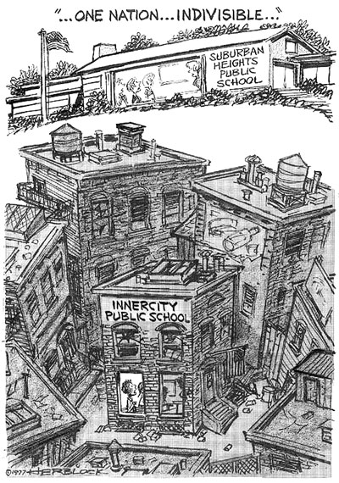
“White Flight”
The expansion of black neighborhoods in American cities was made possible by the emigration of whites from a neighborhood in anticipation of blacks immigrating into the area.
Rather than integrate, whites fled - “White Flight” was encouraged by unscrupulous real estate practices.

Slide 16
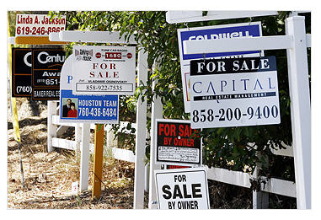
“White Flight”
Under blockbusting, real estate agents convinced white homeowners living near a black area to sell their houses at low prices, preying on their fears that black families would soon move into the neighborhood and cause property values to decline.

Slide 17
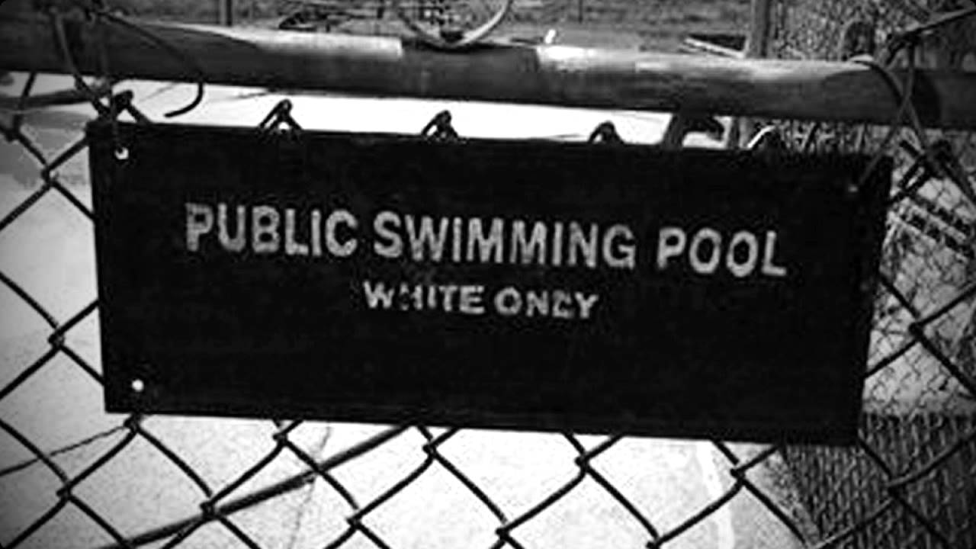
Segregation by Race
The intense discouragement of spatial interaction through legal means, known as segregation, colors a stretch of troubled history in the United States and South Africa.
While these segregation laws are no longer on the books in the United States and South Africa, their legacy endures as a feature of the geography of ethnicity in both countries.

Slide 18
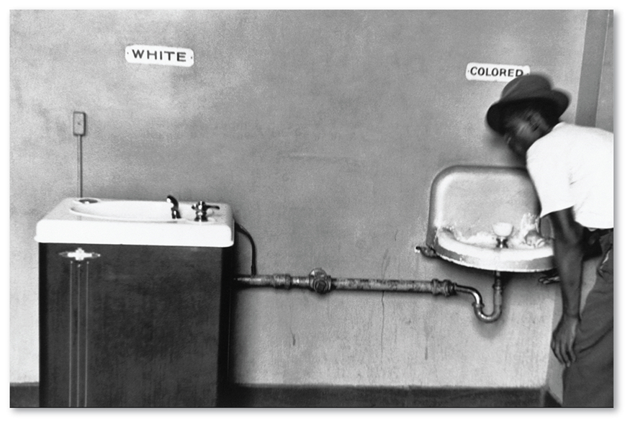
United States: “Separate but Equal”
In Plessy v. Ferguson, the Supreme Court stated that blacks and whites should be treated equally, but equality does not mean that whites had to mix socially with blacks.
Once the Supreme Court permitted “separate but equal” treatment of the races, Southern states enacted a set of laws to separate blacks from whites as much as possible.

Slide 19
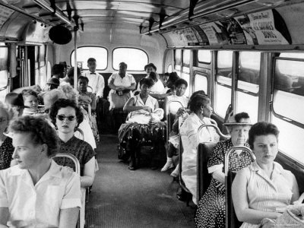
United States: “Separate but Equal”
These “Jim Crow” laws made blacks sit in the back of buses and restaurants.
Throughout the country, house deeds contained restrictive covenants that prevented owners from selling to blacks.

Slide 20
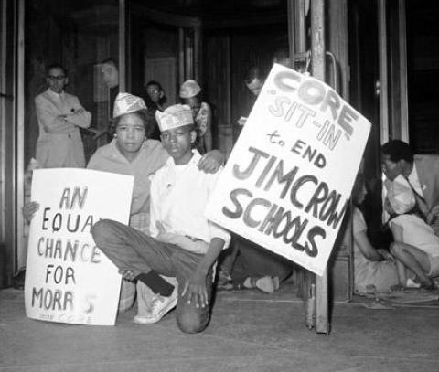
United States: “Separate but Equal”
Schools were also segregated.
U.S. segregation laws were eliminated in the 1950s and 1960s through the Supreme Court decision Brown v. Board of Education of Topeka, Kansas in 1954.
The Civil Rights Acts during the 1960s outlawed racial discrimination, but despite these efforts, cities are still subject to racial segregation.

Slide 21
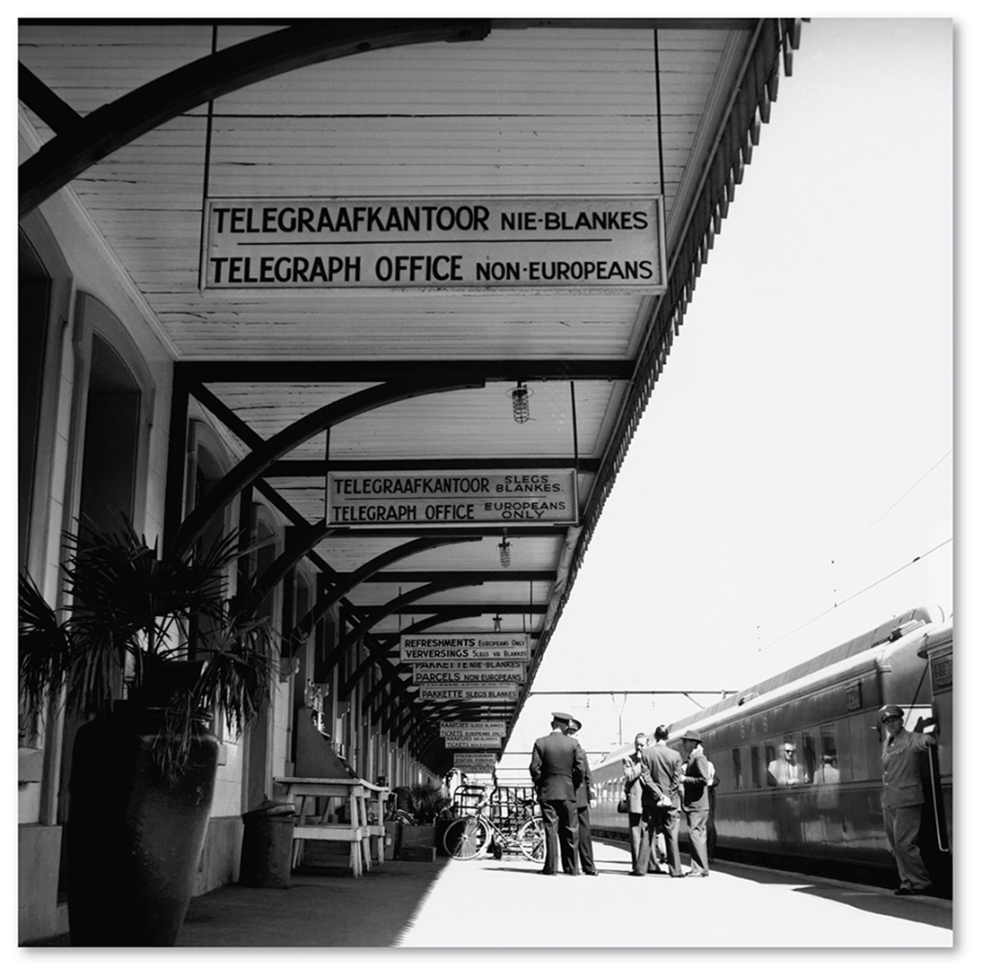
South Africa: Apartheid
While the United States was repealing laws that segregated people by race, South Africa was enacting them.
Apartheid is a legal system that separates different races into different geographic areas.

Slide 22
South Africa: Apartheid
The system of racial segregation in South Africa known as apartheid was implemented and enforced by a large number of acts and other laws.
Population registration and segregation
Job reservation and economic apartheid
Segregation in education
Sexual apartheid -The Immorality Act, 1927 forbade extramarital sex between white people and black people -The Prohibition of Mixed Marriages Act, 1949.
Land tenure and geographic segregation

Slide 23
South Africa: Apartheid
In South Africa, a newborn baby was classified as being one of four races—black, white, colored (mixed white and black), and Asian.
Each four races had different legal status.
The apartheid laws determined where different races could live, attend school, work, shop, and own land.

Slide 24
South Africa: Apartheid
Blacks could not vote or run for political office.
The apartheid laws were repealed in 1991 and in 1994, Nelson Mandela was elected the country’s first black president.

