Slide 1
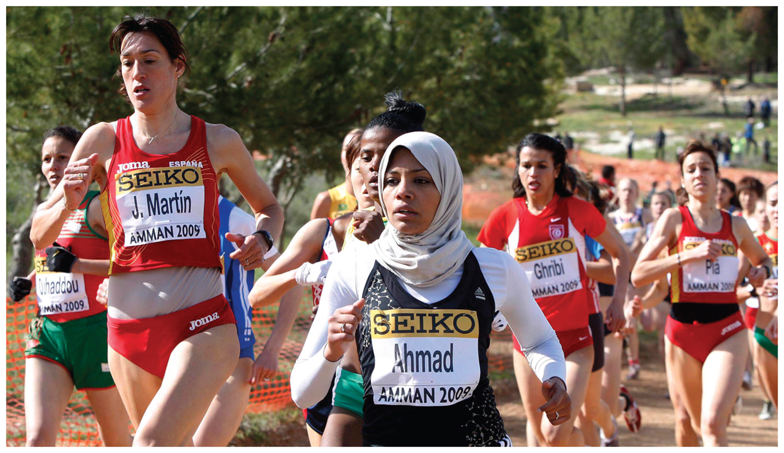
Chapter 7: Key Issue 1 - Ethnicity –

Slide 3
Key Issue #1
Where Are Ethnicities Distributed?
Learning Outcome 7.1.1: Introduce the principal ethnicities in the United States.
Learning Outcome 7.1.2: Clarify differences between ethnicity and race.
Learning Outcome 7.1.3: Describe the regional distribution of major U.S. ethnicities.
Learning Outcome 7.1.4: Describe the distribution of ethnicities within urban areas.
Learning Outcome 7.1.5: Describe the distribution of ethnicities within urban areas.

Slide 4
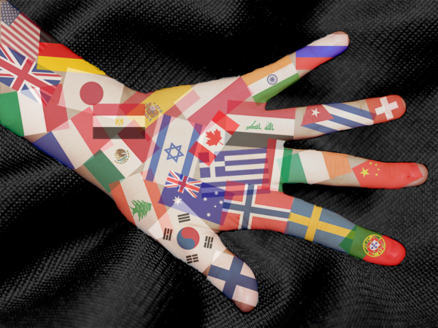
Ethnicity
Ethnicity is identity with a group of people who share cultural traditions of a particular homeland or hearth.
Ethnicity is often confused with race, which is identity with a group who are perceived to share a physiological trait, such as skin color.
The traits that characterize race are transmitted genetically from parents to children.
Nationality is identity with a group of people who share legal attachment to a particular country.

Slide 5
Introducing Ethnicities
Ethnicity may be complex:
The significance of ethnic diversity is controversial in the United States:
To what extent does discrimination persist against minority ethnicities, especially African Americans and Hispanics?
Should preferences be given to minority ethnicities to correct past patterns of discrimination?
To what extent should the distinct cultural identity of ethnicities be encouraged or protected?

Slide 6
Introducing Ethnicities
Ethnicity is especially of interest to geographers due to its position as an anchor for the preservation of local diversity in the face of globalization trends in culture and economy.
While language and religion are expanding globalizing forces, ethnicity is not attempting to achieve global dominance.
Despite this, ethnicities compete with one another to control particular places.

Slide 7
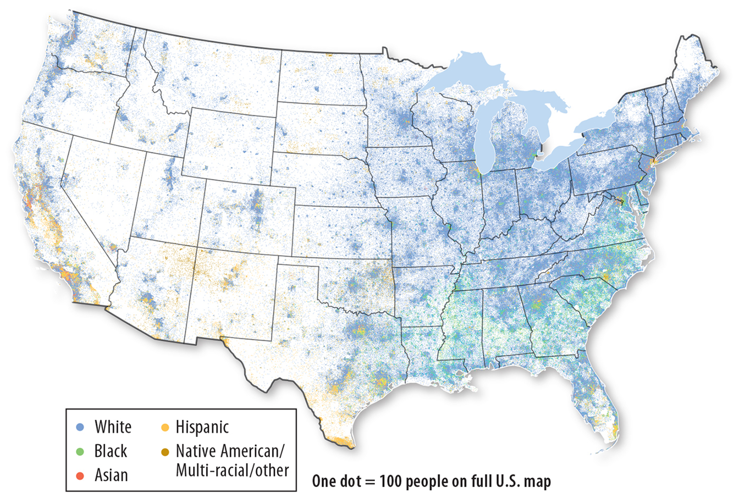
Ethnicities in the United States
The three largest ethnicities-
Hispanic Americans comprise 17 %
African Americans 12 %
Asian Americans 5 %

Slide 8
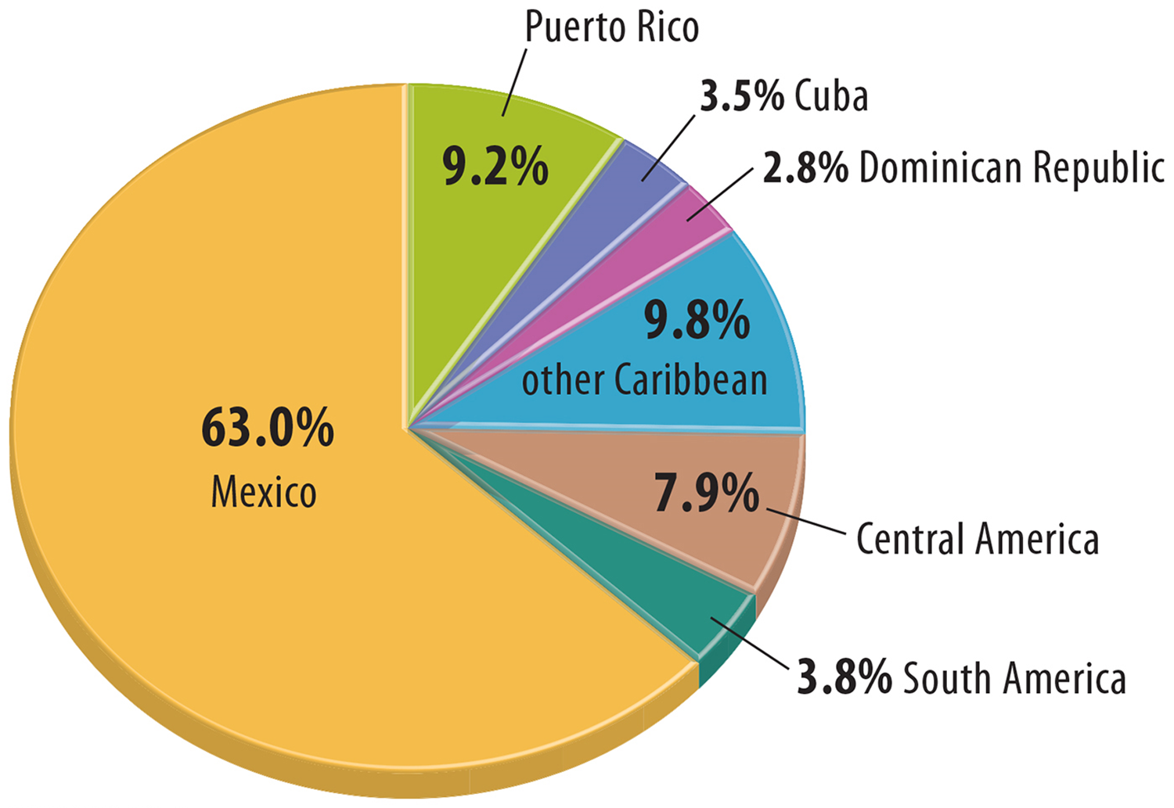
Hispanic Americans
A Hispanic or Hispanic American is a person who has migrated to (or whose ancestors have migrated) to the United States from a Spanish-speaking country in Latin America.
The terms Latino (for males) and Latina (for females) are used interchangeably with Hispanic.

Slide 9
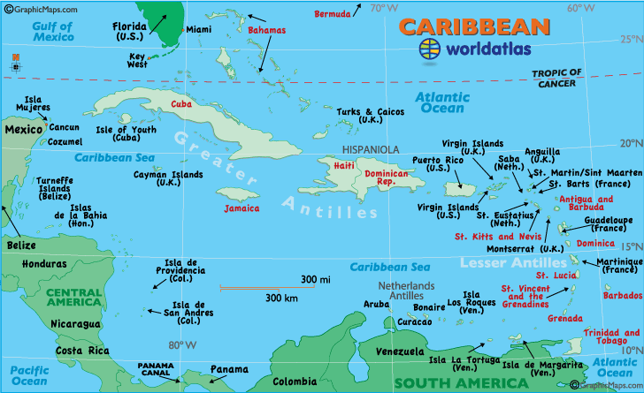
Hispanic Americans
Most Americans of Latin American descent prefer to identify with a more specific ethnicity or national origin.
Nearly two-thirds of Hispanic Americans come from Mexico, and one-quarter from the Caribbean islands.

Slide 10
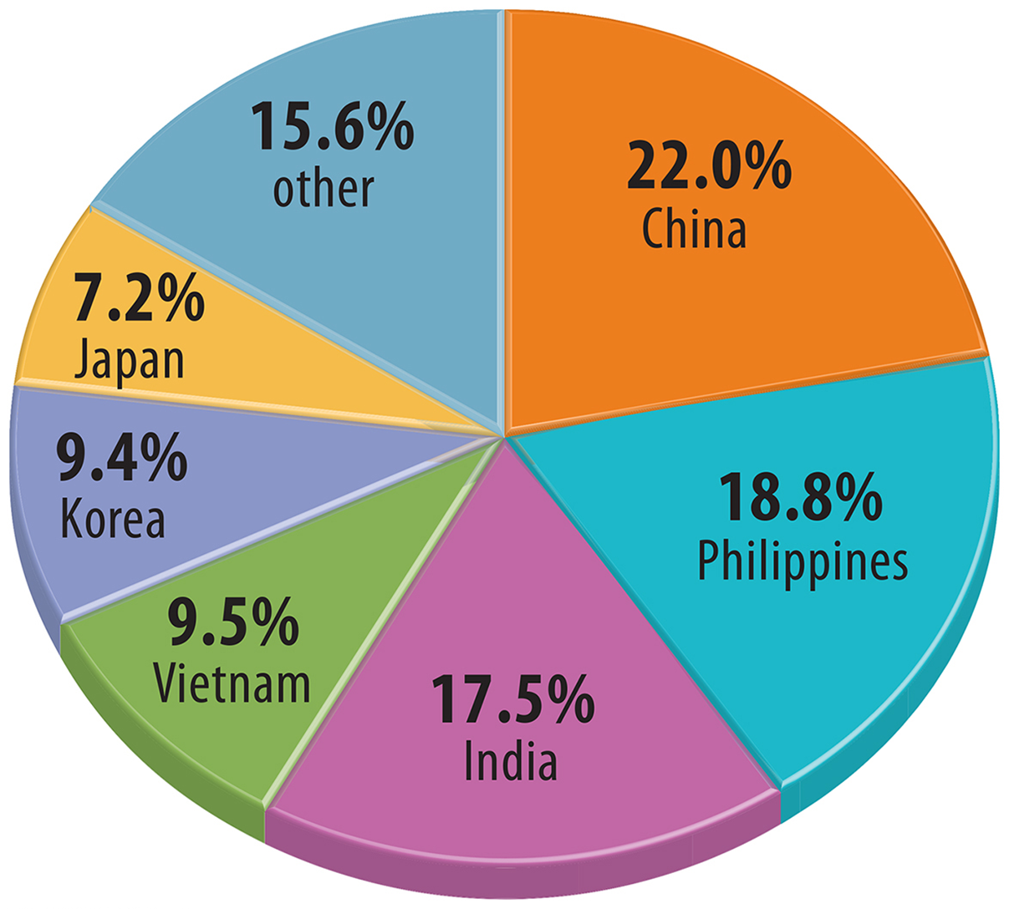
Asian Americans
The term Asian American includes Americans who trace their heritage to various countries in Asia.
Only 19 % of Asian Americans identify with the Asian American ethnicity,
62 % prefer to identify with their ethnicity as the country of origin of themselves of their ancestors.

Slide 11
African Americans
The precise ethnic origins of African Americans are relatively unclear.
300 years ago, some Africans were forcibly taken from lands in Africa that were not yet organized into sovereign countries, and records of the ethnic origin of those taken as slaves were not kept.
DNA testing has narrowed down the ethnic heritage of most African Americans to three areas in West Africa.

Slide 12
Descendants of Indigenous Peoples
Three principal ethnic identities are used to group people who lived in North America prior to European colonization:
Native American
Alaska Native
Native Hawaiian

Slide 13
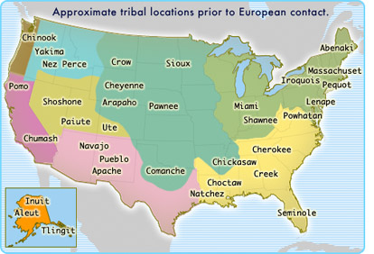
Descendants of Indigenous Peoples
The indigenous ethnic identities with the largest numbers are Native Hawaiians, Cherokee, Navajo, Chippewa, Sioux, and Choctaw.

Slide 14
Ethnicity and Race
While a person’s ethnicity is derived from a place on Earth’s Surface, the traits that characterize race are not place specific.
The biological basis of classifying humans into a handful of races is now categorically rejected by contemporary geographers and other scientists.

Slide 15
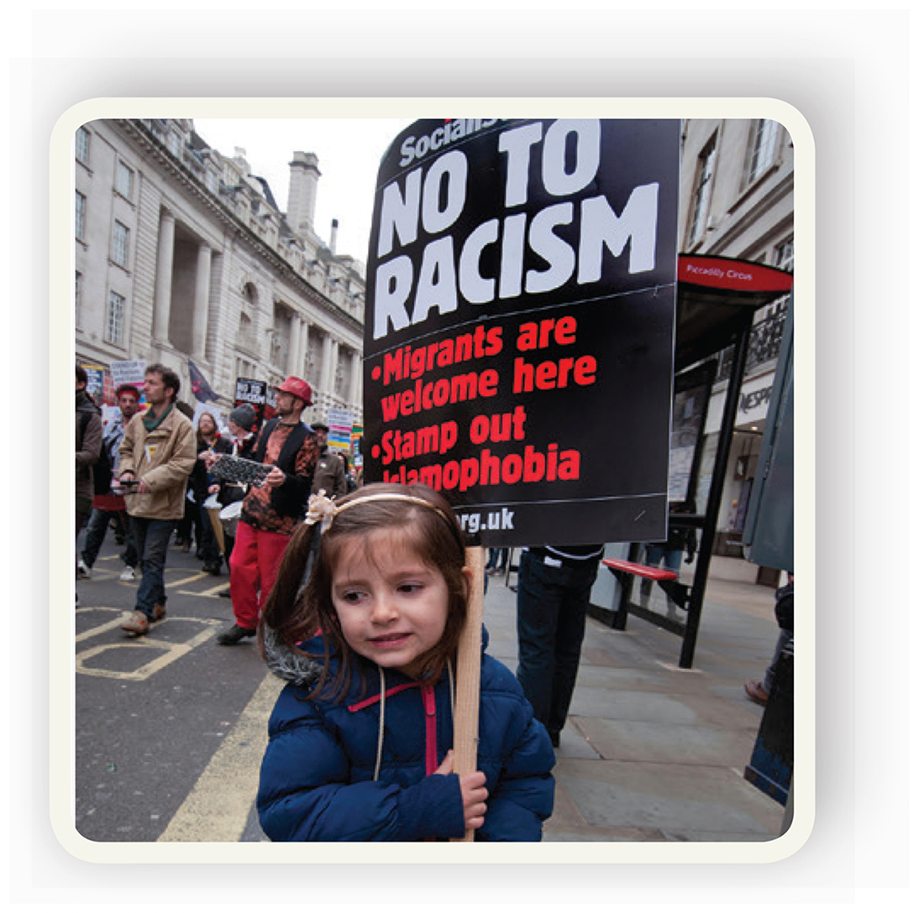
Racism
The color of skin is one characteristic by which people in many societies determine where they reside, attend school, and spend their leisure time.
Classification by race is the basis for racism - belief that race is the primary determent of human traits and capacities and that racial differences produce an inherent superiority of a particular race.
A racist is a person who subscribes to the beliefs of racism.

Slide 16
Race and Ethnicity in the United States
The U.S. census shows difficulty in distinguishing between ethnicity and race.
Most census categories relate to ethnicity, such as Japanese or Asian Indian, because they derive from places.
The census also offers three race-related categories—black, white, and other race.
African American is an ethnicity and black is a race, though the 2010 census combines the two.

Slide 17
Distribution of U.S. Ethnicities
Clustering of ethnicities can occur on two scales within a country.
Ethnic groups may reside in specific regions within the region the state or city.
At the local scale, ethnic groups may reside in specific communities within urban areas.

Slide 18
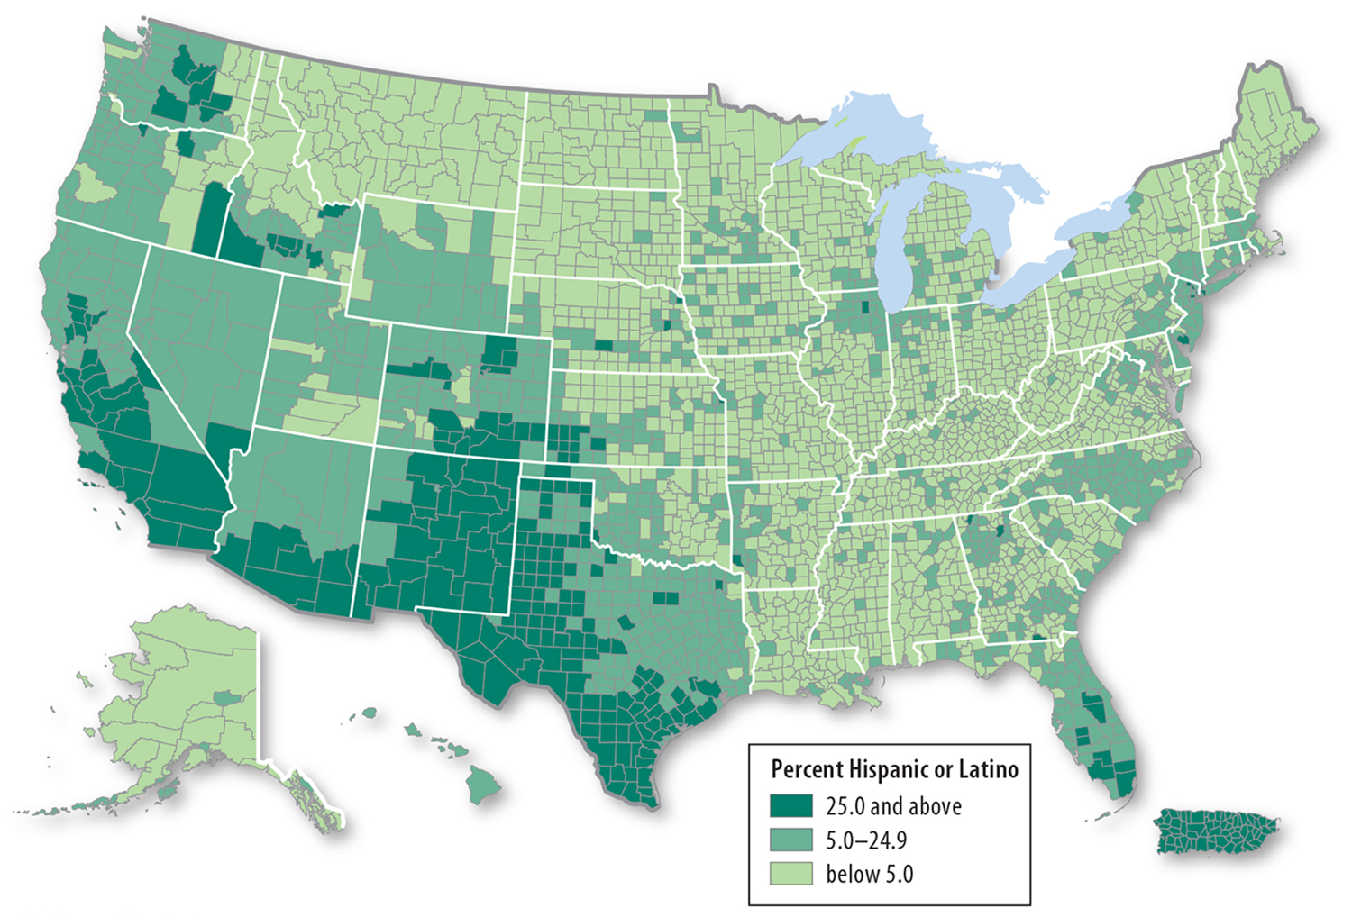
Distribution of U.S. Ethnicities
At the regional scale in the United States, ethnicities have distinctive distributions.
Hispanics are clustered in the Southwest

Slide 19
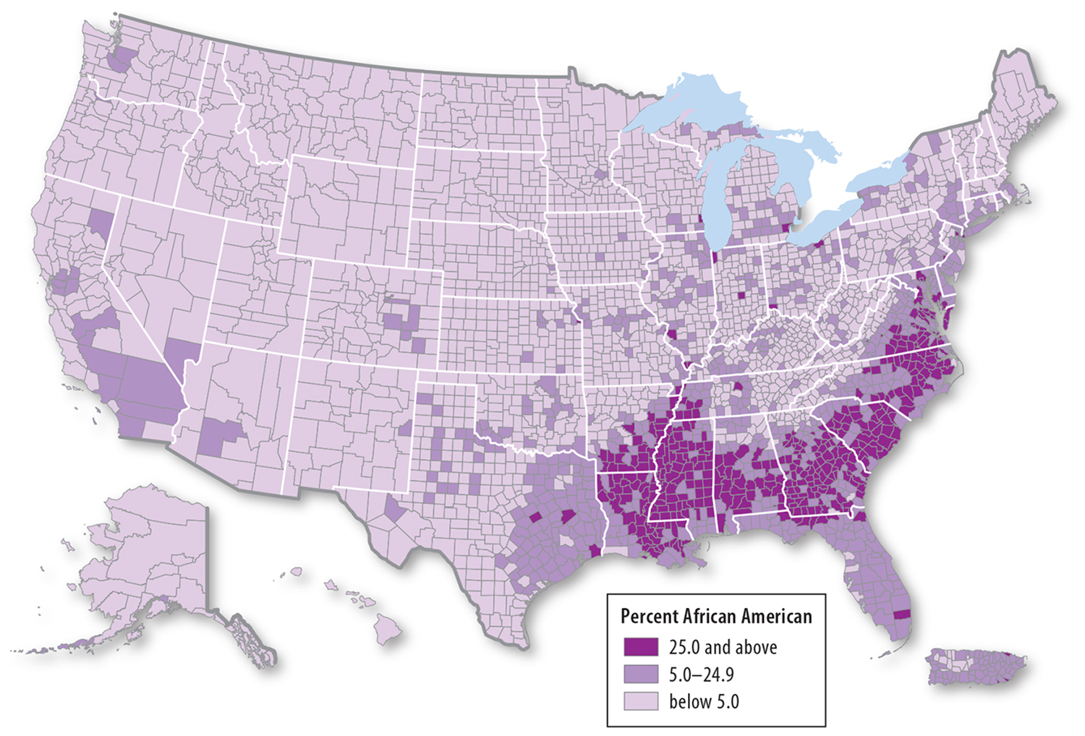
Distribution of U.S. Ethnicities
African Americans are clustered in the Southeast.

Slide 20
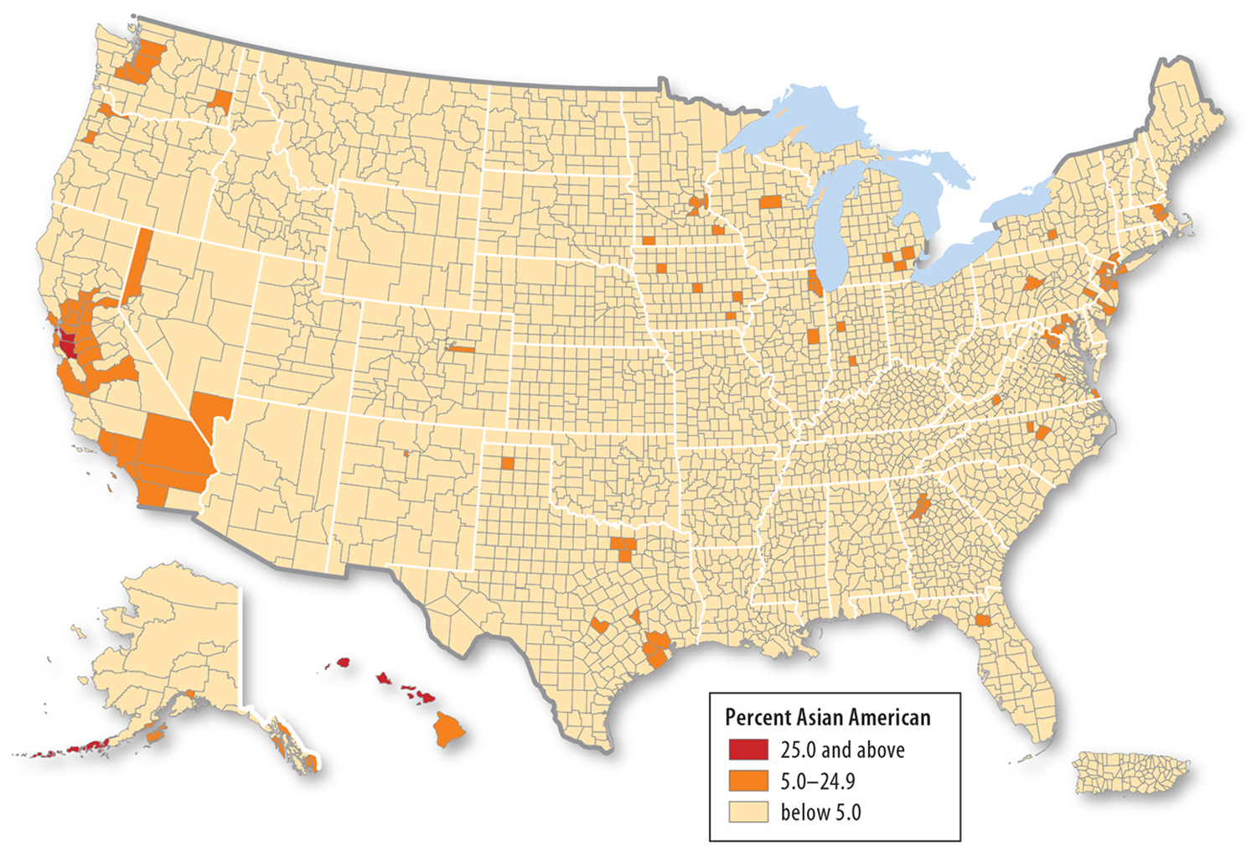
Distribution of U.S. Ethnicities
Asian Americans are clustered in the West (including Hawaii)

Slide 21
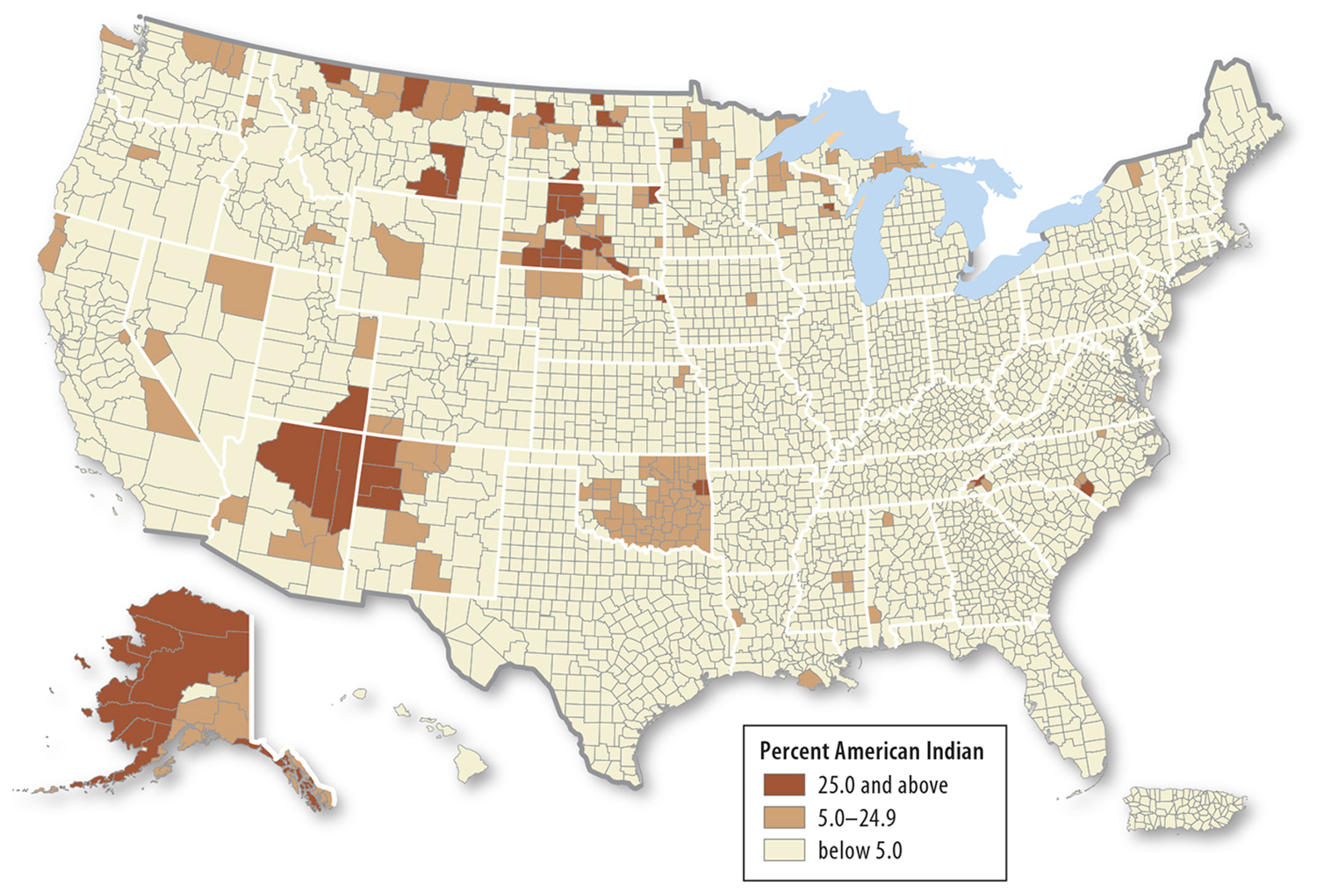
Distribution of U.S. Ethnicities
Native Americans are clustered in the southwest, north-central regions of the continental U.S., and Alaska.

Slide 22
Ethnic Enclaves
Ethnic enclave - A location with a high concentration of an ethnic group that is distinct from those in the surrounding area.
Most ethnic enclaves are neighborhoods in large cities.
Ethnic enclaves generally form through migration.

Slide 23
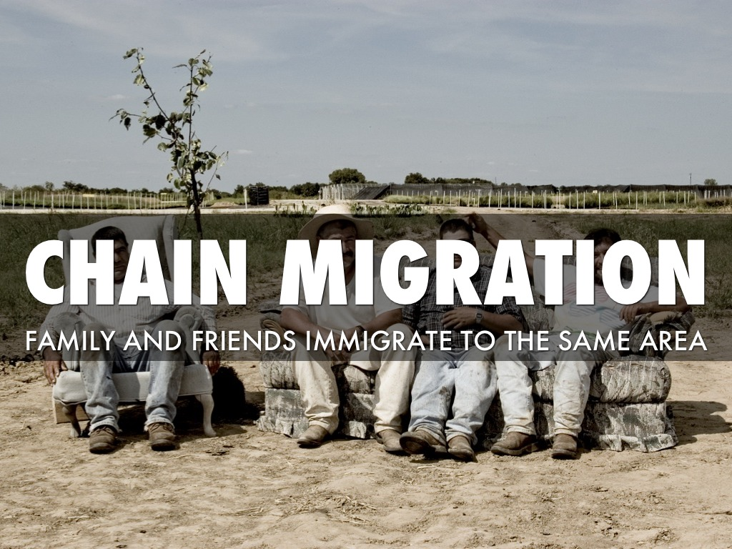
Ethnic Enclaves
Cultural features, such as language, religions, and art help define ethnicities and inform the places characteristic of these ethnicities.
The geographic concept of chain migration is used to conceptualize the formation of ethnic enclaves, whereby new migrants are offered economic support that may not be as easily accessible as in other areas.

Slide 24
Urban Ethnic Enclaves
The clustering of ethnicities is notably apparent at the local, neighborhood scale.
In major metropolises across the world, specific ethnicities primarily reside in distinct neighborhoods.

Slide 25
Urban Ethnic Enclaves
In Paris, the Goutte d’Or neighborhood is emblematic of an ethnic enclave, with immigrants from former African colonies occupying the area.

Slide 26
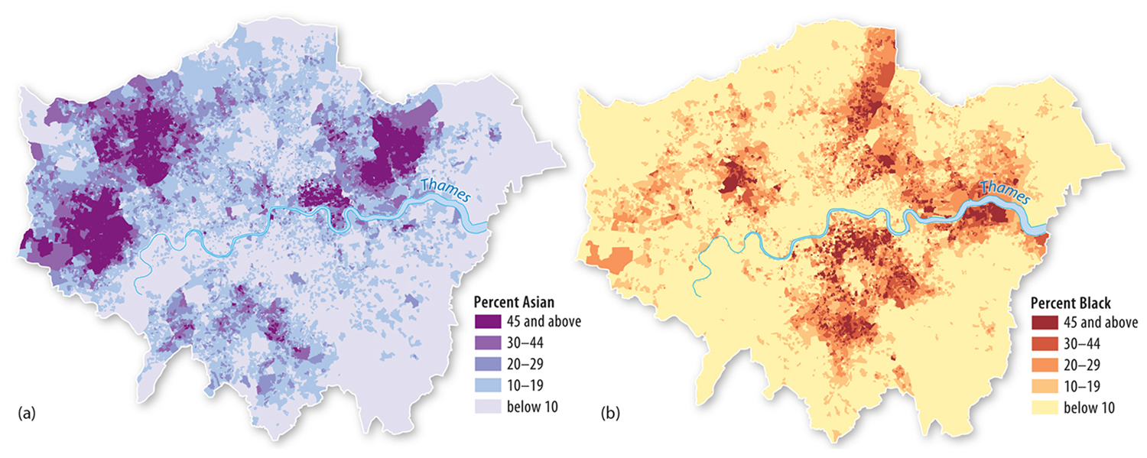
Ethnic Enclaves in London
In London, South Asia Indians have clustered in the west, Pakistanis and Bangladeshis have clustered in the northeast, African blacks in the east, and Caribbean blacks in the north and south.

Slide 27
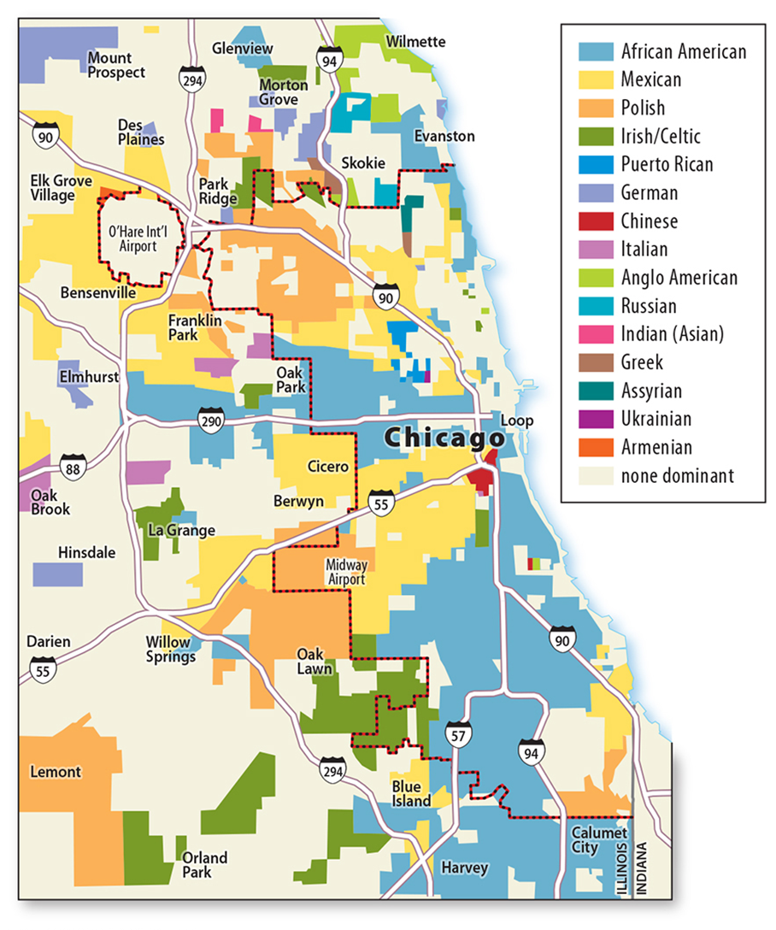
In the United States, the City of Chicago is illustrative of the variety of ethnic enclaves that may be present in an urban area, with whites clustered on the North Side, African Americans on the South and West sides, and Hispanics on the Northwest and Southwest sides.
Urban Ethnic Enclaves

Slide 28
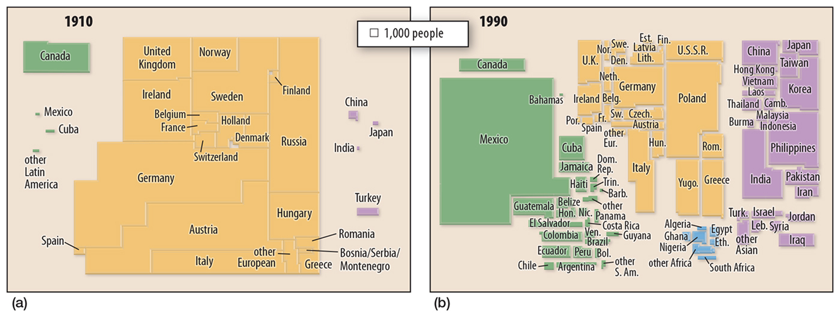
Areas inhabited by ethnicities have shifted over time.
In the early to mid-twentieth century, emigrants from Southern and Eastern Europe traveled to Midwestern U.S. cities to find work in the expanding industrial base.
Neighborhoods took names based on the predominant ethnicity present in the area ex. Chicago’s Ukrainian Village.
Changing Urban Ethnic Enclaves

Slide 29
By the late twentieth century, many children and grandchildren of these immigrants moved from urban enclaves to suburbs, sometimes forming ethnoburbs.
An ethnoburb is a suburban area with a cluster of a specific ethnic population.
Changing Urban Ethnic Enclaves

Slide 30
Ethnically Complex Brazil
Struggles characterizing its population by race or ethnicity.
Brazil is a “melting pot” like the United States, with the ancestors emigrating from many places.
The majority of immigrants came to Brazil from Portugal and West Africa, but European countries, Japan, Southwest Asia and others are also places of origin.

Slide 31
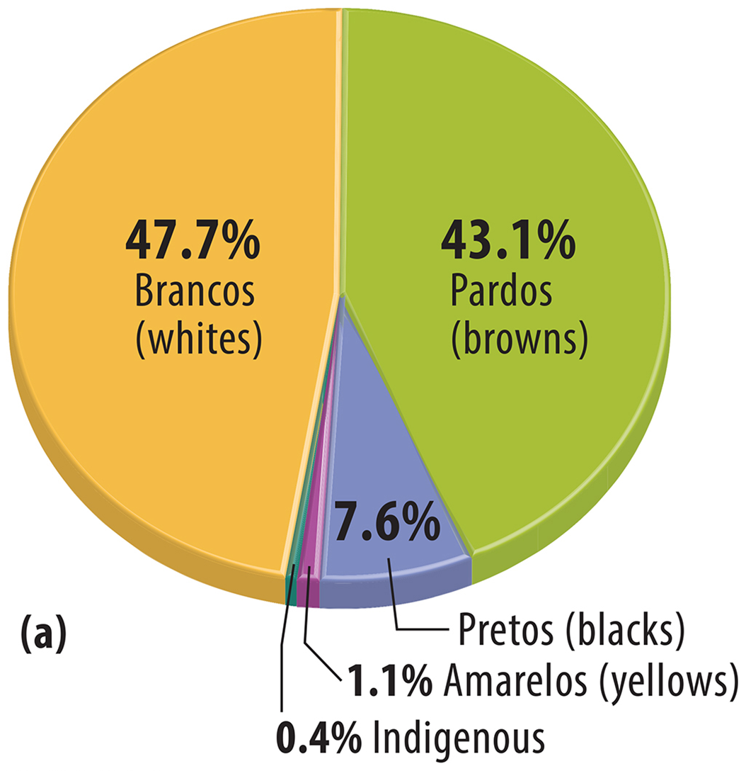
Brazil’s Races and Ethnicities
Brazil’s census categorizes people based on skin color. Five races are available:
branco (white)
pardo (brown)
preto (black)
amarelo (yellow)
indigenous.

Slide 32
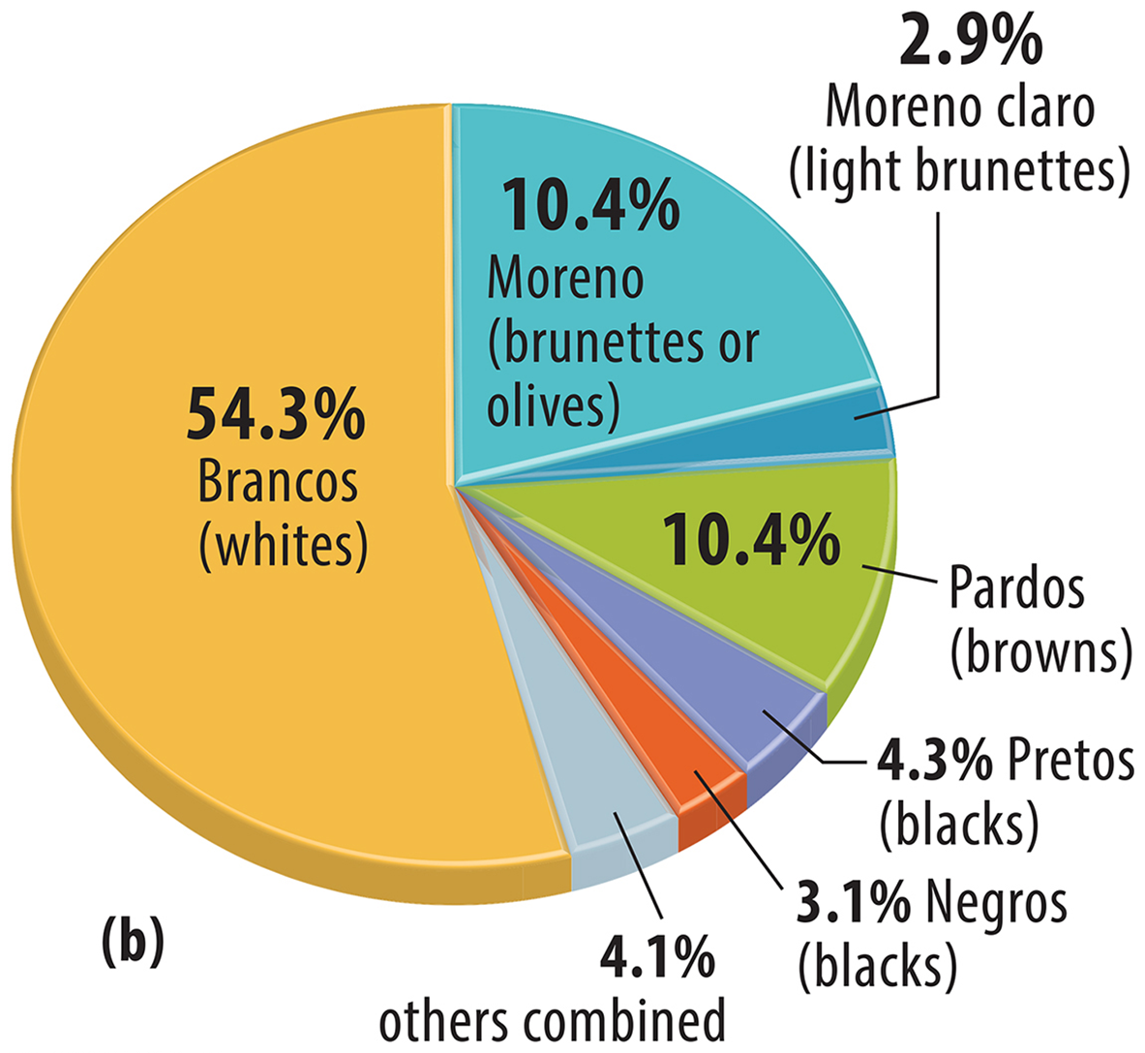
Brazil’s Races and Ethnicities
More than 90 percent of the country’s population are brancos and pardos.
Many Brazilians, however, do not self-identify using this classification scheme -most Brazilians have a mixed of backgrounds.

Slide 33
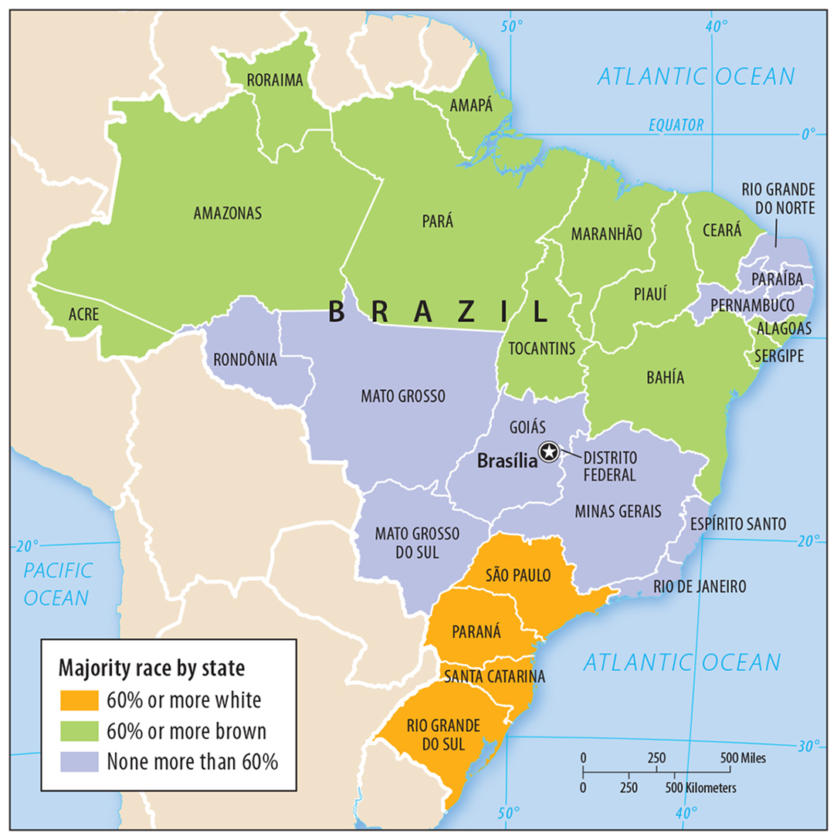
Distinct regional variation can be seen in the distribution of races in Brazil.
Whites clustered in the south.
In Brazil’s interior north (Amazon) indigenous people categorized by the Brazilian census as brown.
The largest number of Blacks (forced by slave trade) inhabit the northeast.
Clustering of Races in Brazil

Slide 34
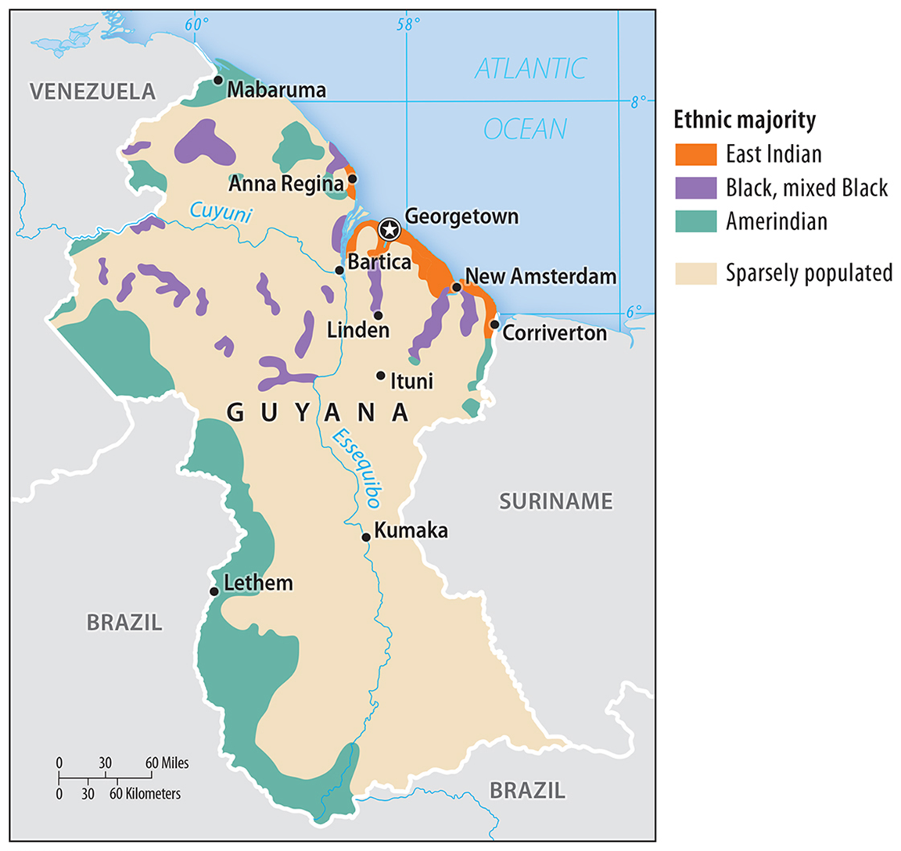
Africans slaves brought by Dutch in the seventeenth century.
Indentured servants brought to the country from India by British.
Amerindian - indigenous descent.
Distribution of Ethnicities in Guyana

